Slide 1
Chamber Recognition in Cave Data Sets
Nico Schertler, Manfred Buchroithner, and Stefan Gumhold
TU Dresden, Germany

Slide 2
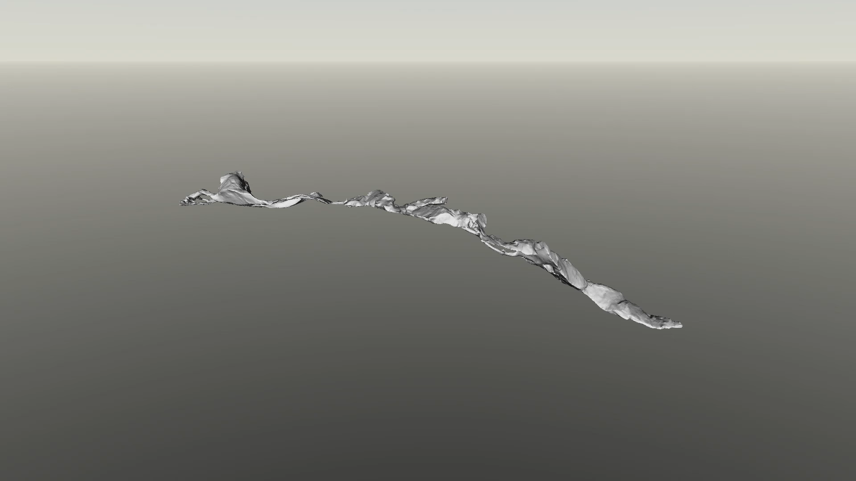

Slide 3
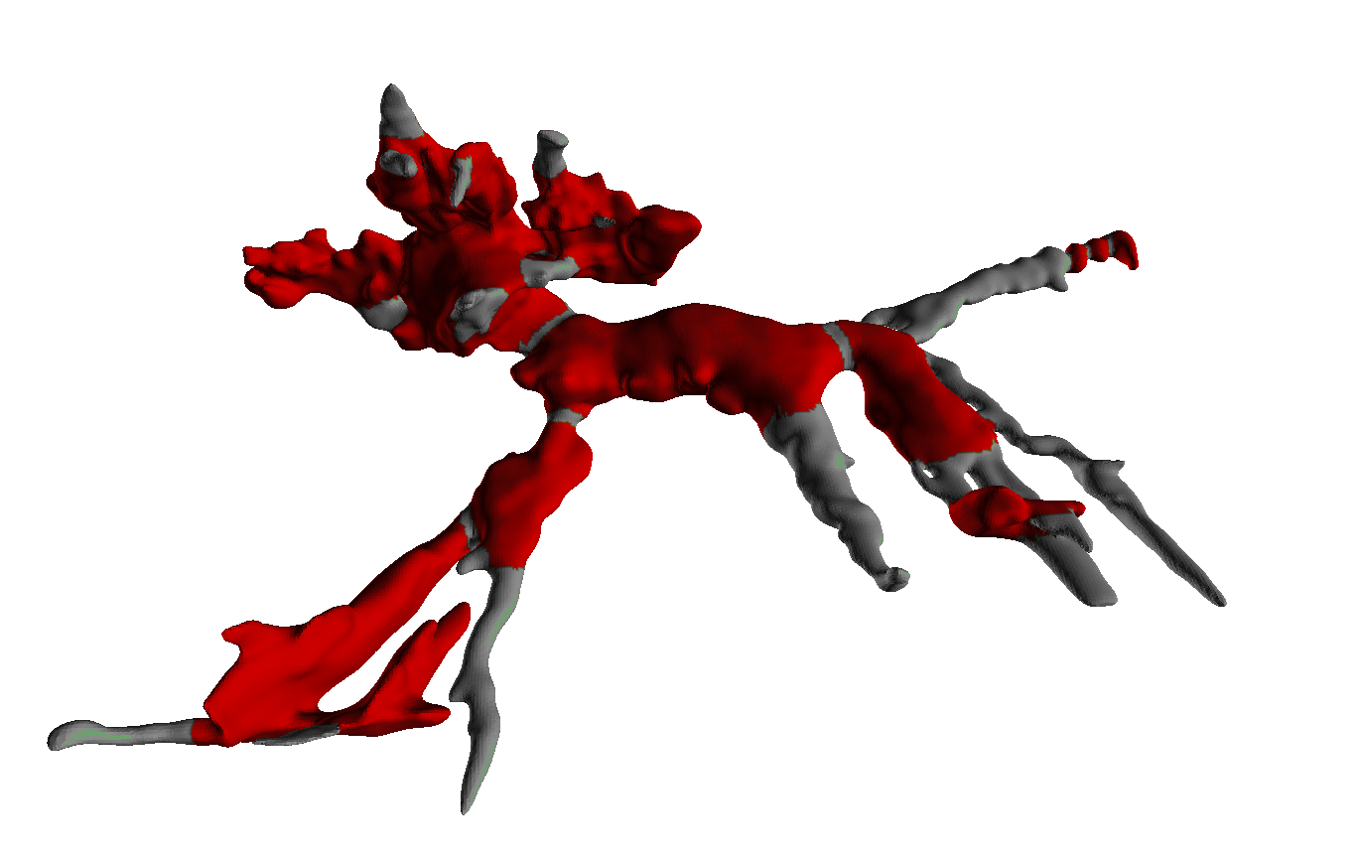
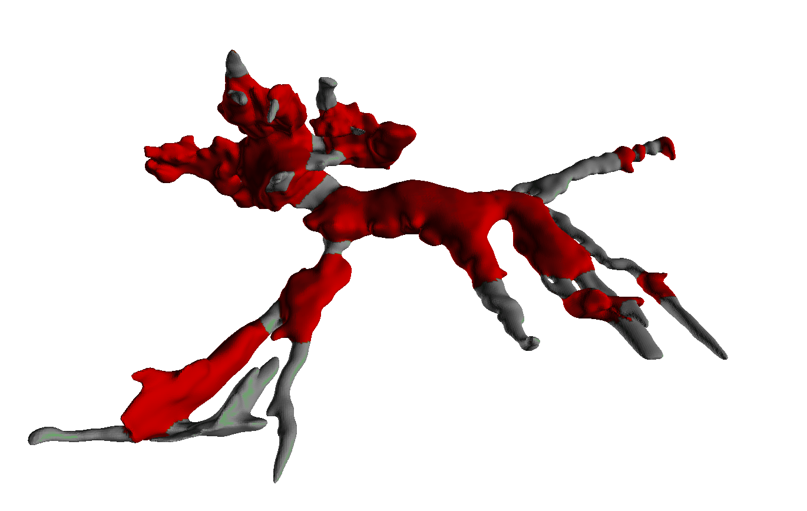
Cave Segmentation – A Subjective Task
Different experts evaluate the extent of chambers differently:
Chamber
Passage

Slide 4
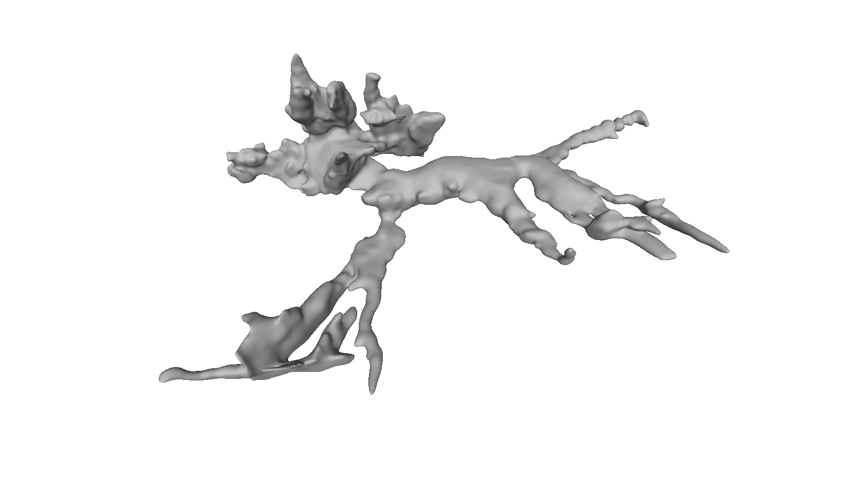
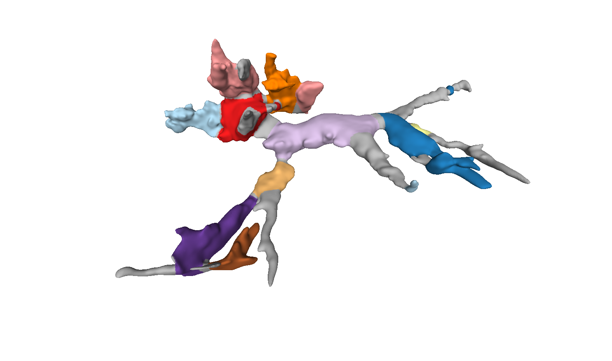


Our Goal – Segment the Cave Surface
Given the surface mesh of a cave system… … calculate a labeling for each vertex.
$$M=(V, F)$$
$$L :V→\left\{𝓒 ,𝓟 \right\}$$
hamber assage
Notes:
Individual chambers can be found via connected component analysis

Slide 5
Agenda
What makes up a chamber?
Geometric characteristics of caves
Our Approach
Transfer to labeling of a curve skeleton
Building Blocks
Local Size Measure
Solution through energy minimization

Slide 6
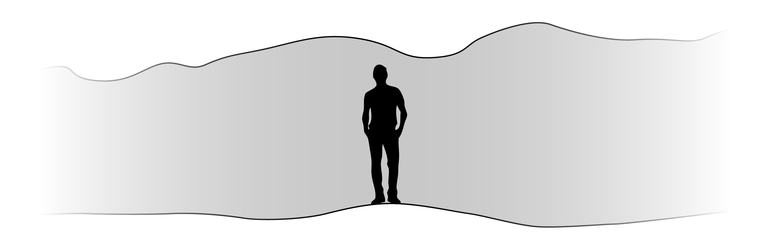
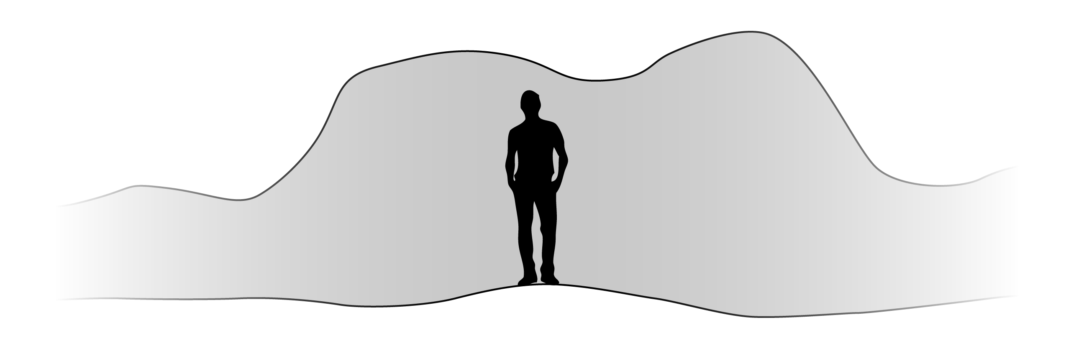

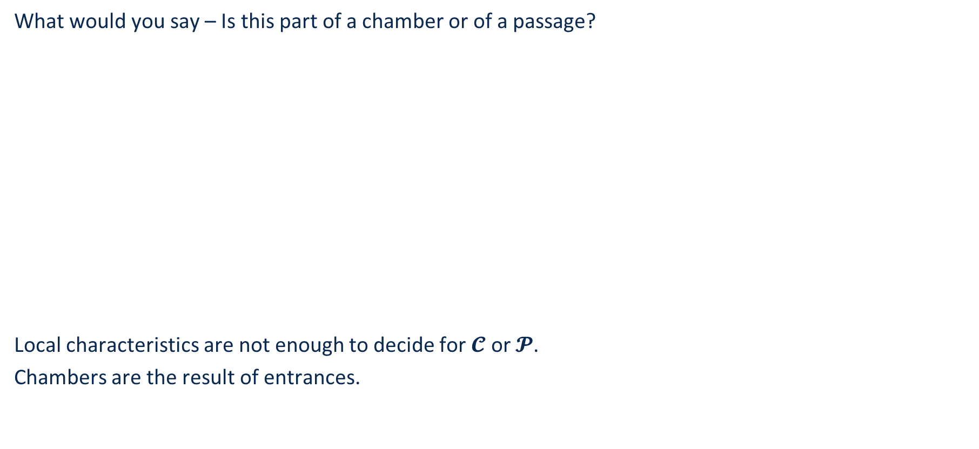
What Makes up a Chamber?
What would you say – Is this part of a chamber or of a passage?
Local characteristics are not enough to decide for $𝓒$ or $𝓟$.
Chambers are the result of entrances.
Entrance

Slide 7
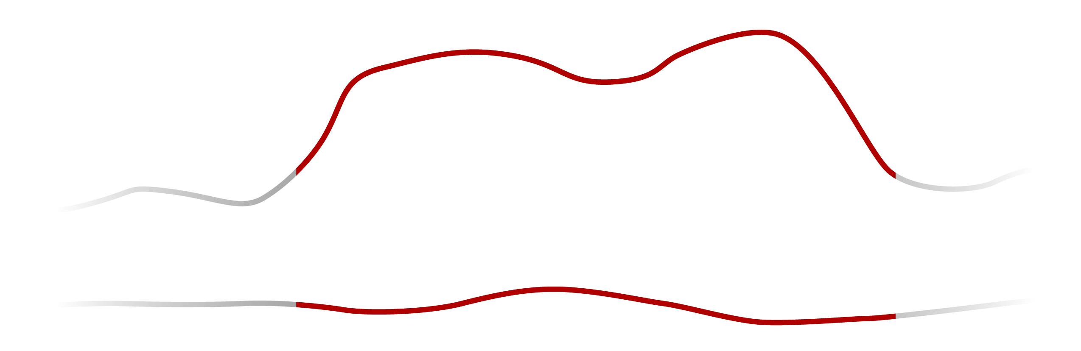
The Ingredients of our Approach
Chamber
Passage
A virtual path through the cave
Curve skeleton calculated with Mean Curvature Skeletons [Tagliasacchi 2008]
A robust local size measure
Radius-like measure calculated from the spherical distance field for a given point
Segmentation of the curve skeleton
Entrance-detecting energy expressed as MRF and minimized with QPBO [Rother 2007]
Back-Projection onto the cave surface

Slide 8
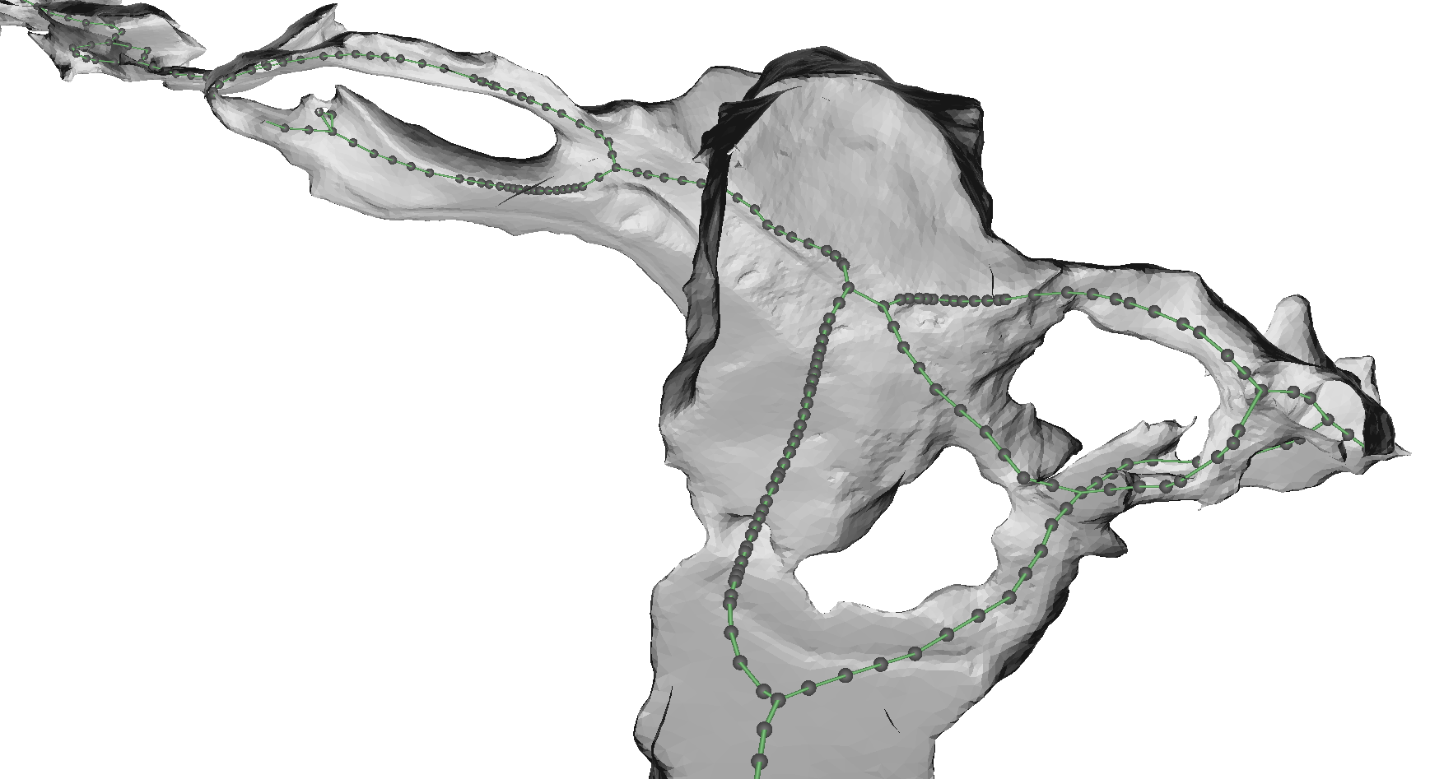
Curve Skeleton

Slide 9
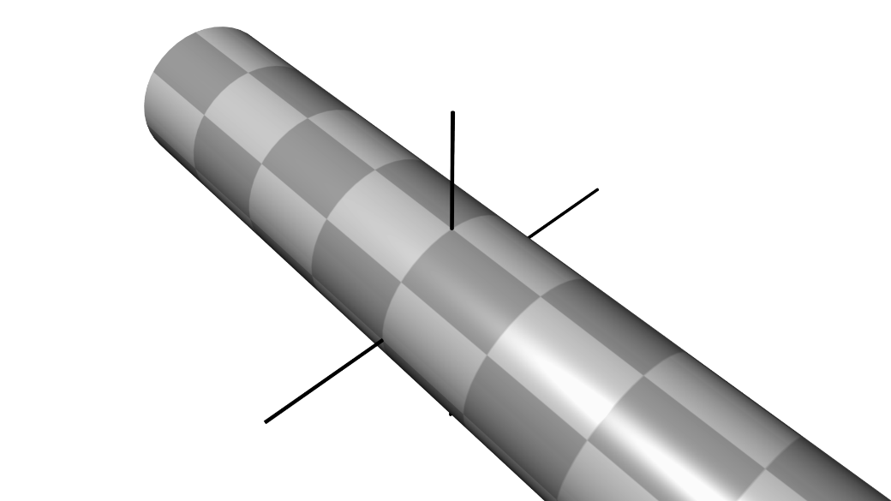
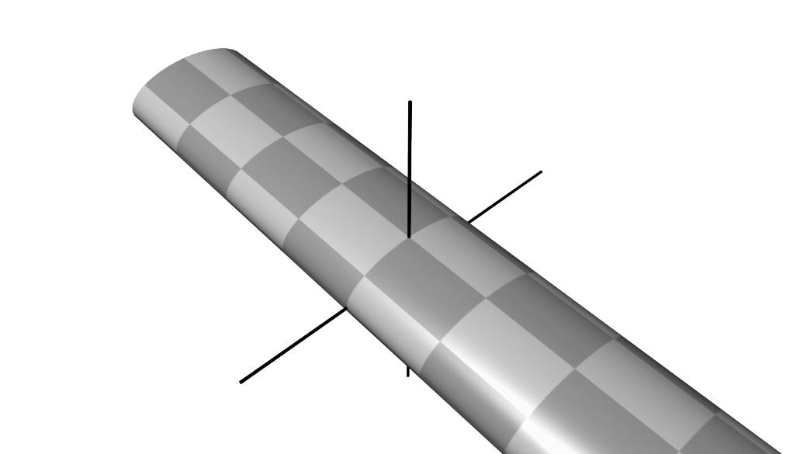
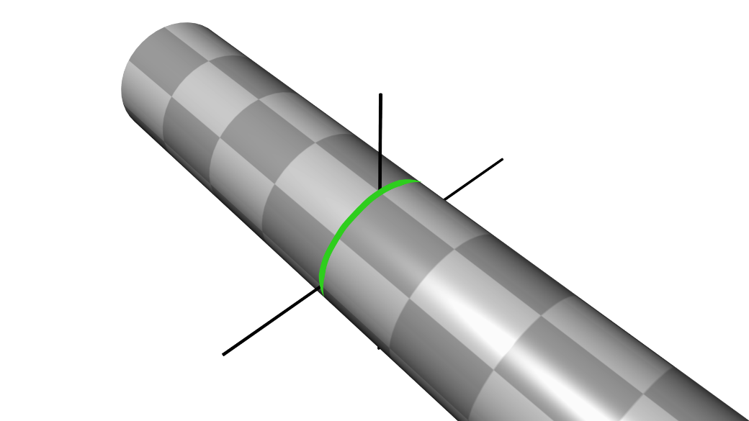
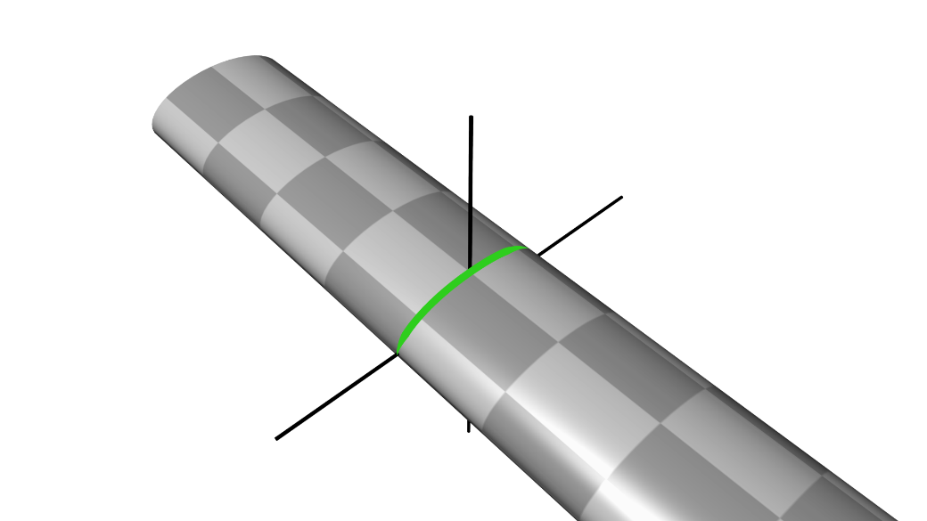
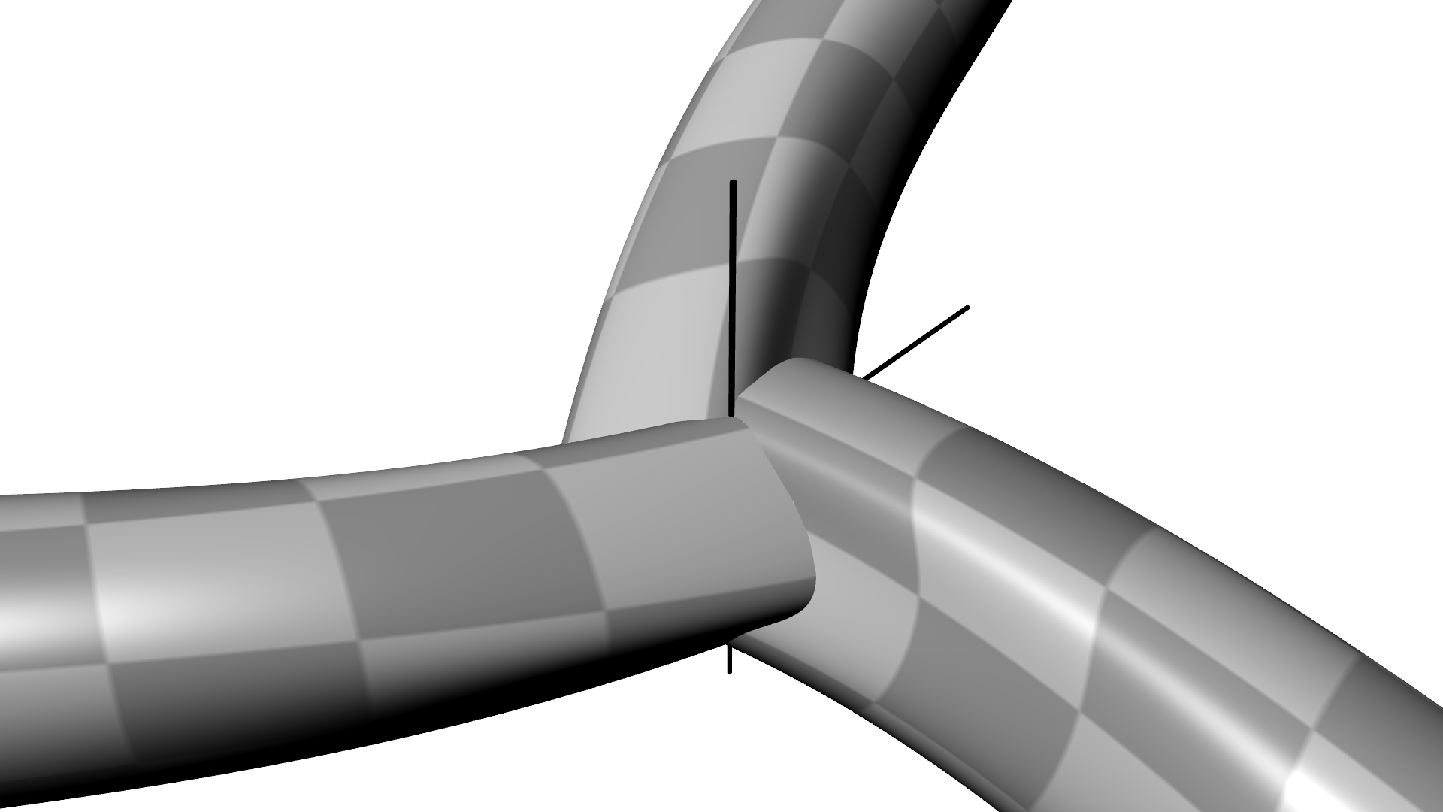
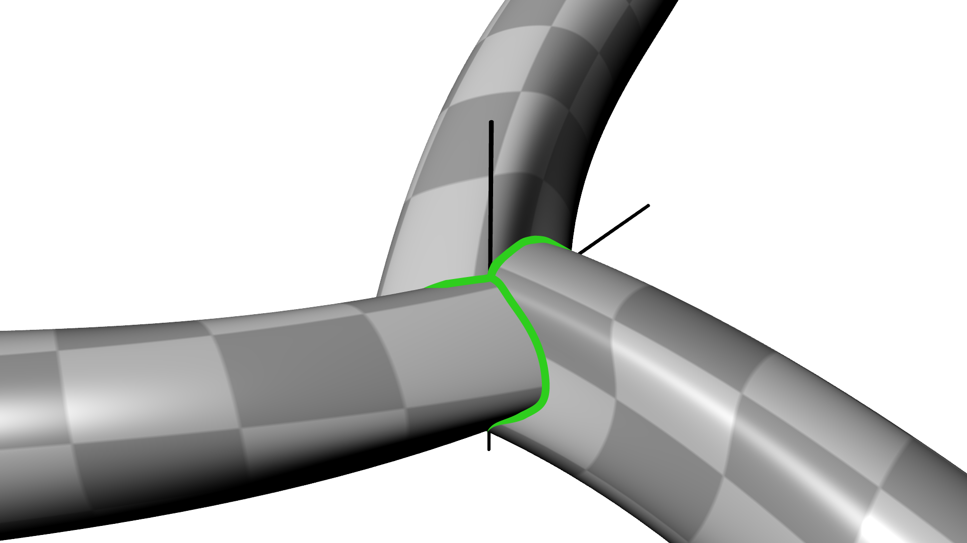
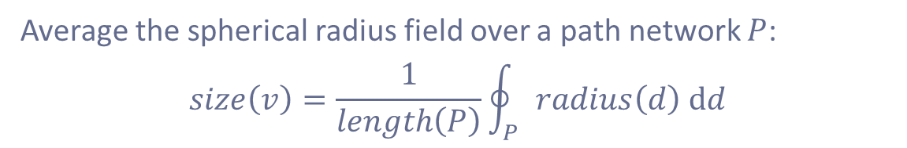
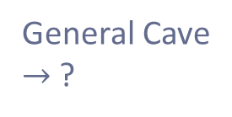
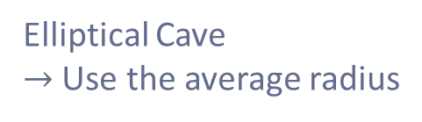
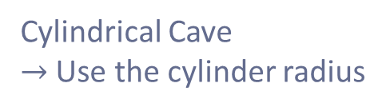
Size Measure - Idea
Cylindrical Cave
$→$ Use the cylinder radius
Elliptical Cave
$→$ Use the average radius
General Cave
$→$ ?
Average the spherical radius field over a path network $P$:
$$size\left(v\right)=\frac{1}{length\left(P\right)}\oint_{P}{radius\left(d\right) dd}$$

Slide 10
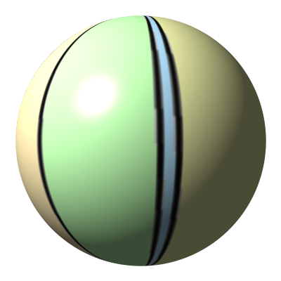
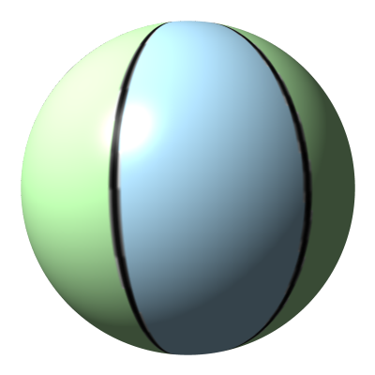
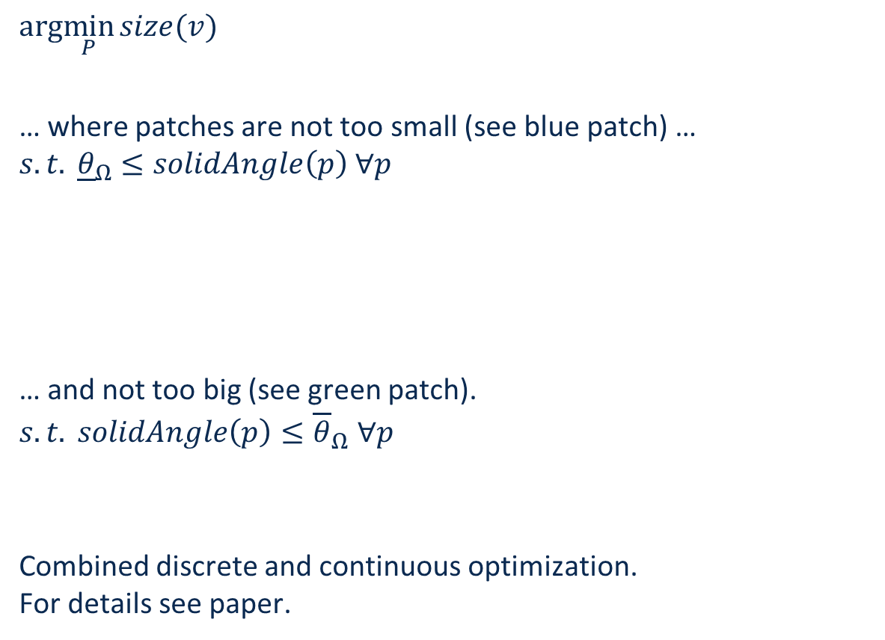
Size Measure – What Path to Choose?
Choose the most compact path….
$$arg\min_{P}{size(v)}$$
… where patches are not too small (see blue patch) …
$$s.t. {\underline{θ}}_{Ω}≤solidAngle\left(p\right) ∀p$$
… and not too big (see green patch).
$$s.t. solidAngle\left(p\right)≤{\overline{θ}}_{Ω} ∀p$$
Combined discrete and continuous optimization.
For details see paper.

Slide 11
The Ingredients of our Approach
Chamber
Passage
A virtual path through the cave
Curve skeleton calculated with Mean Curvature Skeletons [Tagliasacchi 2008]
A robust local size measure
Radius-like measure calculated from the spherical distance field for a given point
Segmentation of the curve skeleton
Entrance-detecting energy expressed as MRF and minimized with QPBO [Rother 2007]
Back-Projection onto the cave surface

Slide 12
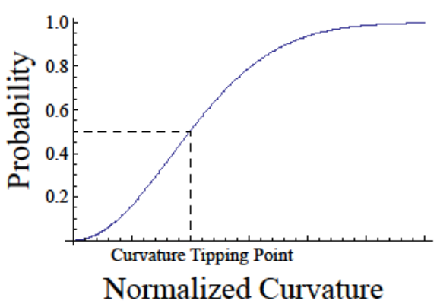
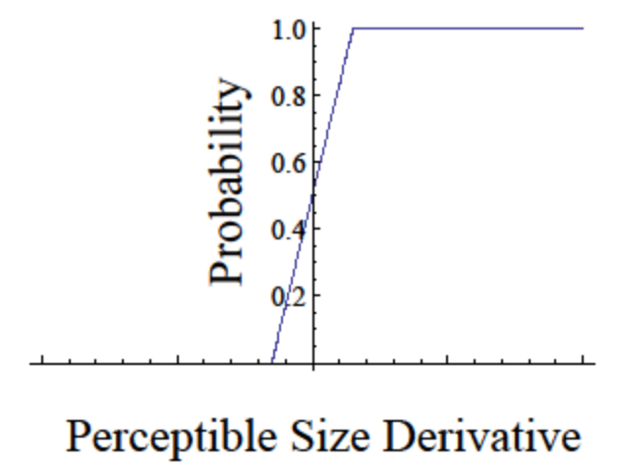

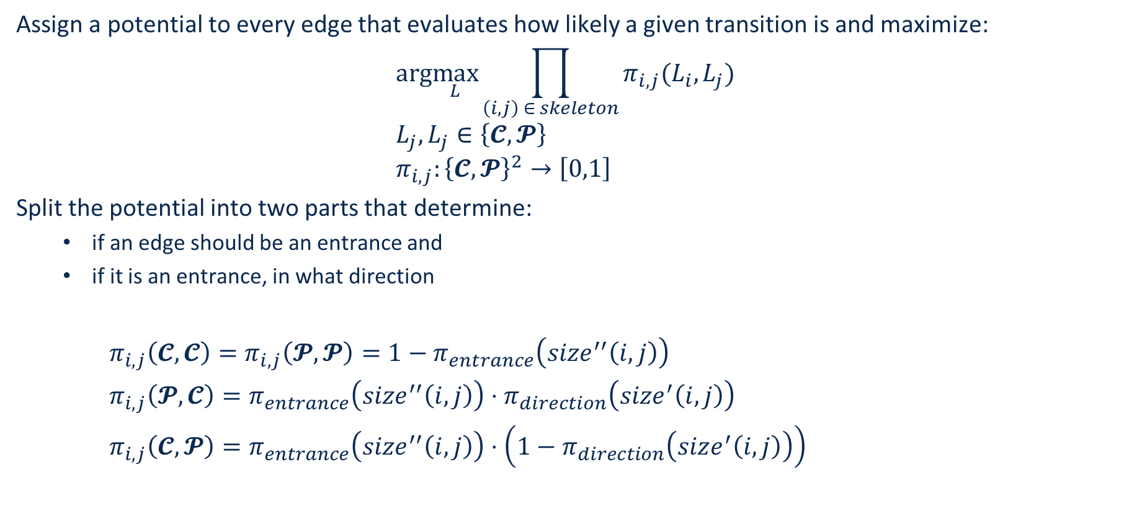

Energy Function Design
Assign a potential to every edge that evaluates how likely a given transition is and maximize:
$$arg\max_{L}\prod_{\left(i,j\right) ∈ skeleton}{π_{i,j}(L_{i},L_{j})} \\ L_{j}, L_{j}∈\left\{𝓒,𝓟\right\} \\ π_{i,j}:{\left\{𝓒,𝓟\right\}}^{2}→\left[0,1\right]$$
Split the potential into two parts that determine:
  if an edge should be an entrance and
  if it is an entrance, in what direction
$π_{i,j}\left(𝓒,𝓒\right)=π_{i,j}\left(𝓟,𝓟\right)=1−π_{entrance}\left(size^{′′}\left(i,j\right)\right)$
$π_{i,j}\left(𝓟,𝓒\right)=π_{entrance}\left(size^{′′}\left(i,j\right)\right)⋅π_{direction}\left(size^{′}\left(i,j\right)\right)$
$π_{i,j}\left(𝓒,𝓟\right)=π_{entrance}\left(size^{′′}\left(i,j\right)\right)⋅\left(1−π_{direction}\left(size^{′}\left(i,j\right)\right)\right)$
$$π_{entrance}$$
$$π_{direction}$$

Slide 13
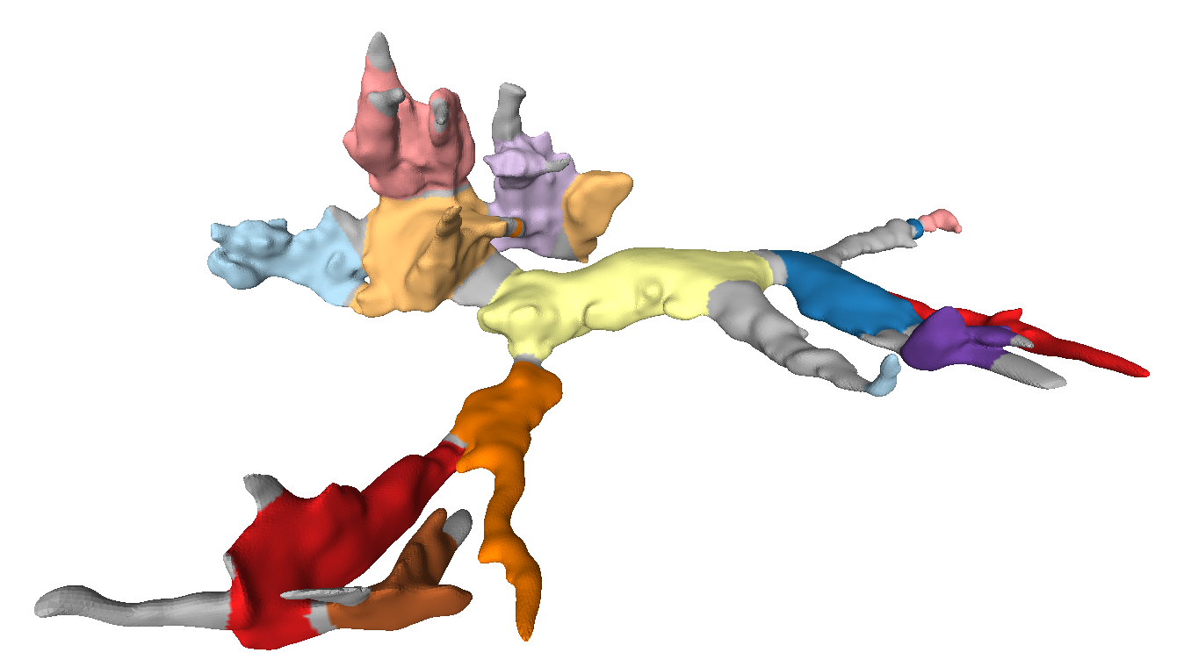
Project Back Onto Surface

Slide 14
Questions?

Slide 15
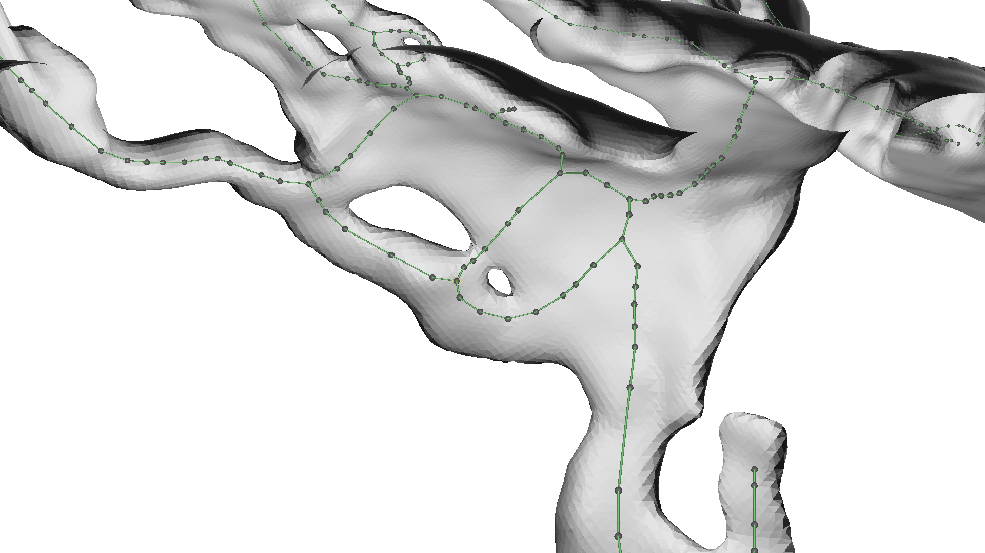
An Example
We focus on this skeleton vertex

Slide 16
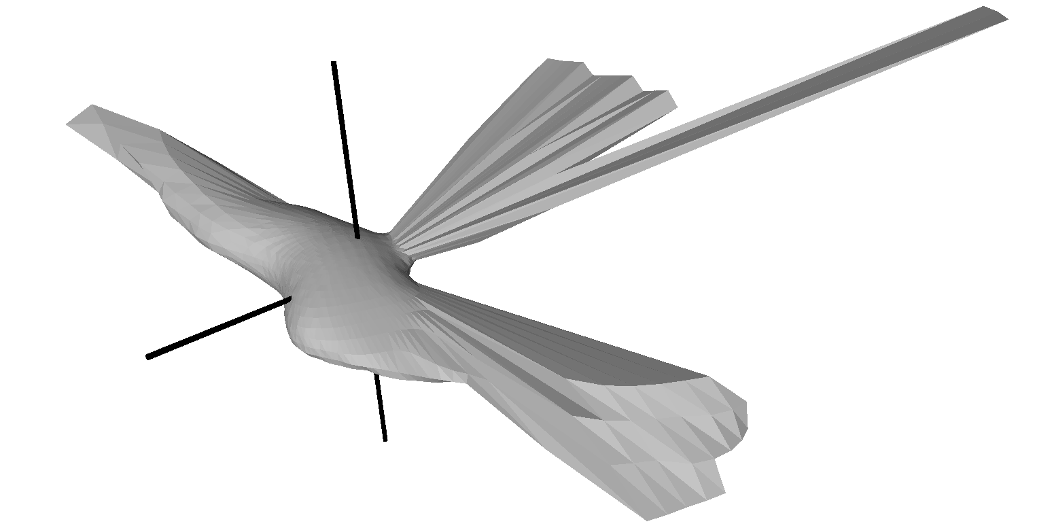
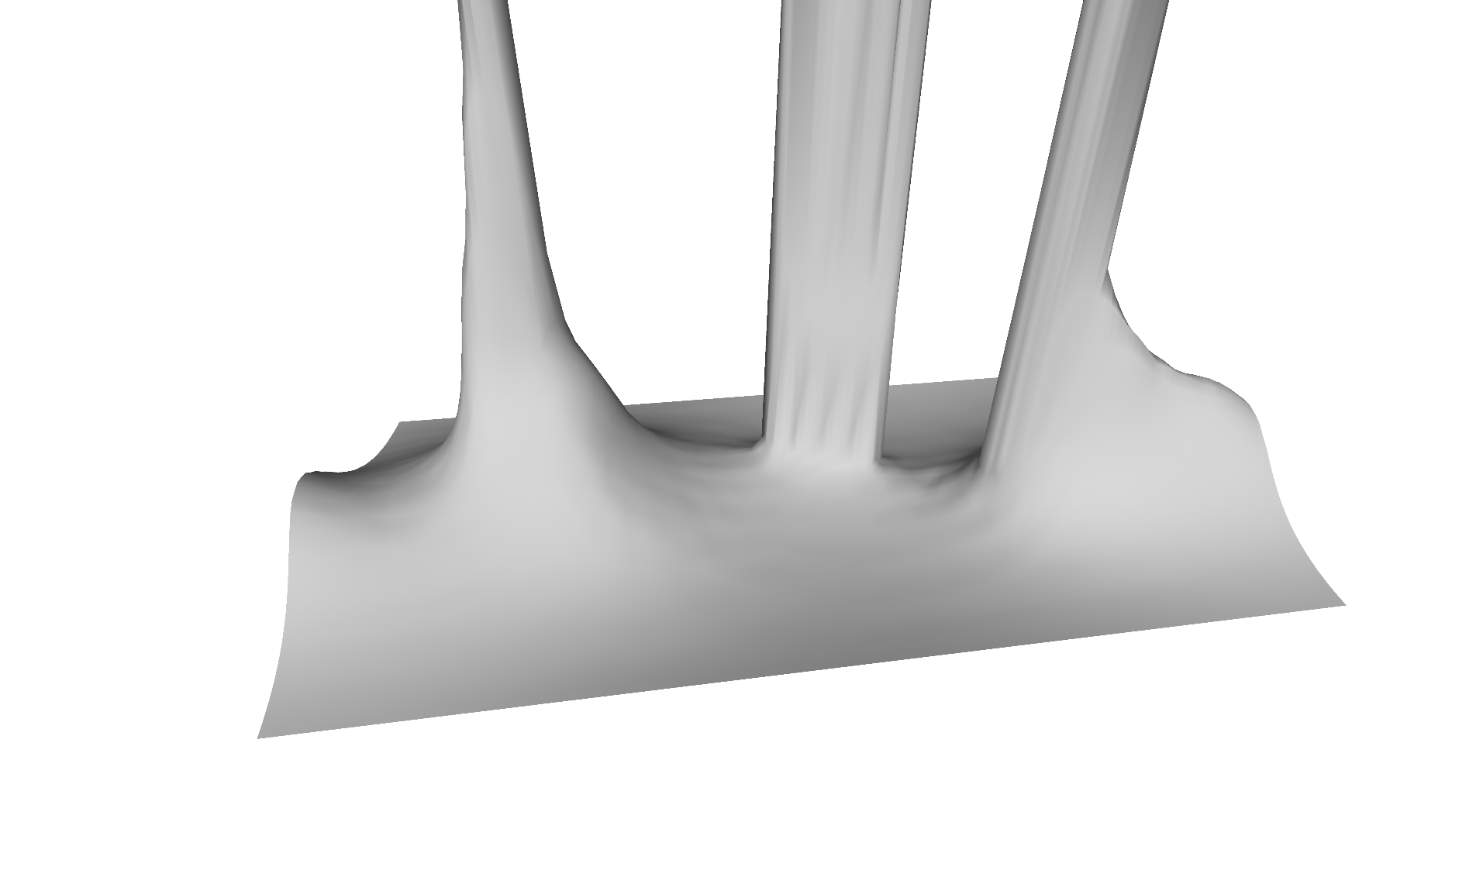
Step 1: Calcuate the Spherical Radius Field
Spherical Representation
Unrolled to sphere parameter space

Slide 17
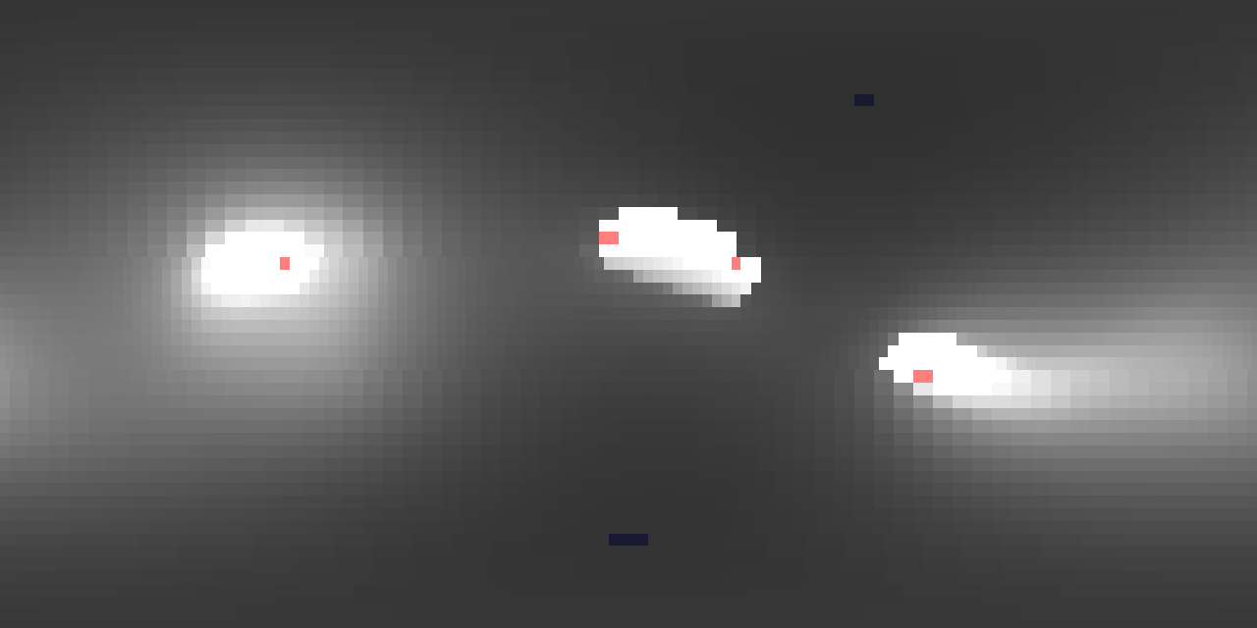
Step 2: Find the Ridge Line That Separates the Minima

Slide 18
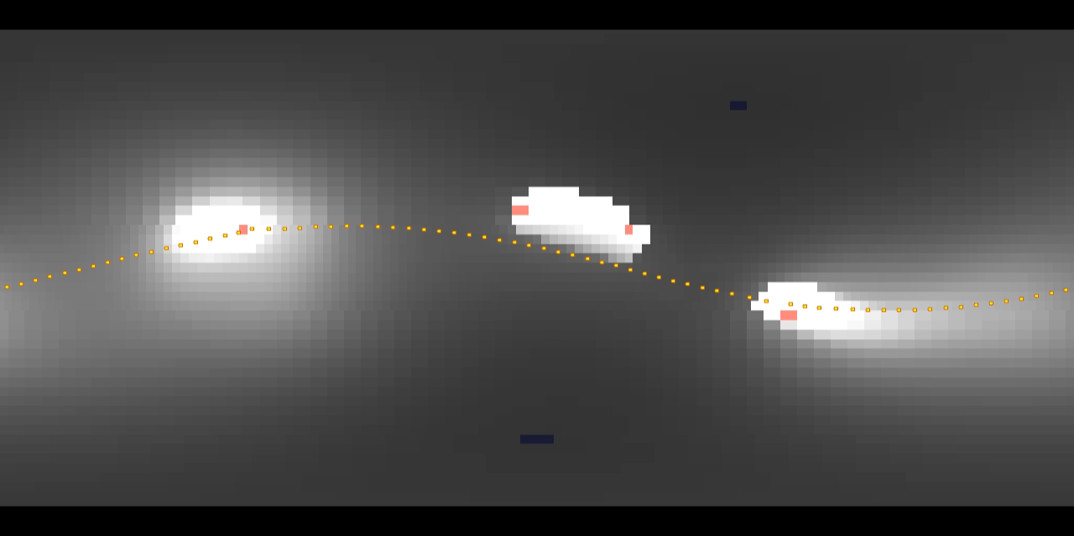
Step 2: Find the Ridge Line That Separates the Minima

Slide 19
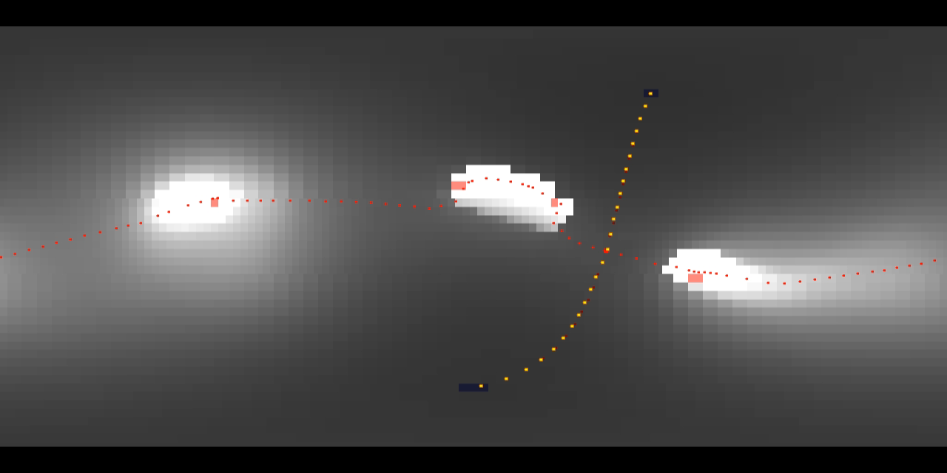
Step 3: Optimize Path Segments

Slide 20
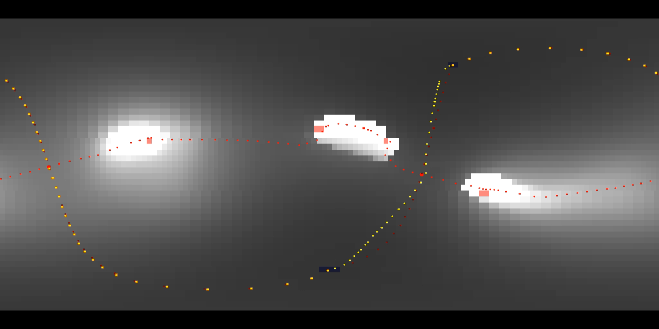
Step 3: Optimize Path Segments

Slide 21
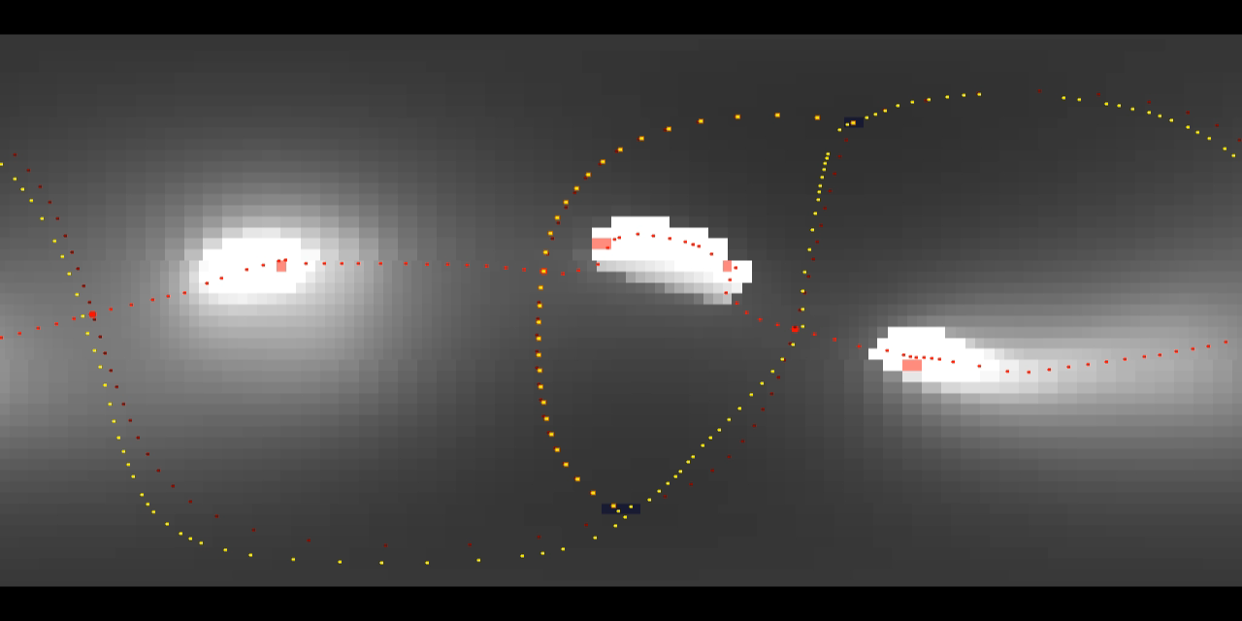
Step 3: Optimize Path Segments

Slide 22
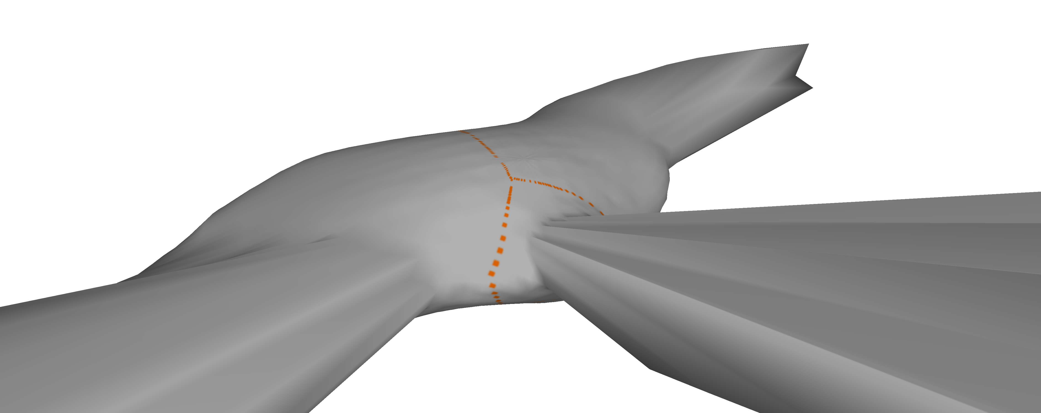
Result

