Slide 1
Visualization of Scanned Cave Data with Global Illumination
Nico Schertler, Mirko Salm, Joachim Staib, Stefan Gumhold
TU Dresden, Chair of Computer Graphics and Visualization, Germany

Slide 2
Goal
Direct visualization of 3D cave scans:
Unstructured point clouds with diffuse color and normals
Near realistic visualization for communication purposes.
Interactive frame rates for realtime exploration.
Spherical Surfels
(Screen Space Hole Filling Possible)
Global Illumination
Hierarchical data structures

Slide 3
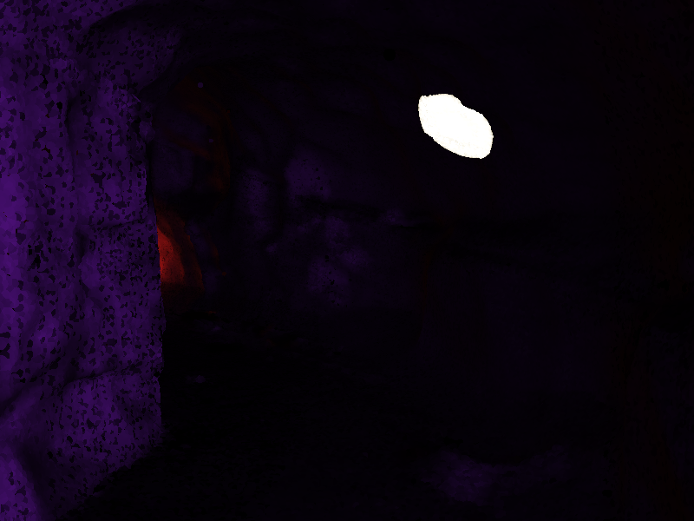
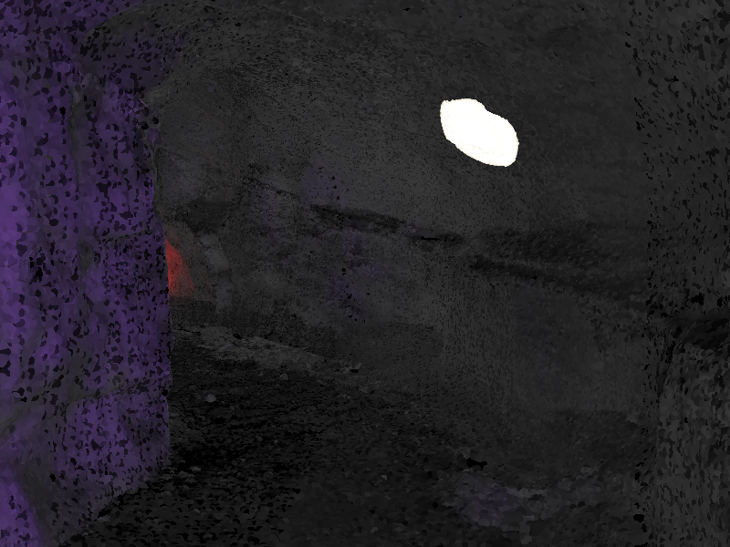
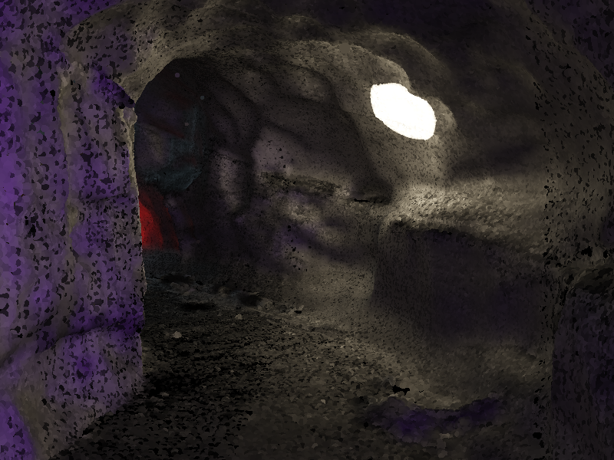
Global Illumination for CaveVis
Local Lighting Only
Local Lighting + Ambient Term
Global Illumination

Slide 4
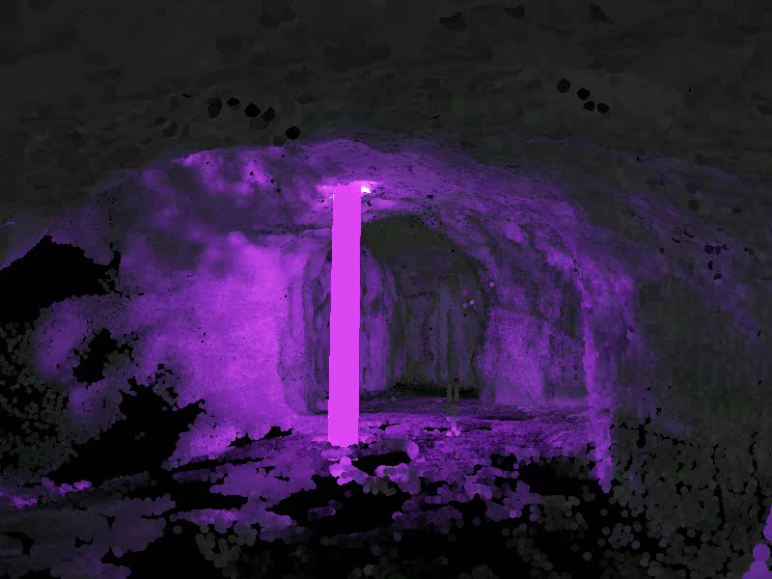
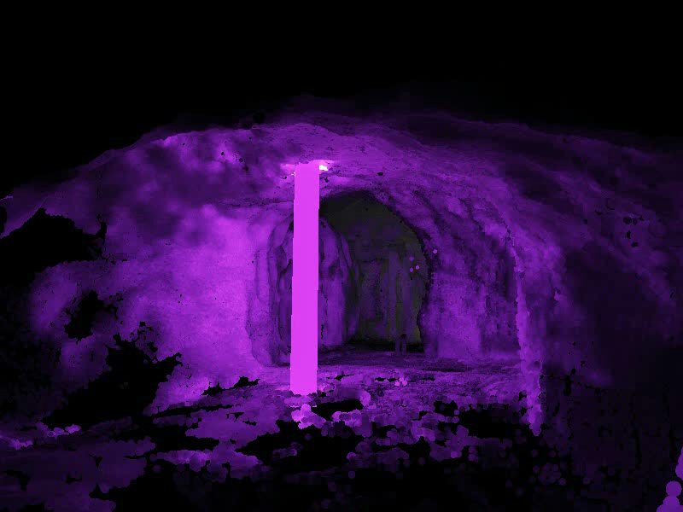
Global Illumination for CaveVis
Local Lighting + Ambient Term
Global Illumination

Slide 5
Basic Idea – Diffuse Light Reflection
When light hits a surface, reflected intensity is uniform in every direction.
Reflected light can again illuminate other parts of the scene.
Idea: Model light distribution in a voxelized scene representation, where each voxel stores the emitted radiance.
Simulate light transport in the voxel representation.
During rendering, look up radiance in the according voxels via interpolation.

Slide 6
Overview of the Visualization Process
Input Point Cloud
Voxel Representation
Diffuse Color
Opacity
Normal Distribution
Reflected Light
Light Simulation
Final Rendering

Slide 7

Not Overview of the Visualization Process

Slide 8
Building a Voxel Representation
Each input point is assigned a cubical Region
of Influence based on the sampling density.
Geometry attributes are splatted additively
into the overlapping voxels with proper weights.
This representation allows continuous sampling
of geometry attributes via interpolation.

Slide 9
Light Simulation
Inject direct light into voxel representation.
  Evaluate direct light analytically at every leaf node.
  Use shadow mapping for occlusions.
  Add to the voxel‘s already existing light information.
Mipmap the light information.
  Sparse Voxel Octree
Propagate light via a gathering process.
  Voxel Cone Tracing (VCT)

Slide 10
Light Mipmapping
Inner nodes of the Sparse Voxel Octree contain:
Reflected light
Opacity
Inner nodes are anisotropic (radiance per facet)
Convert isotropic voxels to anisotropic ones based
on NDF (prevent light from shining through surfaces):
NDF

Slide 11
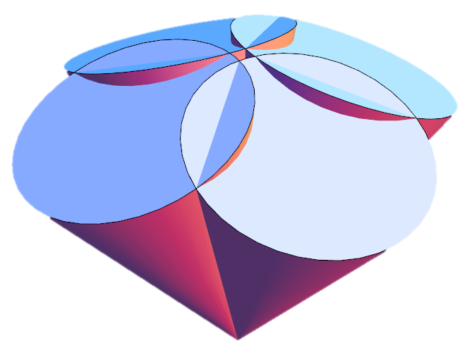
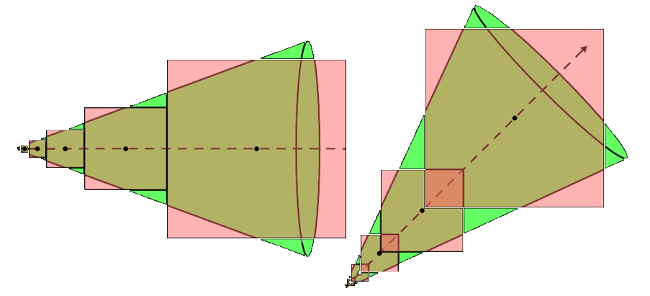
Light Propagation
Reflected light of voxels can be calculated by
integrating over the hemisphere defined by the NDF.
Approximate the integral with few cones.
Perform Voxel Cone Tracing. Use coarser mipmaps
for sample points that are farther away.
Do Front-to-Back-Compositing for sampled radiance.

Slide 12
Light Simulation
Inject direct light into voxel representation.
Mipmap the light information.
Propagate light via a gathering process.
Simulates one bounce of reflection per frame. Multiple bounces accumulate over time.

Slide 13
Final Rendering
Render the point cloud as spherical surfels with
deferred shading.
For each fragment:
Evaluate direct light analytically with shadow maps.
Use approximated global light from voxel representation.
Optional: Trace an additional cone for specular BRDFs.

Slide 14
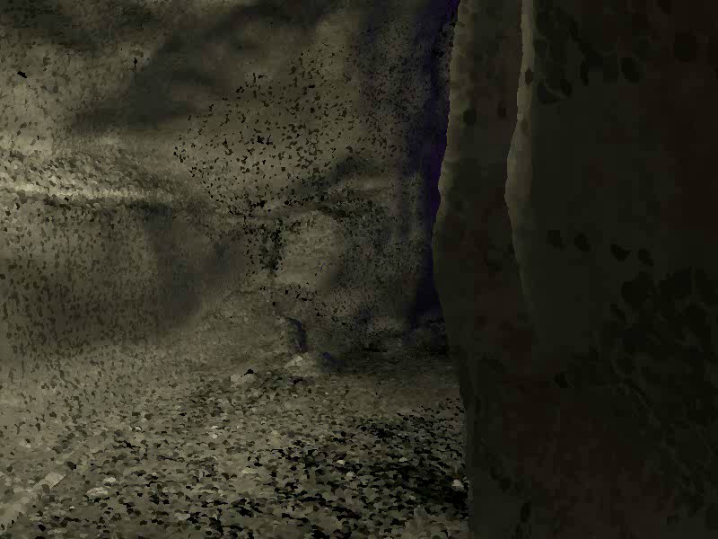
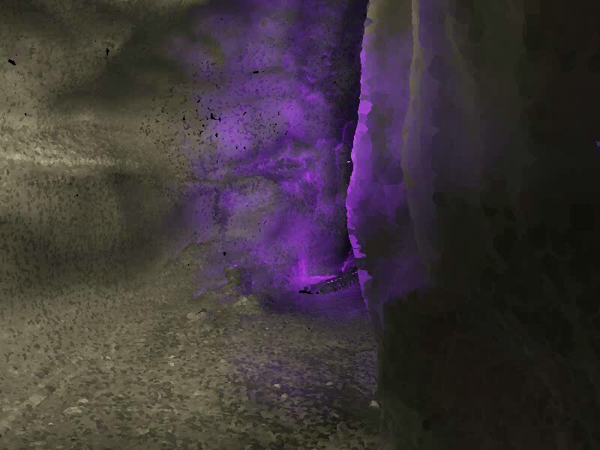
Specular Shading
Diffuse Only
Specular Shading

