Slide 1
Towards Globally Optimal Normal Orientations for Large Point Clouds
Nico Schertler, Bogdan Savchynskyy, and Stefan Gumhold [CGF2016]

Slide 2
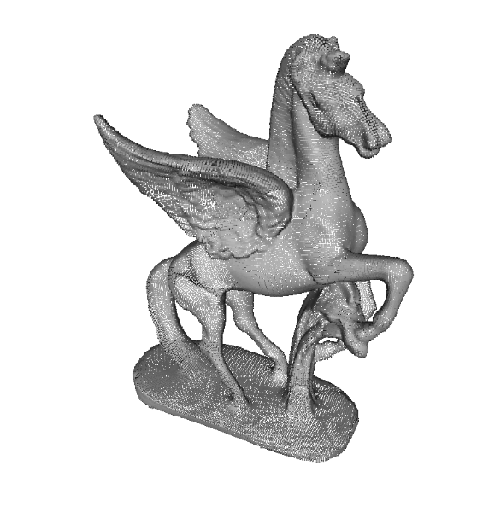
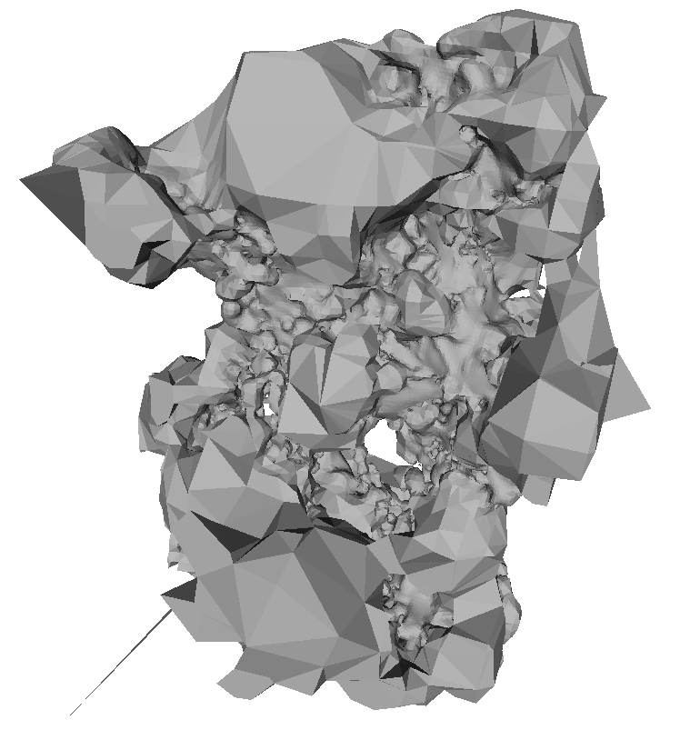
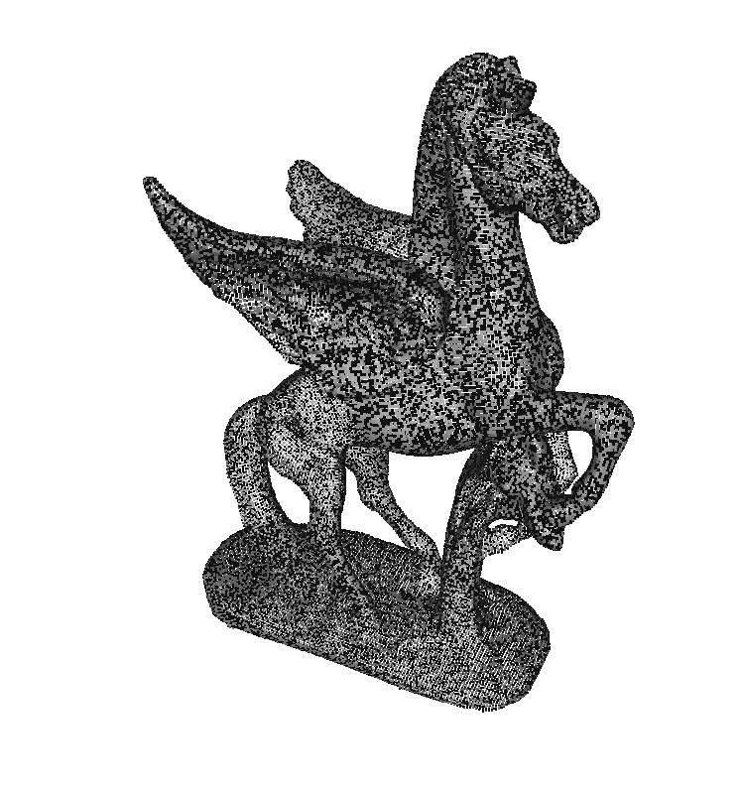
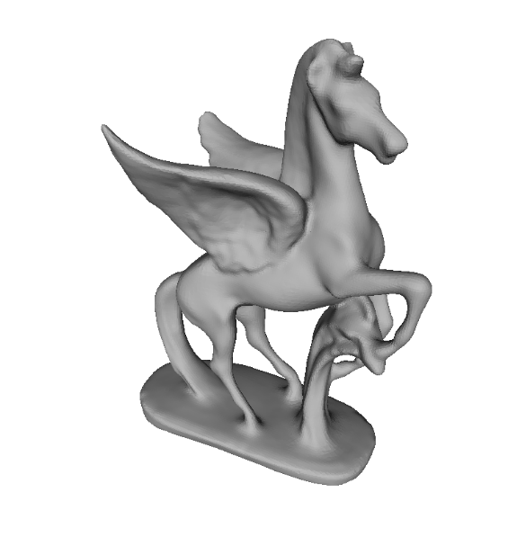
Motivation
Given an unstructured point cloud with unoriented normals:
Double-Sided Lighting
Poisson Reconstruction
Normal Orientation
Poisson Reconstruction

Slide 3

Orientation from 3D Scans
In many 3D-scanning applications, orientation can be deduced from the sensor position.
This approach is not always possible:
if sensor position is not available
if normal directions do not represent the acquired geometry

Slide 4
Agenda
Related Work
Problem Formulation
Solving
Out-of-Core Processing
Results

Slide 5
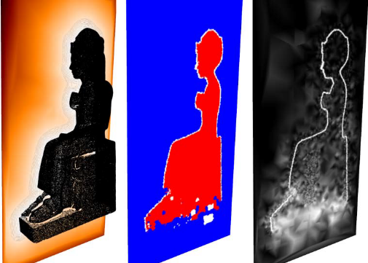
Related Work
Propagation-Based Methods [Hoppe*92, Xie*03, …]
Based on neighbor graph, uncertainty measure, and flip decider.
Propagate orientation along MST that minimizes uncertainty.
Volumetric Methods
Interpret point cloud as samples of an implicit surface (e.g. distance field).
Find sign of implicit function through ray-shooting [Mullen*10] or connected-component analysis [Gong*12].
Problems arise with non-closed surfaces.
Other Methods
Variational approaches find direction and orientation simultaneously [Wang*12].
Use a coarse triangulation to gather topological information [Liu*10].
[Mullen*10]

Slide 6
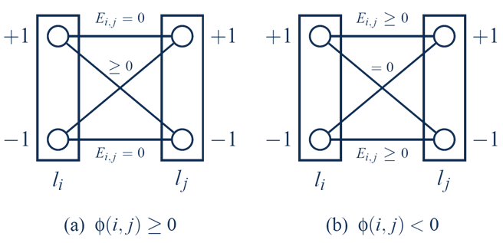
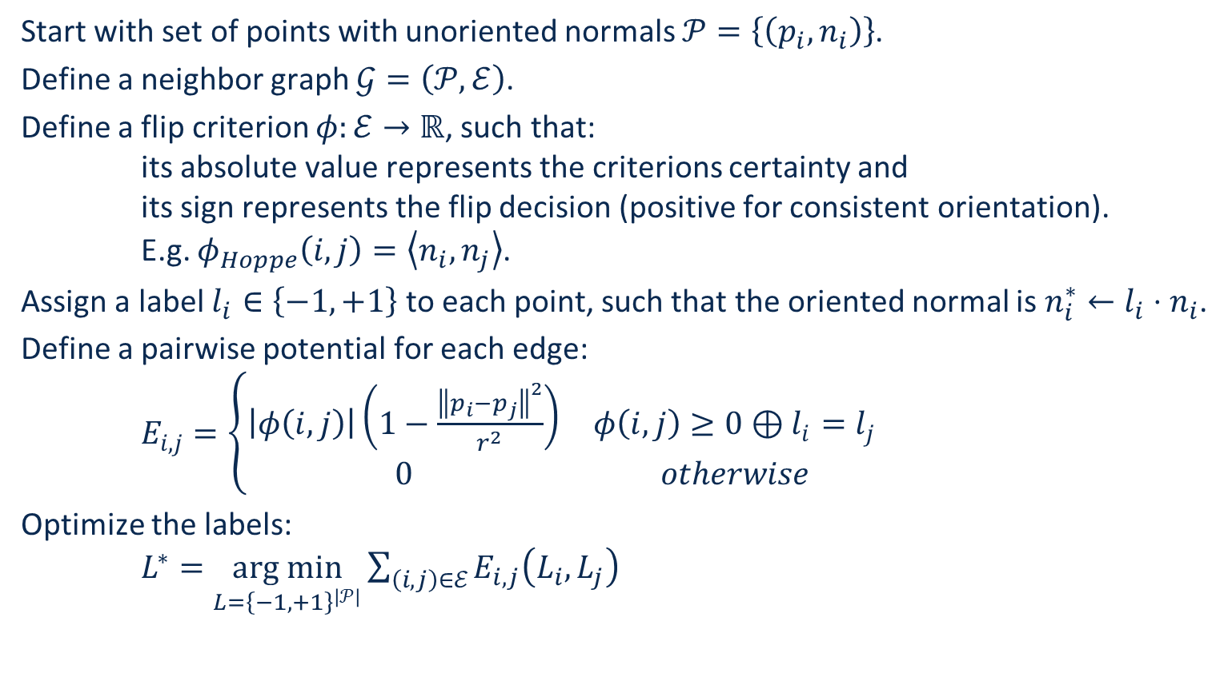
Problem Formulation as a Markov Random Field
Start with set of points with unoriented normals $𝒫=\left\{\left(p_{i},n_{i}\right)\right\}$.
Define a neighbor graph $𝒢=\left(𝒫, ℰ\right)$.
Define a flip criterion $φ:ℰ→ℝ$, such that:
its absolute value represents the criterions certainty and
its sign represents the flip decision (positive for consistent orientation).
E.g. $φ_{Hoppe}\left(i,j\right)=\left\langle n_{i},n_{j}\right\rangle$.
Assign a label $l_{i}∈\left\{−1,+1\right\}$ to each point, such that the oriented normal is $n_{i}^{∗}←l_{i}⋅n_{i}$.
Define a pairwise potential for each edge:
$E_{i,j}=\left\{\begin{matrix}\left|φ\left(i,j\right)\right|\left(1−\frac{{\left\|p_{i}−p_{j}\right\|}^{2}}{r^{2}}\right) & φ\left(i,j\right)≥0⊕l_{i}=l_{j} \\ 0 & otherwise\end{matrix}\right.$
Optimize the labels:
$L^{∗}=\underset{L={\left\{−1,+1\right\}}^{\left|𝒫\right|}}{arg min}{\sum_{\left(i,j\right)∈ℰ}{E_{i,j}\left(L_{i},L_{j}\right)}}$

Slide 7
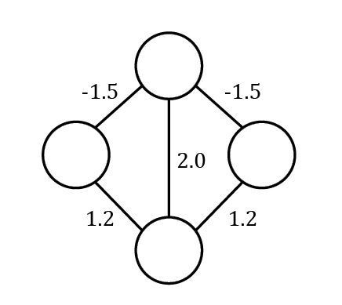
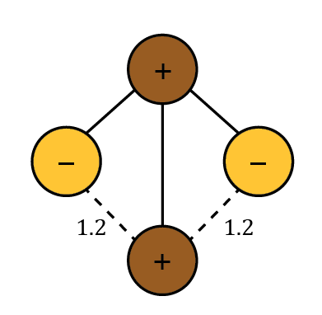
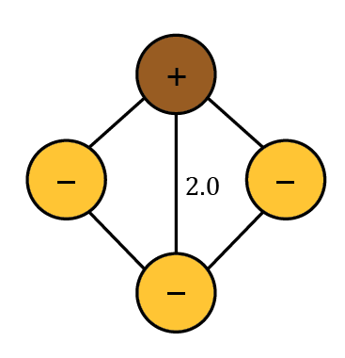
Why Should We Care about Global Optimality?
Distance-weighted output of flip criterion
MST solution, E=2.4
Optimal Solution, E=2.0

Slide 8
Solving the Orientation Problem
The orientation problem is NP-hard (unless unoriented normals are already consistent).
Exact globally optimal solvers:
Exist, but are slow and require a lot of memory.
E.g. Multicut, General Integer Linear Programming
Approximate solvers:
Spanning tree-based (Signed Union Find)
Local Submodular Approximation (LSA-TR)
Semi-approximate solvers:
Quadratic Pseudo-Boolean Optimization (QPBO) and its variants

Slide 9





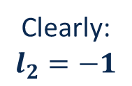
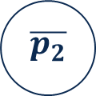



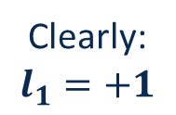







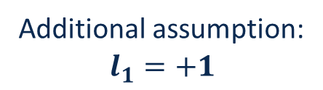





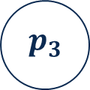









QPBO
Generate a graph with two vertices per point and find a minimum cut.
Example from earlier (slightly modified):
$$1.0$$
$$p_{1}$$
$$0.75$$
$0.$4
$$−1.5$$
$$−1.5$$
$$s_{+1}$$
$$∞$$
$$p_{1}$$
$$p_{2}$$
$$p_{3}$$
$$p_{4}$$
$$0.75$$
$$0.6$$
$$p_{2}$$
$$p_{3}$$
$$2.0$$
$$t_{−1}$$
$$∞$$
$$\overline{p_{1}}$$
$$\overline{p_{2}}$$
$$\overline{p_{3}}$$
$$0.6$$
$$\overline{p_{4}}$$
$$0.8$$
$$p_{4}$$
$$1.2$$
$$0.75$$
$0.$4
$$1.0$$
Additional assumption:
$$l_{1}=+1$$
Clearly:
$$l_{1}=+1$$
Clearly:
$$l_{2}=−1$$
Clearly:
$$l_{3}=−1$$
Unlabeled

Slide 10
MST + QPBO-I
QPBO needs at least one additional unary term per connected component (for symmetric energies).
Still, most points stay unlabeled. Therefore, we use a combination of MST and QPBO-I
Fix random label to MST solution
No
Solve MST
Solve QPBO
All labeled
Repeat
n times
Yes
Return best solution
Revert fixing
Notes:
Fixed nodes:
Dragon / Xie: 56 / 28,885 (0.2%)
Ramses / Xie: 13 / 60,910 (0.02 %)
Thai / Hoppe: 961 / 723,583 (0.1%)

Slide 11
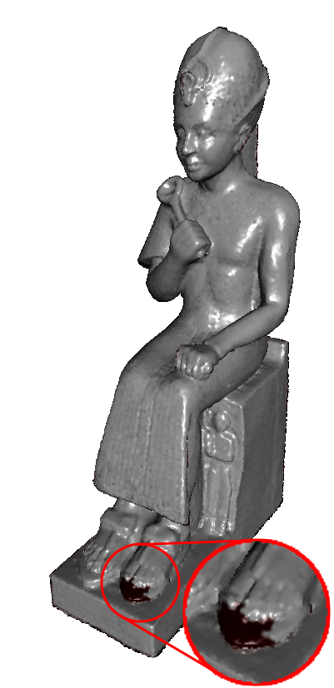
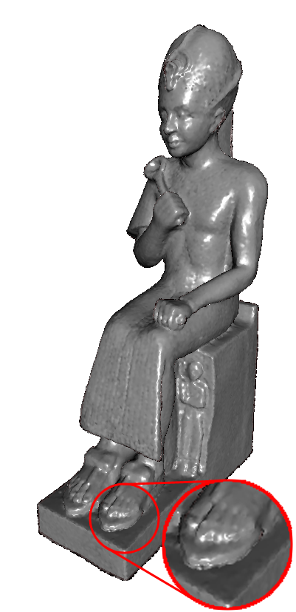
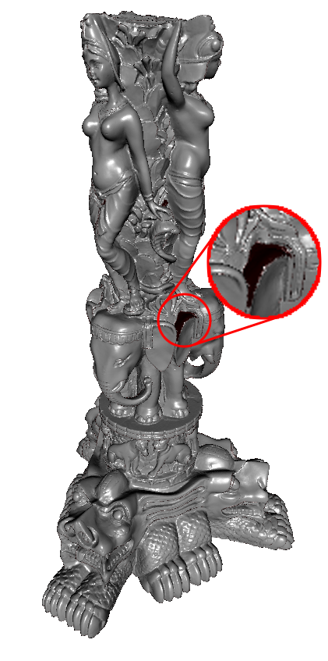

MST + QPBO-I Results
Xie, MST
Xie, MST + QPBO-I
Hoppe, MST
Hoppe, MST + QPBO-I

Slide 12
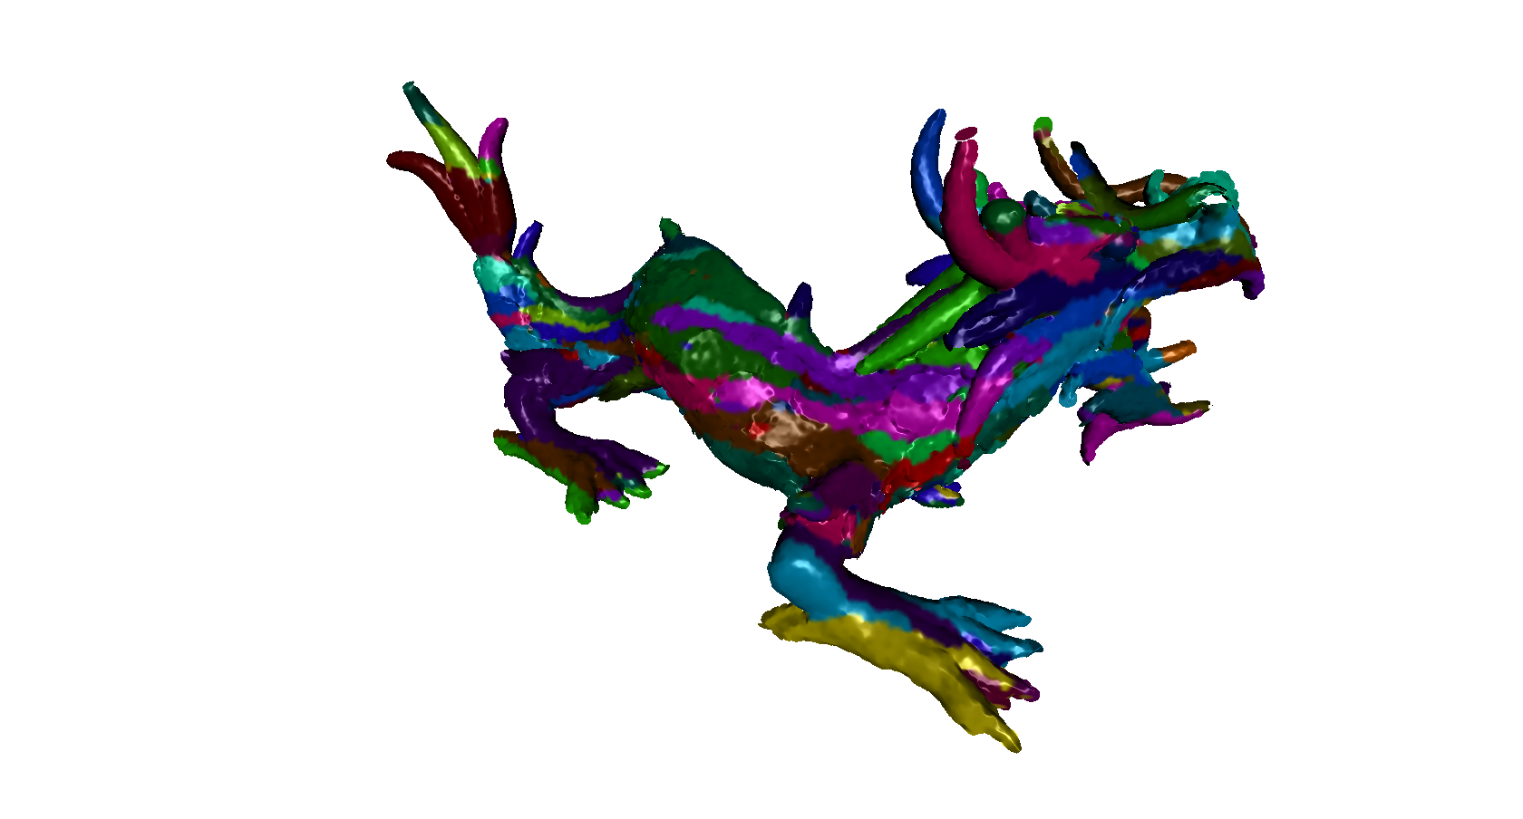
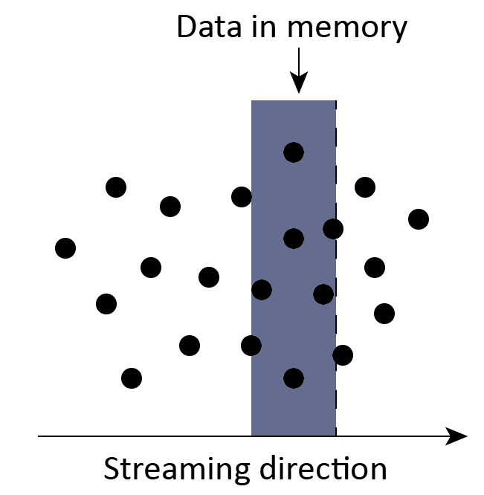
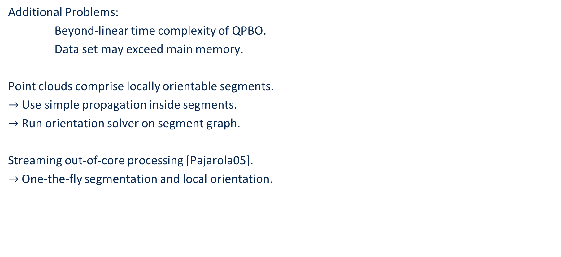
Processing Large Point Clouds
Additional Problems:
Beyond-linear time complexity of QPBO.
Data set may exceed main memory.
Point clouds comprise locally orientable segments.
$→$ Use simple propagation inside segments.
$→$ Run orientation solver on segment graph.
Streaming out-of-core processing [Pajarola05].
$→$ One-the-fly segmentation and local orientation.

Slide 13
Segment-Based Orientation
Input Graph
In-Segment Orientation
Segment Graph
Sum of original flip criteria

Slide 14
Streaming Segmentation
Consider only left neighbors, assign point to the segment with the highest absolute vote:
Intra-Segment Criterion:
Ensure same signs in segment.
Fulfilled:
Not fulfilled:
Inter-Segment Criterion:
Ensure same signs across segment borders.
Fulfilled:
Not fulfilled:
Vote for purple segment
?
?
?
Vote for yellow segment
?
Positive flip criterion
Negative flip criterion
Notes:
Theta_acc (segment vote must be higher than threshold)
Theta_S (allow small contradicting votes)

Slide 15
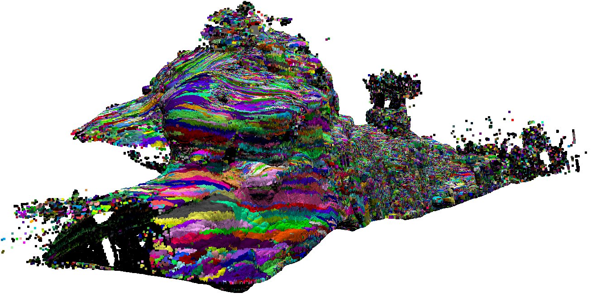
Results
Gomantong Caves
261 M points
71 minutes

Slide 16
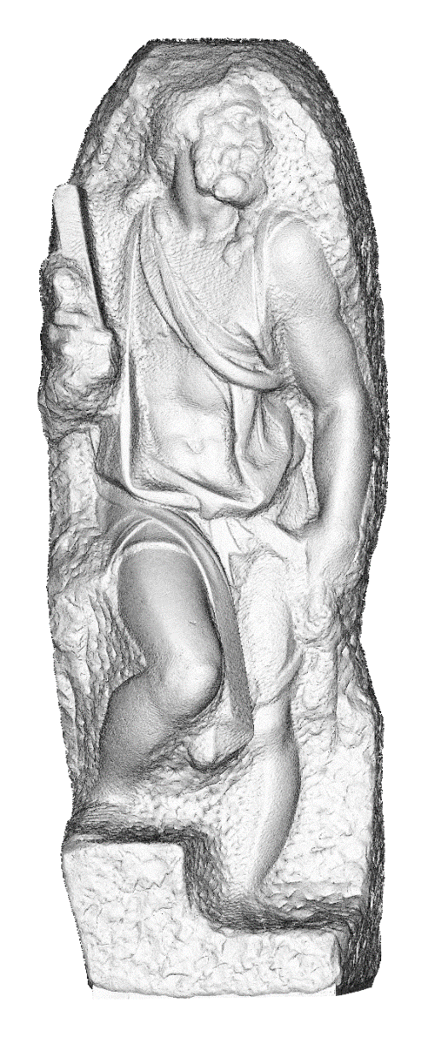
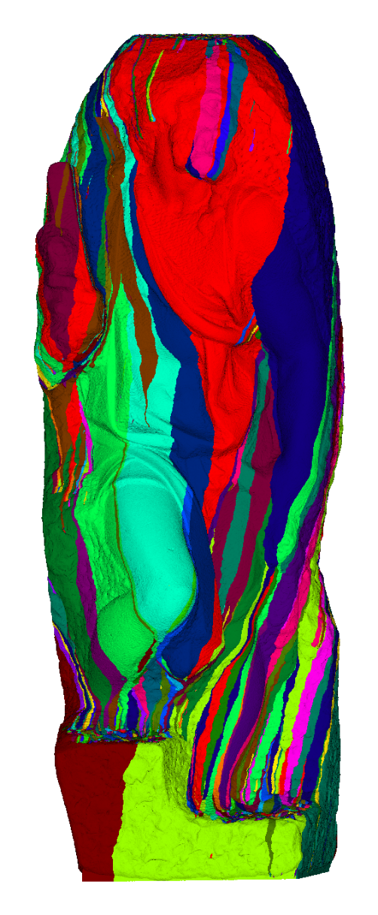
Results
St Matthew
187 M points
16 minutes

Slide 17
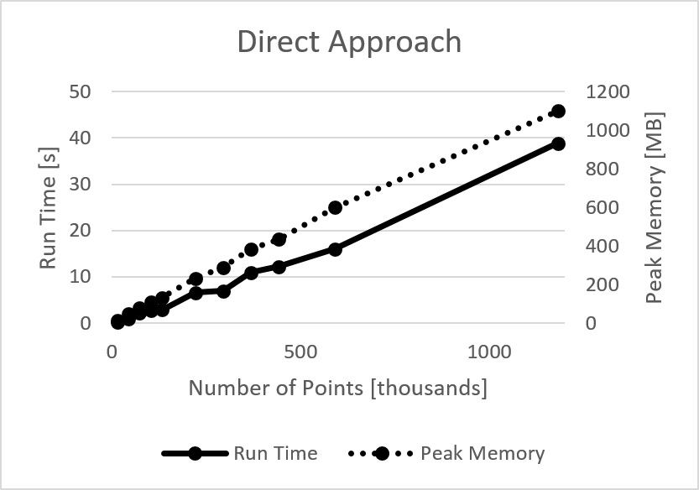
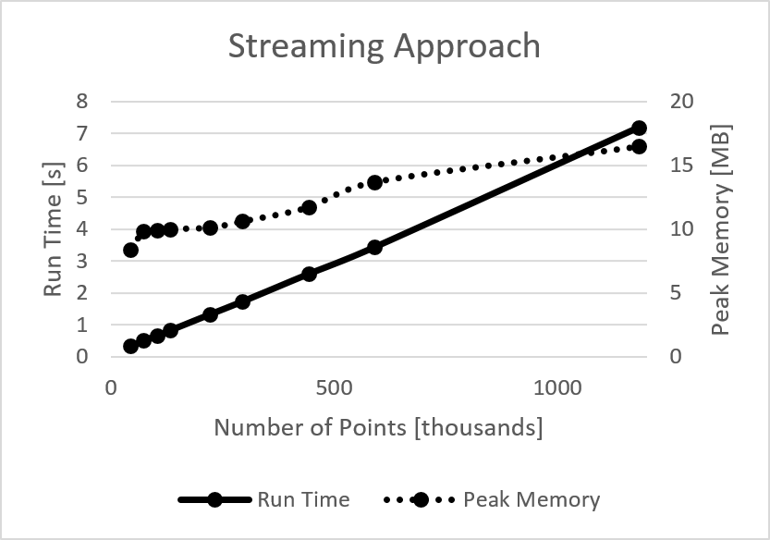
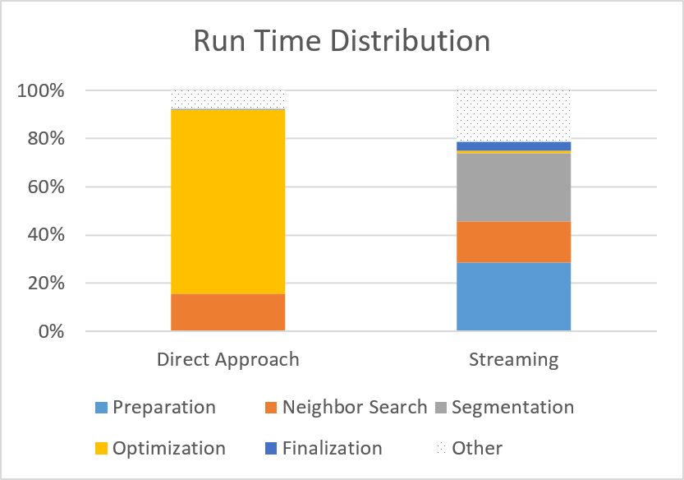
Comparison Direct – Streaming Approach

Slide 18
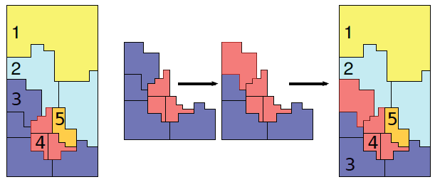

Future Work
Development of a possibly higher-order flip criterion.
Application of other solvers.
User-guided fixing in the QPBO-I step.
$$φ$$
[Beyer*14]

Slide 19
Questions?

