Slide 1
Network Operations Automation at DE-CIX
Lucas Immanuel Nickel

Slide 2

Servus, I’m Lucas.
Building and operating NetOps automation
Focused on making operational automation reliable, observable, and maintainable
Lucas Immanuel Nickel
Network Operations Engineer

Slide 3
At DE-CIX scale, automation is not optional
The scale of DE-CIX
Global interconnection platform
3,700+ connected networks
79 EB exchanged in 2025
100+ routers and hundreds of circuits worldwide
Automation at scale needs guardrails
Automation is required at scale
Automation must be trustworthy, repeatable, and maintainable
Otherwise, automation becomes the root cause of the next incident with your name in the Git log
At this scale, NetOps automation needs SRE practices:
reliable delivery, observability, and safe failure.

Slide 4
Operational automation, not network orchestration
Network orchestration
Provisioning
Configuration rollout
Lifecycle management
→ Owned by the NORC team
Operational automation
Monitoring & Alarming
Data correlation
Workflow automation
→ Owned by the NetOps team
For more on NORC, I recommend:
DENOG17 - Inventing the wheel - Network Orchestration at scale

Slide 5
Our problem is not writing code
15+
20+
3
production cron jobs
operational scripts
production web services
One library
to rule them all

Slide 6
500+
executions per day

Slide 7
Useful automation starts with operational pain
Repeated toil
Missing visibility
Friction between systems and work
Where it hurts:
maintenance handling, software upgrades, route servers, …

Slide 8
When do we automate?
Repeated toil
→ daily or weekly work
Scale pressure
→ tens of routers, hundreds of devices, hundreds of tickets
Good data
→ known systems, APIs, source-of-truth available
Manageable blast radius
→ failure can be constrained, reviewed, or rolled back
Automate when the work is repetitive,
data-backed, and the blast radius is understood.

Slide 9
From legacy hosts to Kubernetes
Legacy
Shared hosts
Fragile deployments
No standardized path for deploying web services
Limited workload isolation, visibility, and rollback
Today
Cron jobs and web services run in Kubernetes
Standardized CI/CD delivery
Isolated workloads with better visibility and rollback support

Slide 10
GitOps-style workload delivery
Engineers start with a main.py in a UV project
One shared library to abstract boilerplate and glue code
They define the workload in a Helm chart
They push the change to Git
Review and CI/CD validate the change
Kaniko builds, Harbor stores, Helm deploys, Kubernetes runs
Renovate keeps dependencies up to date

Slide 11
gNMIc config generation
Get devices + types
Read config
NetBox
Proxy 1
Write configs + port mappings
Generator Pod
Git
Proxy n
Read config
Update ($GNMIC_URL)
Zabbix
Zabbix
Macros
Get hosts + proxies
As part of modernizing monitoring, we generate gNMIc proxy configs to expose device telemetry as Prometheus metrics.

Slide 12
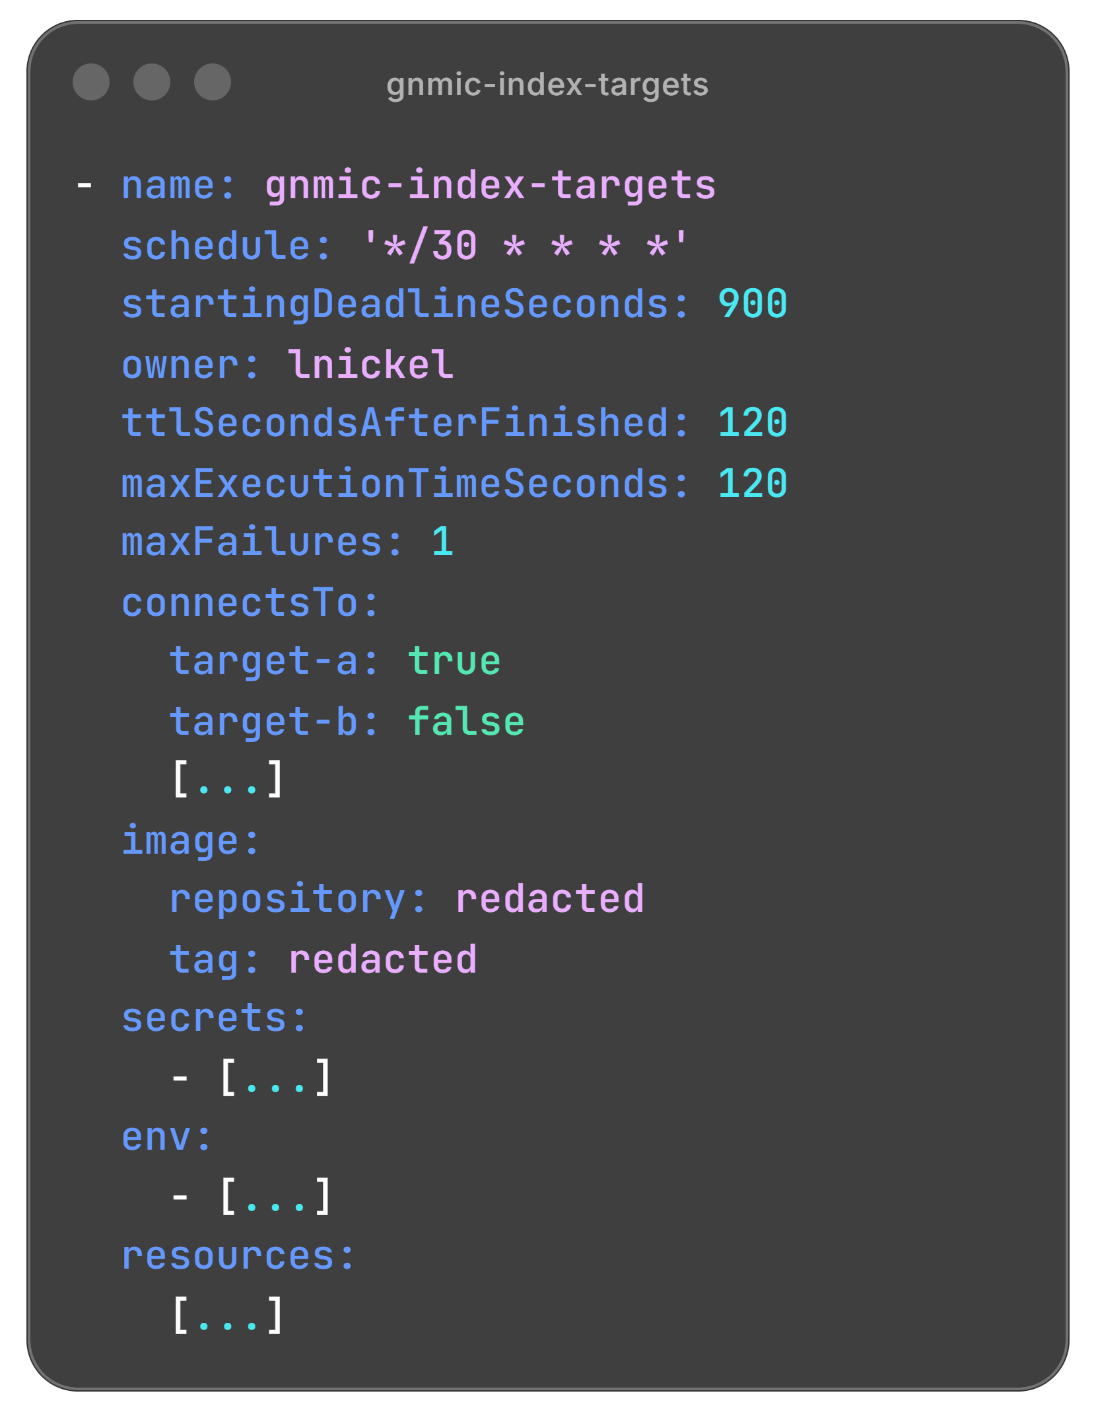
Define how it runs

Slide 13
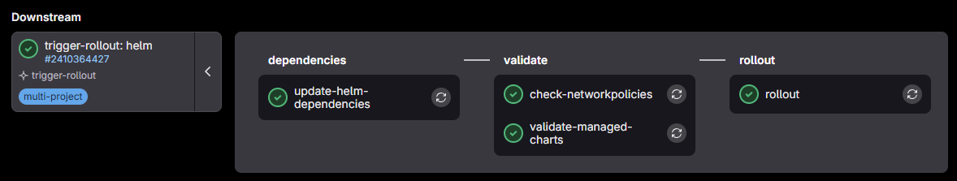
Deliver it like every other workload

Slide 14
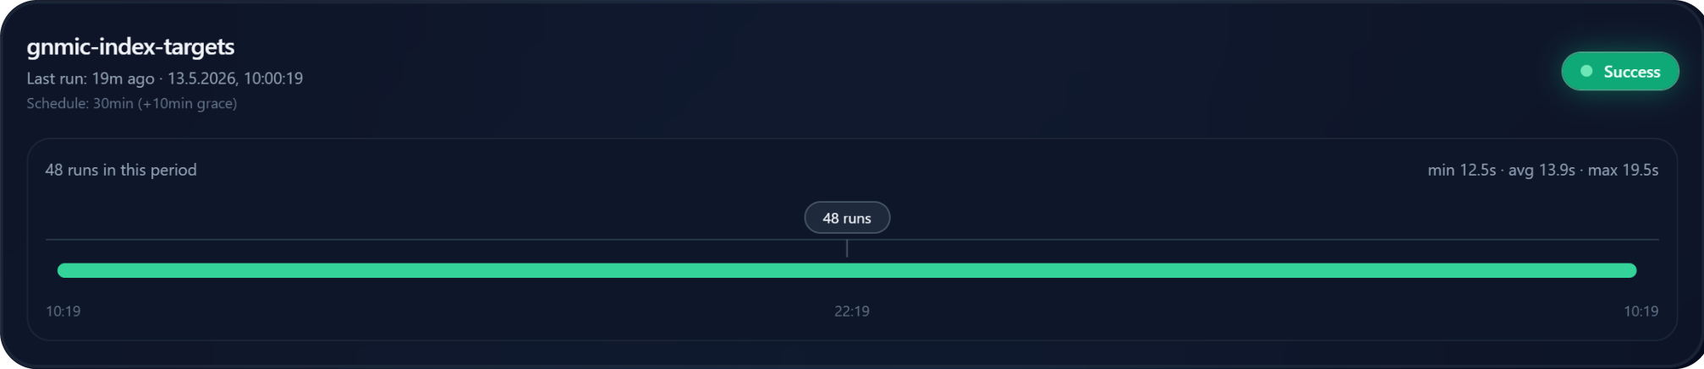
Monitor it by failure mode, not by tool
Delivery
● Did the change reach production?
● Who gets notified when it doesn’t?
Cronjobs
● Can you even scrape it fast enough?
● Where do operators see failed runs?
Scripts
● What happened during execution?
● How to keep the operator in the loop?
Services
● Is it healthy and useful?
● Is stale data becoming a problem?

Slide 15
Failure moved left
1 in 3
0
deploys got rejected before production in April
deploys failed on the production path in April

Slide 16
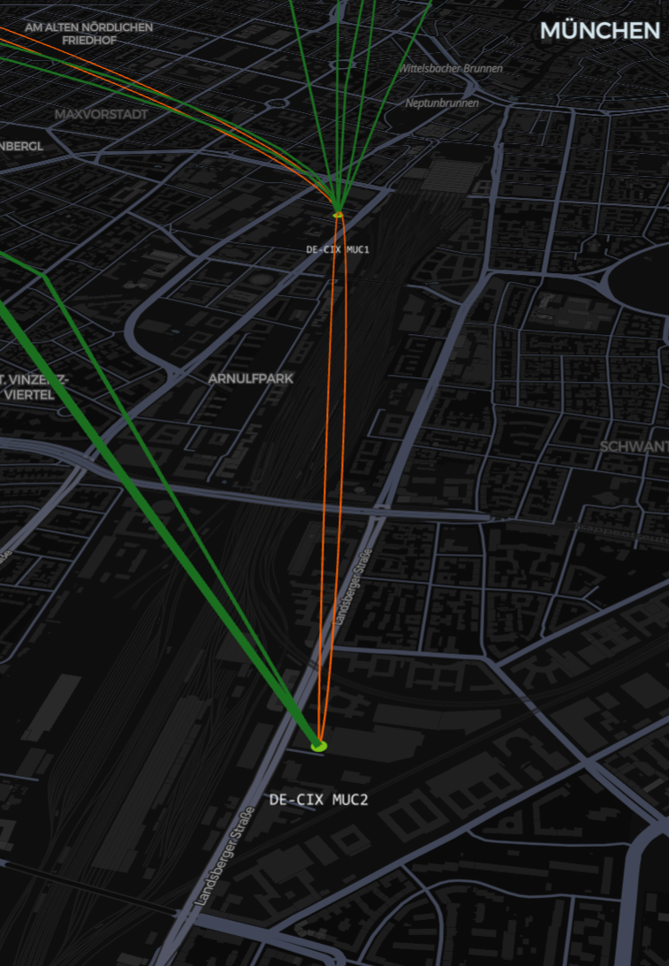
Geo
Provides a geographic view of the interconnection platform
Correlates NetBox and Zabbix data
Resolves sites, circuits, and LAGs
Handles imperfect data
API is used by other consumers
Used across the company
FPU-to-FPU case
A FPU switches traffic between primary and backup fibers
NetBox objects terminates on the FPU
Zabbix data sits on the edge
Geo leaves the endpoint unresolved

Slide 17

Geo is a data problem
NetBox and Zabbix are not always complete
Traces can be partial, missing, or wrong
Names do not always follow conventions
Relationships must be inferred
Not every object belongs on the map

Slide 18
Production automation must degrade safely
Validate and normalize inputs before action
Surface failures where operators can see them
Prefer incomplete
but honest output
Automate defensively

Slide 19
Patterns that survived production
Delivery
One release path for every workload
Let development fail before production
Separate business logic from platform concerns
Data
Treat data as untrusted input
Make generated output deterministic and auditable
Prefer visible partial failure over silent success

Slide 20
Automation is production infrastructure.
Treat it like it.
Lucas Immanuel Nickel
Network Operations Engineer @ DE-CIX

Slide 21
Questions?

