Slide 1
Automation at Scale Across Domains
Data Center/Campus/WAN

Slide 2

$ whoami
Daytime: Global IT Network Architect - Rohde & Schwarz GmbH & Co. KG
Nighttime: VyOS Universal Router - core maintainer
What gpt-oss-120b describes me:
I combine deep routing and switching expertise with a decade of embedded Linux experience and eight years as a VyOS core maintainer, delivering secure, automated, and scalable network solutions that move from code to production in minutes instead of weeks.

Slide 3
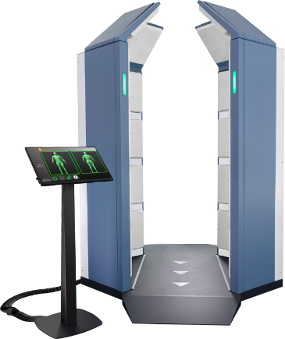
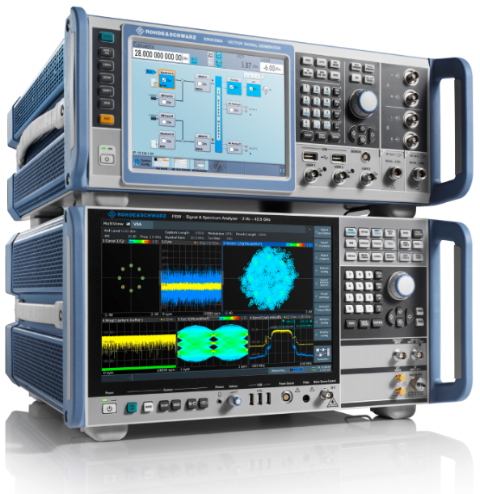
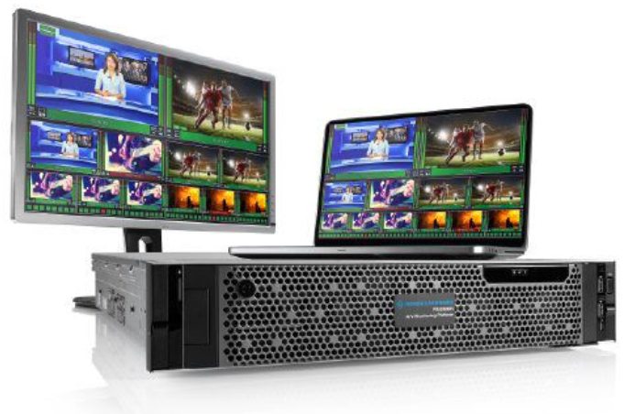
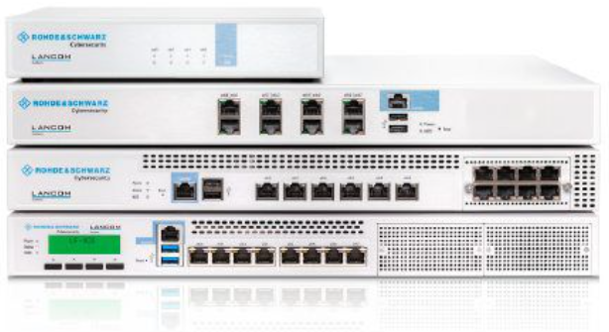
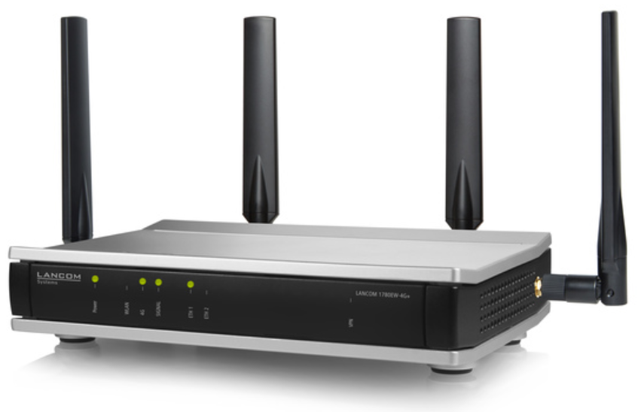
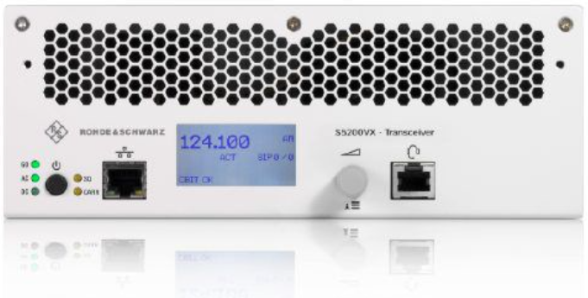

One company, three divisions, diverse markets:
We are a reliable technology partner
TEST &
MEASUREMENT
Wireless I Industry, Components & Research I Aerospace & Defense Testing I Automotive
TECHNOLOGY
SYSTEMS
Mobile Network Testing I Secure Communications I Critical Infrastructure I Government I IP Network Analytics I Broadcast, Amplifiers & Media
NETWORKS &
CYBERSECURITY
Cloud Managed Business I
Network & Security Solutions I
Certified & High-Grade Crypto Solutions

Slide 4
Building an Automation Playground

Slide 5
Where our journey begins
Pain points started to increase rapidly in Q1/2020
Single vendor, but
  Multiple Operating Systems
  Multiple CLI variants
Missing automation framework
Increasing demand on port density and speed
No dedicated QA lab environment
Who is this new EVPN-VXLAN technology?

Slide 6
Scouting a future-proof NOS
Vendor-provided and vendor-supported automation framework
  Ideally open-source, so we can tailor it to our needs
  Extend in the open-source spirit
Vendor-supported virtualization images for QA
  Fail-fast and iterate in a simulated environment
  Break things on purpose!
Simulation support for EVE-NG
  There was no Containerlab back in 2020

Slide 7
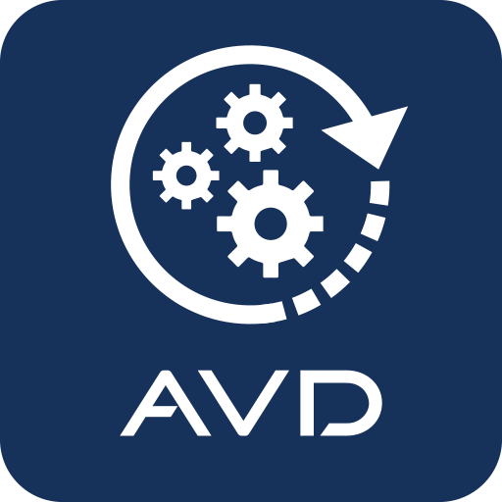
Scouting a future-proof NOS #2
Arista provided image download access for a POC
  Set up a CloudVision POC cluster on our hypervisors
  Used vEOS-lab so we could get to know each other
Moved vEOS-lab VMs into EVE-NG
Recreated current WAN topology using Arista AVD
Reiterate the current design and future optimisation
  Seamless changes due to the virtual QA environment
One source for both PROD and QUAL environment (git)

Slide 8
Putting pieces together
Design, deploy and connect two EVPN-VXLAN fabrics
Set up everything in EVE-NG
  maintain a 100% replica of the network at all times
Test network convergence behavior/routing changes
Have the full configuration done
  … while waiting on the hardware

Slide 9
“There won’t be much Day-2 work” - or so we thought

Slide 10
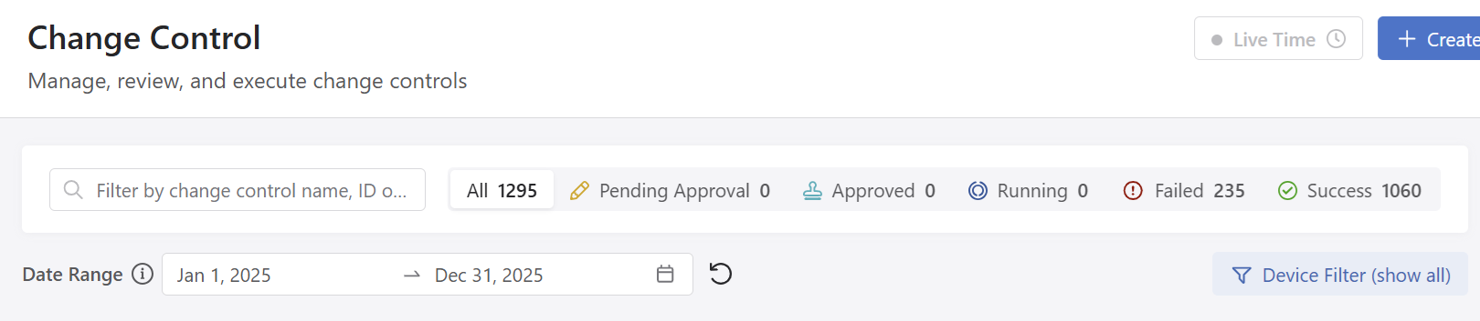
Expanding from WAN and DC to CAMPUS
“Once the network is up and running, we will only have a few changes, e.g., adding one or two VLANs.”
New features bring new flexibility — and customers are requesting new L2/L3 domains at a high rate
A “slight” increase in the expected change rate
  2021 (109), 2022 (280), 2023 (647), 2024 (983), 2025 (1060)

Slide 11
Why automate across domains?

Slide 12
Business Drivers
Reliability - We act as an internal service provider, and this is the company’s core backbone.
Speed - New customer demands arrive frequently
Consistency - We have all forgotten to add a VLAN to a Port-Channel at least once
MTTR - Mean Time to Repair: thanks to Git, we can always revert to a known-good state

Slide 13
Human Drivers
We tend to be lazy, and laziness is a good thing — it drives automation
Nobody likes siloed config templates
Configuration drift: “Just one little change… and one more tiny thing.”
Unpredictable change windows
Lack of a QA environment

Slide 14
Declarative Automation Model

Slide 15


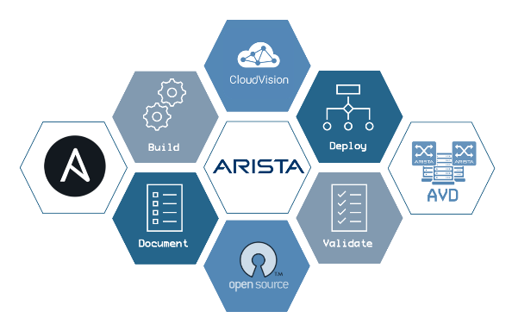

Architecture Highlights
Git is used for both source code and documentation (MD)
NetBox as an additional source of truth alongside Git
GitLab is also used for CI/CD runs and pushes to Arista CloudVision
Use ansible-lint and yamllint to keep everything consistent
ANTA to detect issues
  E.g., decommissiond endpoint ports

Slide 16
Data-driven design
Data determines what to render or include in the resulting switch configuration
  VLANs on Port-Channels
  VLAN database
  VNI (VXLAN Network Identifiers)
Source of truth (NetBox)
Idempotence is a must

Slide 17
Core Concepts
Define once, reuse often (Encapsulation)
Structured Inventory: YAML and NetBox (Abstraction)
  One inventory per domain: DC, LAN and WAN
  One playbook per site and domain: MU DC, MU LAN or MU WAN
Domain-specific extension: DC.yml, LAN.yml and WAN.yml (Inheritance)
Who changed what, why and when (Audit Trail via git blame)

Slide 18
Domain Specific Add-Ons
EVPN active-active multihoming ESI IDs
L3 edge point-to-point configurations
DCI underlay
Maintenance Mode profiles
ACLs
DNS/NTP settings with generic all.yml fallback

Slide 19
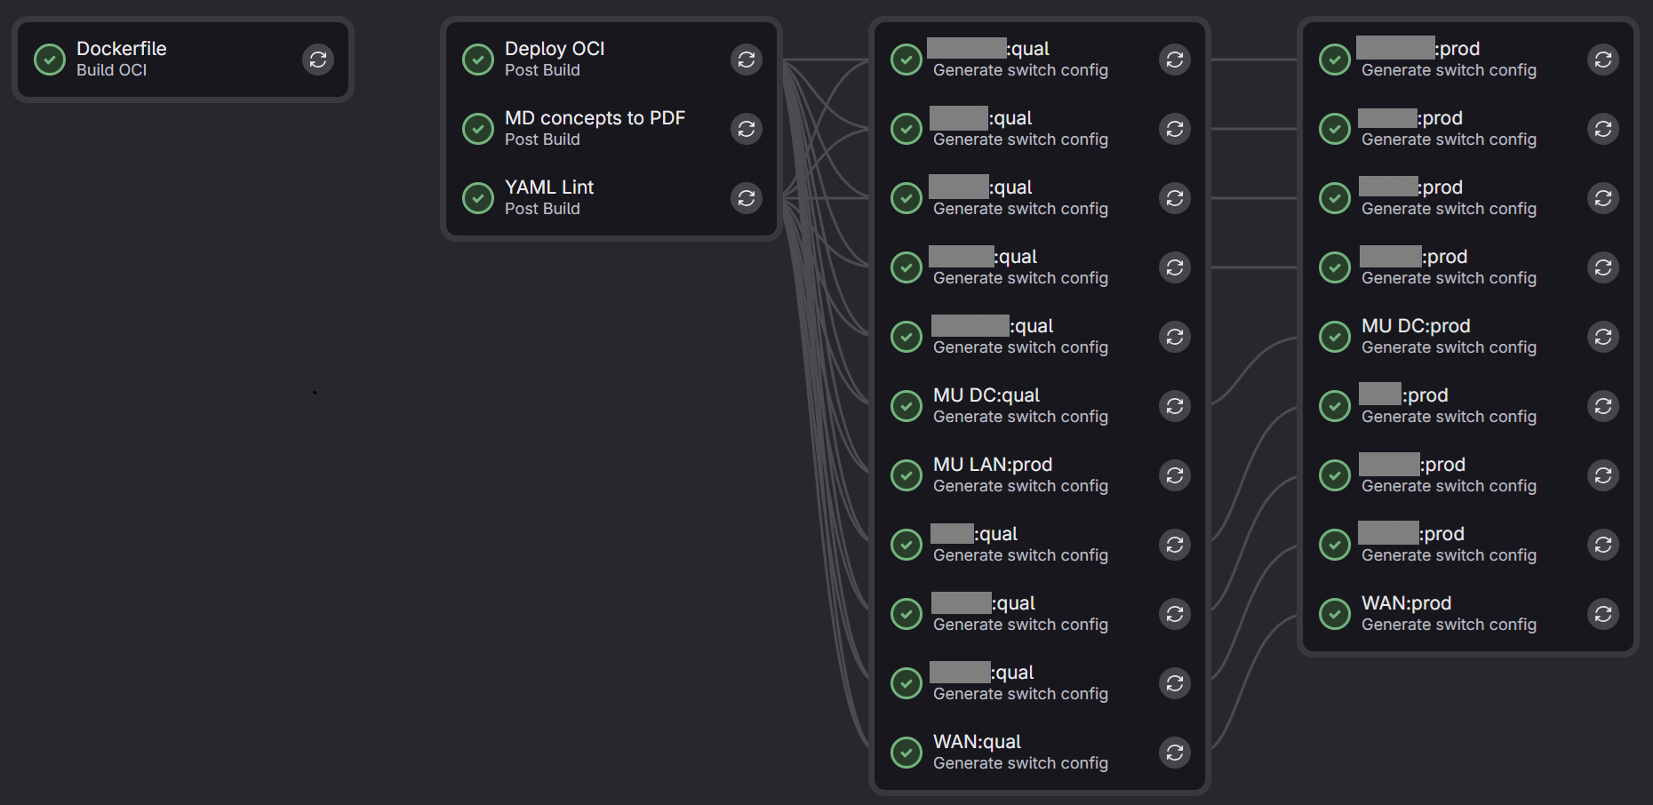
GitLab CI Pipeline

Slide 20
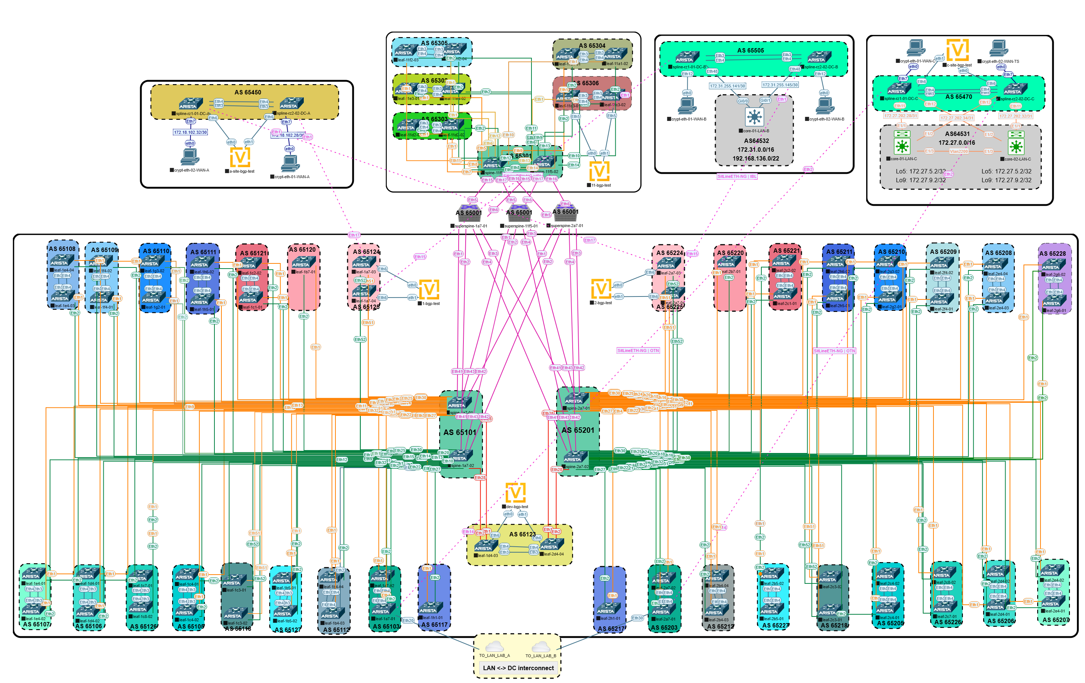

Slide 21
Scaling Tips
2-byte ASN vs 4-byte ASN (BGP RD field is only 32-bit)
IP addresses for MLAG peer links
  choose wisely, e.g., 169.254.0.0/31. Renumbering is painful
  They could conflict with customer IPs in a customer VRF
Automated documentation
GitLab runners
DC, Campus, WAN — you name it. They are all just tenants on our network
Think BIG

Slide 22
Lessons Learned
“Not many Day-2 operations” turned into a fast-evolving, service-provider-like network
Always test changes in a QA environment — even the smallest change can open the gates to STP hell
We spend 80% of our time in the QA environment — use proper servers
Do not forget legacy 100 Mbps equipment SFP-10G-MRA-T
Ansible AVD evolves quickly — update frequently to save time in the long run

Slide 23
Questions?

