Slide 1


How Workflow-Driven Automation Becomes Operable
Henry
under Air Gap and Compliance Constraints
Notes:
Speaker Henry:
> Today we wan’t to share the automation case that we developed over the last months together at 50 Hertz in our session “How Workflow Driven Automation Becomes Operable under Air Gap and Compliance Constraints”
> Before we start, just a short introduction of ourselves

Slide 2


Who we are?
Henry
Christian Miene
Network Automation Engineer
Henry Ölsner
Principal Technical Consultant
Notes:
Speaker Christian:
> Christian Miene. I work as an Network Automation Engineer and Architect focussing on automation and operations at 50 Hertz
Speaker Henry:
> My name is Henry and I work as a Technical Consultant focussing on Automation & AI projects at NTT DATA and with me is
Speaker Henry:
> Before we dive in, I want to tell you about my first meeting at 50 Hertz when that kicked off the automation effort back in 2024

Slide 3
The first meeting...
Henry
Notes:
Speaker Henry:
> we want to start with the first meeting that I attended
> Christian, what was the goals?

Slide 4
The first meeting...
Christian
“We want to automate our brownfield environment within our critical infrastructure”
“We have a lot of existing python scripts on our backup server that we need to operate”
“We developed a reporting web-app that needs to be deployed”
Notes:
Speaker Christian:
> In the first meeting, we got three Topics
> - Brownfield Automation
> - Assess existing automations that were in place
> - deployment of a python based web app that was created for reporting
> Sounds fairly straight foraward, right? This was my first contact with the clients environment and I had no clue

Slide 5
Let’s deploy it quickly on Friday
Christian
Notes:
Speaker Christian:
> Lets deploy the app on a friday around 18 Months ago

Slide 6
Let’s deploy it quickly on Friday
Henry/Christian
No connectivity to GitLab
The python application requirements vs. legacy enterprise repository versions
air-gapped installations → Wheels → transitive dependency chain
Insufficient permissions to resolve dependencies
Notes:
(Dialog between Henry and Christian where we Henry face the limitations of critical infrastructure first hand)
dialog:
H: Okay, let´s deploy quickly our reporting Tool and after it the closing of this week
C: Okay, we will try it
H: Can you already prepare a git clone to the server?
C: There is no connectivity to Gitlab, but i will manage it via SSH
...
C: Oh, Django 5 does not support python3.9
H: Okay, let´s install python3.10
C: It´s not part of the Remote Repo and i don´t have rights to install it
H: Hm... okay, we will downgrade the App to Django 4.2?
C: Django 4 installed, but now asgiref is missing
H: okay, install it directly via PIP
C: no Pip install possible
H: okay, we will install it via Wheel from an internet-connected server
C: Okay, for the installation via Wheel sqlparse is needed
H: ...
C: cryptography failed because of OpenSSL on the server
H: okay, we cannot install newer version of OpenSSL on the server because of missing rights?
C: yes
H: okay, let´s install python-ldap via Wheel
C: okay, gcc failed , something with openldap-devel
H: okay, we need a break

Slide 7
What is the environment?
Christian
Notes:
Speaker Henry:
> We got it finally somehow working, but we need a better foundation for the automation system going forward
> Christian, do you want to introduce the company and environment that you’re working in?
(Handover Christian)

Slide 8
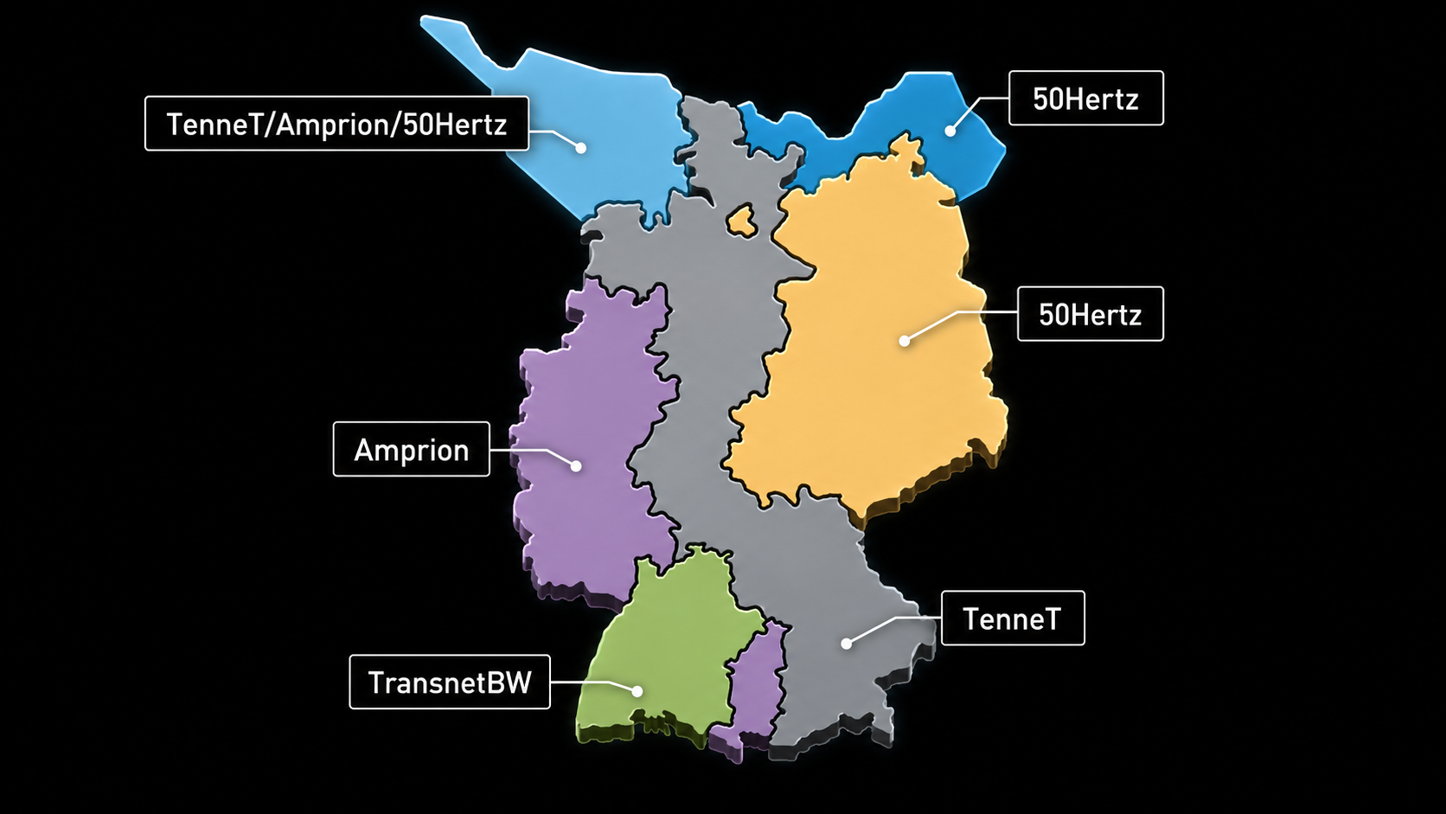
50Hertz Transmission GmbH
Christian
Transmission System Operator (TSO)
Operates critical high-voltage energy infrastructure
Part of Germany’s Critical Infrastructure

Slide 9
50Hertz Transmission GmbH
Christian
around 4,000 IT infrastructure devices: routers, switches,
firewalls, load balancers, proxies, DDI, etc.
6 Network Zones/Domains (critical/non critical)
Notes:
Network Zones → physically separated!

Slide 10
The Operational Constraints
Christian
Air-gapped
environment
Brownfield
Network
Limits connectivity
and access
Strict
Compliance
Integrates new
within existing
Ensures integrity and
safety

Slide 11
Where we are today?
Christian
Notes:
Speaker Christian/Henry?
> Where we are now, around 18 Months later?

Slide 12
5 | 4 | 719
Christian
Team Members
Apps
Workflow Executions
106,654
Sub-process executions
As of 29.05.2026
Notes:
show the numbers and results of the effort so far

Slide 13
Implemented Use Cases until Today
Christian
VM Network
Rollout
CMDB
Synchronization
802.1X
Migration
MPLS VRF
Rollout
Data Center
Self-Service Portal
Setting up VM networks with end-to-end connectivity and documentation
Aligning CMDB with
management and
monitoring tools
Automating the
migration to 802.1X
authentication
Rollout of MPLS
VRFs for WAN network
segmentation
self-service portal for
switch port configuration and checks
Notes:
Brief description of the implemented workflows

Slide 14
How did we get there?
Henry
Notes:
Describe how we get there

Slide 15
Where our automation journey started
Henry
python scripts like test_final.py
Large unmanaged log files
Manual SSH sessions
Regex-based parsing
Undocumented cron jobs
What We Had
Use-case inventory in Excel
Classification and grouping
Prioritization by business value
First stakeholder: server team
How We Started
Notes:
Where we started
KEY: For the first fairly large use-case we got the server team onboard which supported us with servers, a container registry and ways to deploy services reliable within the infrastructure
KEY: Question is, how to interact with the automation system?

Slide 16
First use case: server connectivity automation
Henry

Slide 17
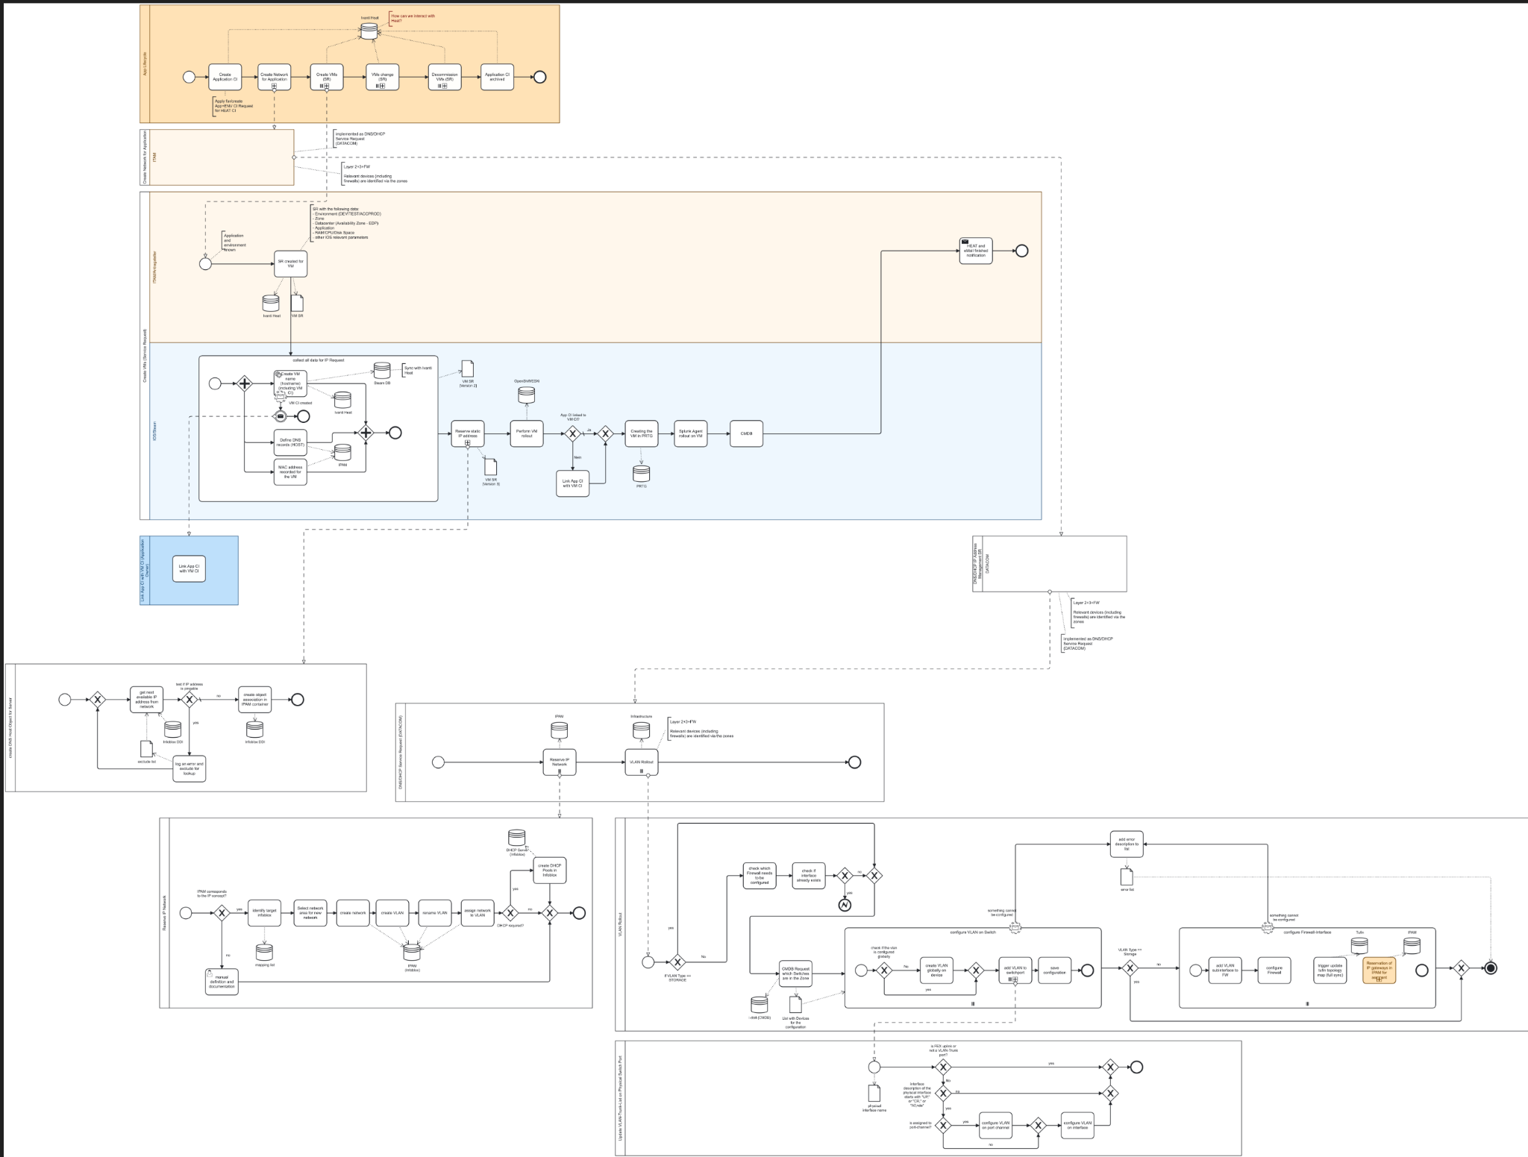
Henry
Notes:
> Just briefly to get an impression, on how complex and distributed the process was at the end

Slide 18
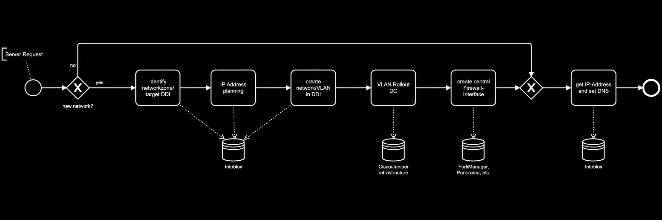
First use case: server connectivity automation
Henry
Notes:
> That is the first use-case, fairly straight forward

Slide 19
First use case: server connectivity automation
Henry
CI/CD Pipeline
Ticket System
Server Connectivity Use Case
Firewall Orchestration
Cisco NX-OS Switches
DDI Service
Asset Database
Notes:
Who are the end users of the automation?
triggered by Ansible
REST API for Operators
initial perspective on the usage of the system
Day-2 Operations in mind
IMPORTANT: initial mentioning the User Experience and Ansible - first it was only consumed by another automation system and the operators

Slide 20
First use case: server connectivity automation
Henry
CI/CD Pipeline
Ticket System
Server Connectivity Use Case
Firewall Orchestration
Cisco NX-OS Switches
DDI Service
Asset Database
We need a development team!
Notes:
KEY: We develop a custom solution > we need a dev team

Slide 21
How the platform looks today
Henry
Notes:
Speaker Henry:
> lets take a look under the hood

Slide 22


Platform Architecture
Henry
Service Management & Ticketing
Other Automation Systems
Management Environment
Consumers of the Platform
DATACOM Infrastructure Network Automation (DINA)
Logging & Monitoring
Infrastructure and IT-Systems
Security & Firewall Orchestration
Network Devices & Controllers
CMDB
DDI
...
Notes:
> one key system inbetween that serves as the gateway for the automation
> auditability and operational support is key (internal within 50Hertz - critical environment network zone)

Slide 23


Platform Architecture
Henry
Service Management & Ticketing
Other Automation Systems
Management Environment
DATACOM Infrastructure
Network Automation (DINA)
PRTG Infrastructure Automation (PIA)
Automation Gateway (DAG)
Infrastructure Reporting Tool (DIRT)
Data Collector (DACO)
Security & Firewall Orchestration
Network Devices & Controllers
CMDB
DDI
...
Notes:
> Deeper explanation
KEY: Mention the DACO as the “Intent-Translator” - this helps a lot while developing the environment because of the decoupling of the systems
KEY: Data access now solved, lets continue with some first view on how the system look like

Slide 24
Platform Principles
Henry
Notes:
> After the bootstrapping of the platform, the following principles emerged

Slide 25
Platform Principles
Henry
Air-gapped by design
Build once, deploy unchanged
Notes:
> After the bootstrapping of the platform, the following principles emerged

Slide 26
Platform Principles
Henry
Air-gapped by design
Build once, deploy unchanged
Operations and scalability first
Distribute workload execution with Django and Celery
Notes:
> After the bootstrapping of the platform, the following principles emerged

Slide 27
Platform Principles
Henry
Air-gapped by design
Build once, deploy unchanged
Operations and scalability first
Distribute workload execution with Django and Celery
Usability drives adoption
Design every workflow from the end-user perspective
Develop without live-system access
Enable fast iteration during development
Notes:
> After the bootstrapping of the platform, the following principles emerged

Slide 28
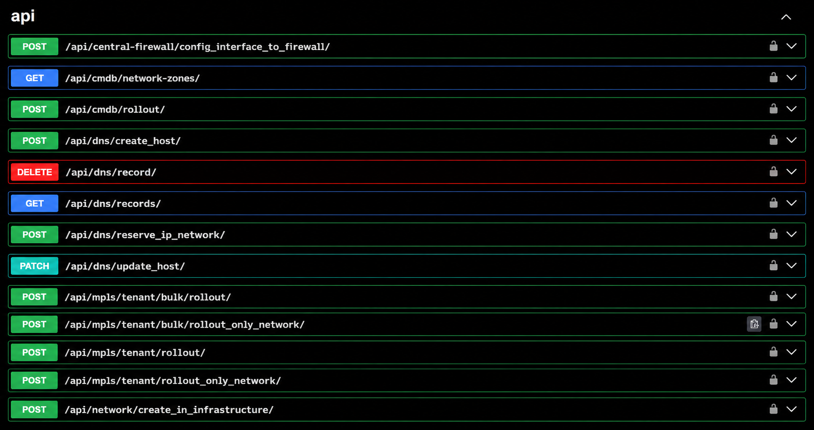
Henry
Swagger UI
Notes:
> Until now, it’s just an API Gateway that is triggered by Ansible - fairly straightforward

Slide 29
Scaling-out: from use case to workflows
Henry
Notes:
> We got the first use-case and everything went good
> Got some attention within the organization - new use cases and end users are onboarded

Slide 30
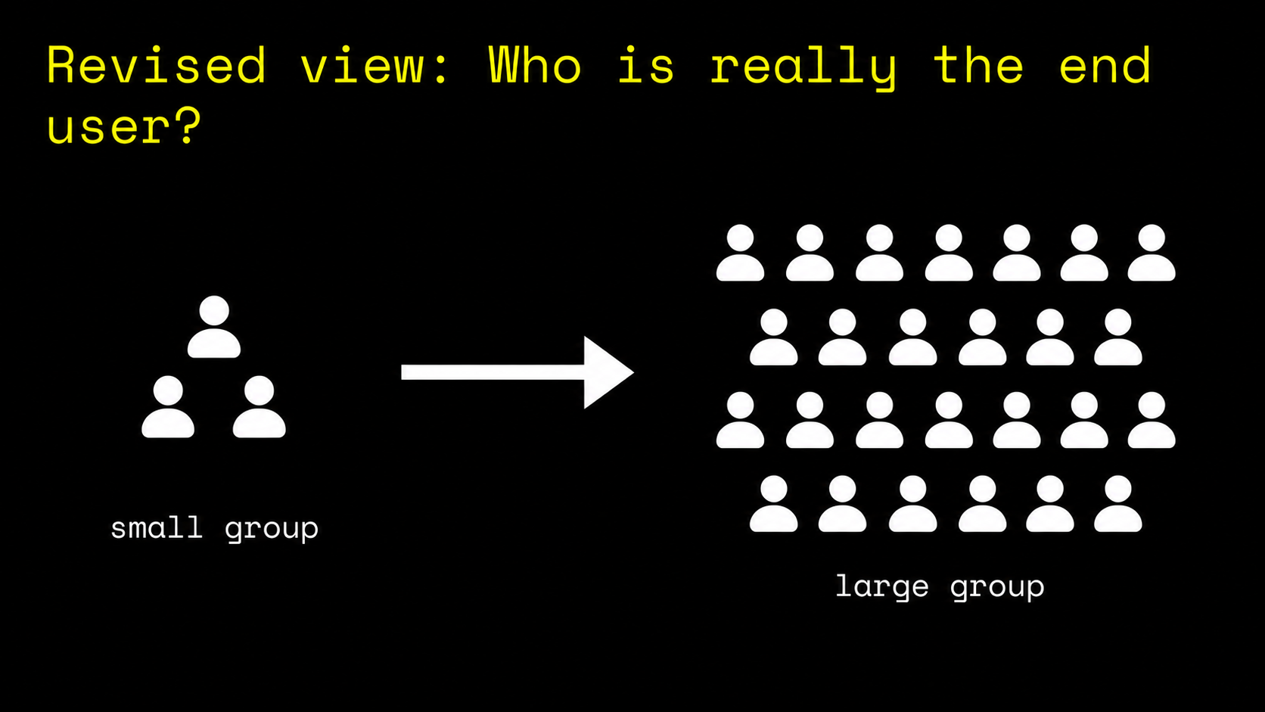
Revised view: Who is really the end user?
Henry
Other automation systems and Ansible playbooks
Network Engineers/Operators and Support Staff
Notes:
Three challenges we face when scaling the system:
Common understanding of the requirements
Tailored solutions (migration scripts vs. day-to-day use)
Skill requirements for interaction
> Initially, we just required an API gateway
> Ansible skills and also the handling within the management area were not that intuitive
> - users start to use the components (DAG, DACO etc.) directly
> - other users are hesitated to use an API
KEY: we need an frontend
—
The “Ansible assumption 2
“We don’t need a frontend” - Really?

Slide 31
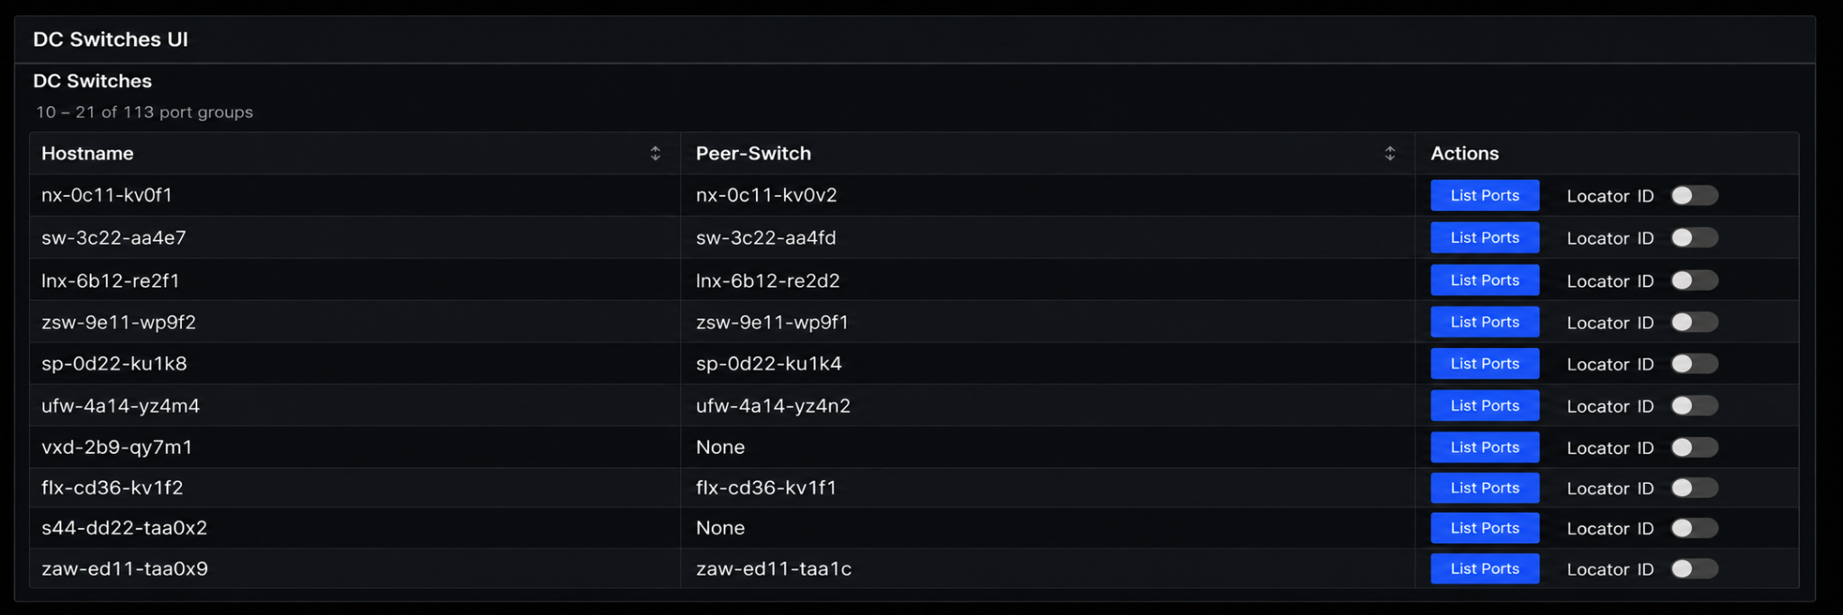
Data Center Self-Service Portal
Henry

Slide 32
From Use Case to Workflow Contracts
Henry
Notes:
KEY: How to ensure that the team is building the right things? > Workflow Deinition Documents

Slide 33




From Use Case to Workflow Contracts
Henry
Timebox for Release
Weekly Standup
Iteration
Stakeholders
Definition of Done
Workflow Definition Document
Platform Development
Team
Platform
Owner
Stakeholder Review
Automation Backlog
Iteration Backlog
Platform Release
Planning
Release Version
Notes:
KEY: Continuous Effort within the organization based on the WDD

Slide 34
From Use Case to Workflow Contracts
Henry
Timebox for Release
Weekly Standup
Iteration
Stakeholders
Definition of Done
Automation is continuous organizational effort
Workflow Definition Document
Platform Development
Team
Platform
Owner
Stakeholder Review
Automation Backlog
Iteration Backlog
Platform Release
Planning
Release Version

Slide 35
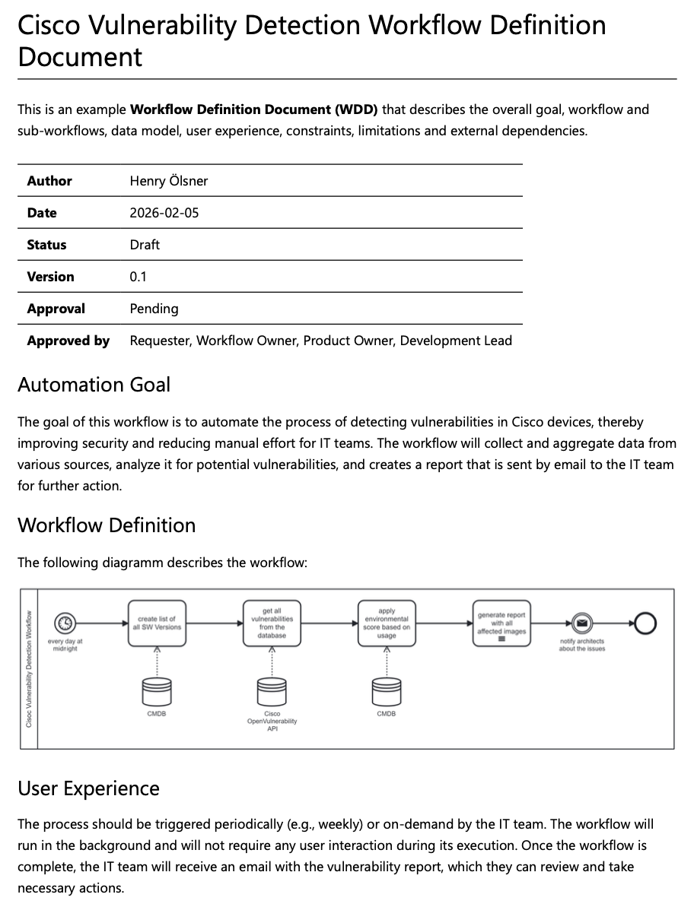
From Use Case to Workflow Contracts
Henry
One shared Workflow Definition Document (WDD) per use case
Contents:
  Goal and KPI
  Workflow Definition (BPMN)
  User-Interface Design
  Data Models and Interfaces
  Constraints
  External Dependencies
  …
Notes:
KEY: How to ensure that the team is building the right things? > Workflow Deinition Documents

Slide 36
From Use Case to Workflow Contracts
Henry
One shared Workflow Definition Document (WDD) per use case
Contents:
  Goal and KPI
  Workflow Definition (BPMN)
  User-Interface Design
  Data Models and Interfaces
  Constraints
  External Dependencies
  …
Goal: Create a shared understanding on what to build
Notes:
KEY: How to ensure that the team is building the right things? > Workflow Deinition Documents

Slide 37
Key Takeaways
Henry

Slide 38
Key Takeaways
Henry
Requirements engineering and workflow contracts
align users, operations, and audit needs
Automation is continuous effort that requires control, operability,
and governance, not tools (in the first place)
Workflow automation must shape the IT operating model and system landscape
Agile delivery balances reviewability,
compliance, and urgent operational demand.

Slide 39
What's next?
Henry
New Workflows
Operational Workbench
On-Premises Coding Assistance
AI Model Hosting
Notes:
Next Workflows:
Device Onboarding und Provisioning
Configuration Compliance Checks
Device Discovery
Evolution of the System
Frontend for one group, APIs and scripting for another
The platform evolves from a tool to an operational capability
provide a development environment for operations
Automation will be integrated to organisation within next year
Hosting of Language Models to:
Code completion (AI-assisted Development)
Refinement improvement (e.g. WDD Agent)
Agent-based Development and Operations (e.g. Goose)
User-Support for custom One-Time Use-Cases (Chat Assistant)

Slide 40
Questions?
Henry

Slide 41
Thank You
Henry

