Slide 1
Lessons Learned Testing Network Automation Solutions
Observing Sturgeon’s Law in Virtual Labs
Ivan Pepelnjak (ip@ipSpace.net)
Network Architect
ipSpace.net AG

Slide 2



Who is Ivan Pepelnjak (@ioshints)
Past
  Kernel programmer, network OS, and web developer
  Sysadmin, database admin, network engineer, CCIE
  Trainer, course developer, curriculum architect
  Team lead, CTO, business owner
  SDN skeptic and network automation evangelist
Present
  Network architect, consultant, blogger, open-source developer
Focus
  SDN and network automation
  Large-scale data centers, clouds, and network virtualization
  Scalable application design
  Core IP routing/MPLS, IPv6, VPN
Also: I built too many labs for one lifetime, and hated that with passion

Slide 3
The Challenge

Slide 4

Imagine You Would Have a Tool That Would…
  Take your high-level intent in
  infrastructure-as-code format
  Do IPAM and network design for you
  Generate device configurations
  Deploy a running virtual lab
Trivial example:
  Three-router SR-MPLS network running
  Arista EOS
  IS-IS as the IGP
SID: 1
SID: 2
SID: 3
PE1
P
PE2
topology.yml
provider: clab
defaults.device: eos
module: [ isis, sr ]
nodes: [ pe1, p, pe2 ]
links: [ pe1-p, p-pe2 ]
More @ https://netlab.tools/

Slide 5
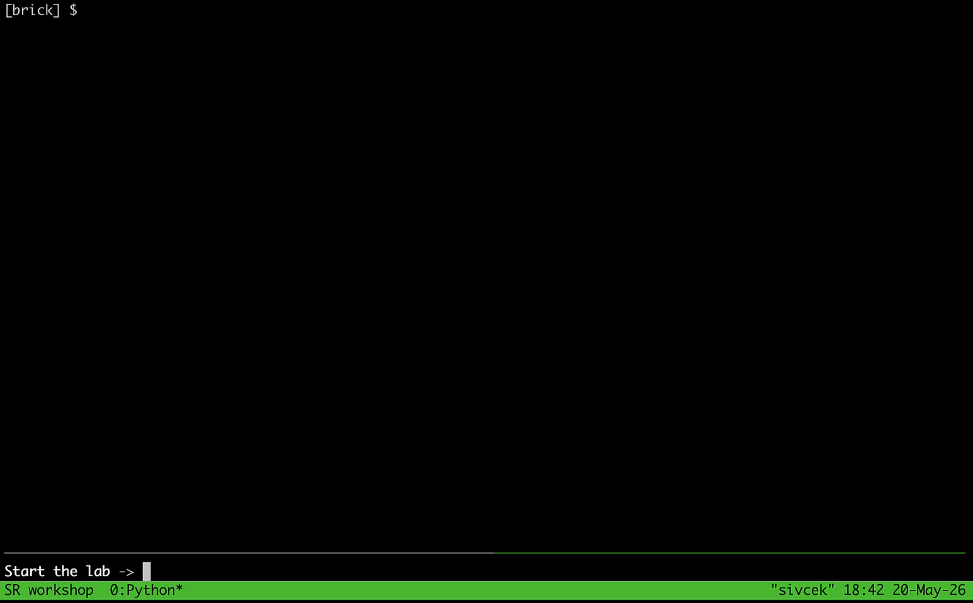
A Working Lab in 30 Seconds

Slide 6
How Do We Know It
Works Correctly?

Slide 7
Behind the Scenes

Slide 8


High-Level Architecture Seems Complex…
netlab
create
Topology file
Plugins
Modules
Defaults
CLI arguments
Data model transformation
Transformed topology
snapshot
Orchestrator
configuration
Device
configurations
Ansible
inventory
Prepare virtual infrastructure
Start the lab
Adjust networking infrastructure
netlab
initial
Deployment task lists
Ansible playbook

Slide 9


But It Matches Every Decent Service Deployment Automation Project
High-level Intent
  Lab topology specifies high-level intent
  netlab transforms the lab topology into device-level data structures
  Jinja2 templates are used to transform device-level data structures into device configurations
  Configuration snippets are deployed to network devices (yay, Ansible 😩)
We need more than that to have a lab solution
  The lab has to be started and stopped
  netlab has to create some glue around the lab
  A few lab management/reporting functions
Magic (aka Business Logic)
Device-Level Data
Configuration Templates (or YANG magic)
Device configurations
Configuration deployment

Slide 10
Testing Methodology

Slide 11

Transformation Tests
  No traditional unit tests
  Transform predefined lab topologies into device-level data or error messages
  Compare results with expected results
How Does It Work?
  Tests the whole transformation logic
  Input lab topologies drive testing of individual features
  Expected results are stored in YAML format for trivially easy diffs
  Whenever code changes the expected results, the new results have to be part of a PR
  Changes in expected results are reviewed manually
Scope of Transformation Testing
  ~100 transformation tests
  ~100 error tests
  Additional test to improve code coverage

Slide 12

Integration Tests
How Does It Work?
  Start a lab topology with one or two devices under test (plus attached hosts and probes)
  Wait for devices to boot
  Use probes (usually FRRouting containers) to check the expected device behavior
  Most checks are done with show something json commands
Validates
  Jinja2 templates
  Device configuration syntax correctness
  Expected behavior of configured devices
Scope of Integration Testing
  Over 25 test suites
  Over 250 individual tests
  Executed on ~30 different devices ➔ requires over 3700 labs instances
Sad Reality
  It takes days to go through all the tests
Integration test results @ https://tests.netlab.tools/ and https://release.netlab.tools/

Slide 13
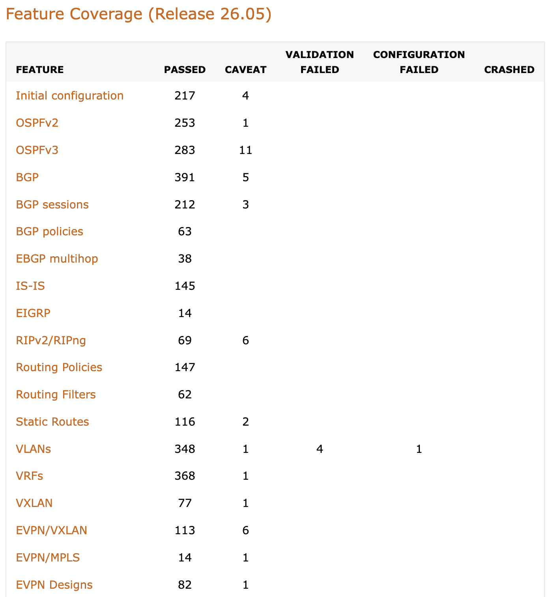
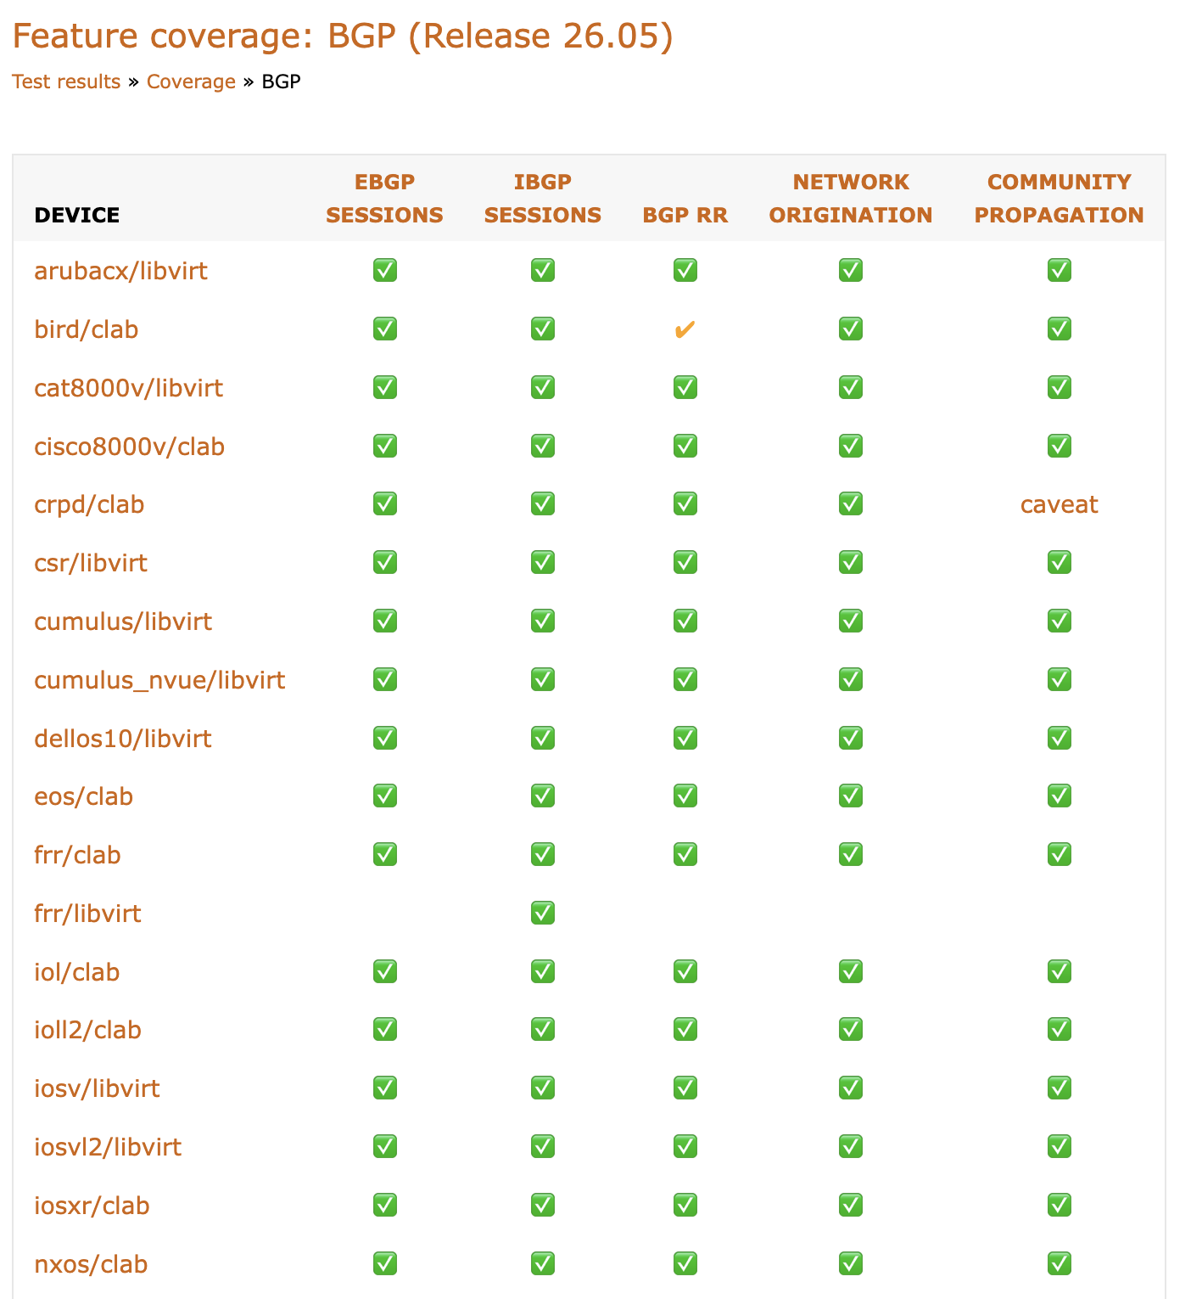
Sample Integration Test Results

Slide 14
Using pre-commit and GitHub Actions for Fun (and No Profit)
Pre-commit hook (on the user workstation)
  Cannot be enforced
  yamllint, ruff, mypy checks
  Some transformation/error tests
On Git Push (GH Action)
  Same as pre-commit hook
  Additional tests for code coverage
  Executed for all supported Python versions
On Pull Request (GH Action)
  Even more testing than on Git Push
  Can take longer (changes will have to be reviewed anyway)
  Includes transformations of all integration tests
Integration testing (on a dedicated server)
  Start manually (takes hours)
  Executed for specific devices/features before merging a PR
  Usually run for all fully-supported devices before a new release goes out

Slide 15
Integration Tests: Lessons Learned

Slide 16
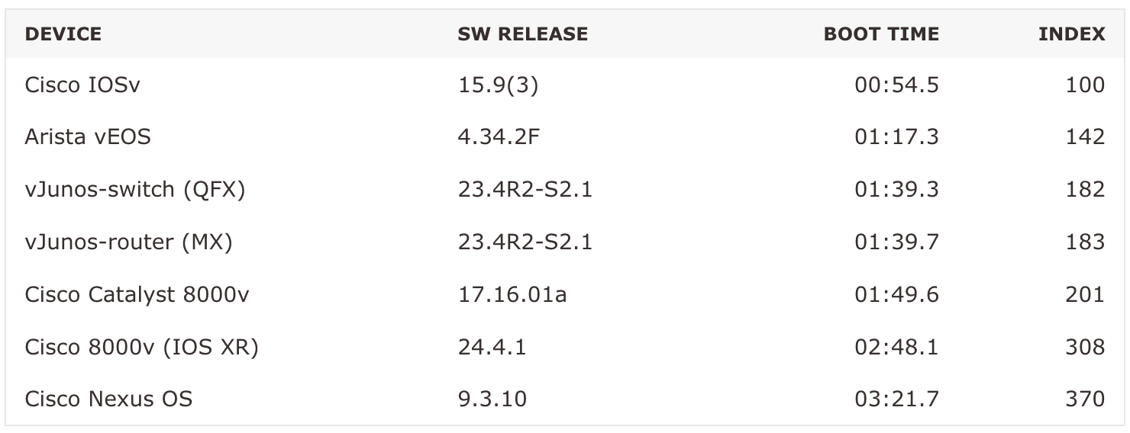

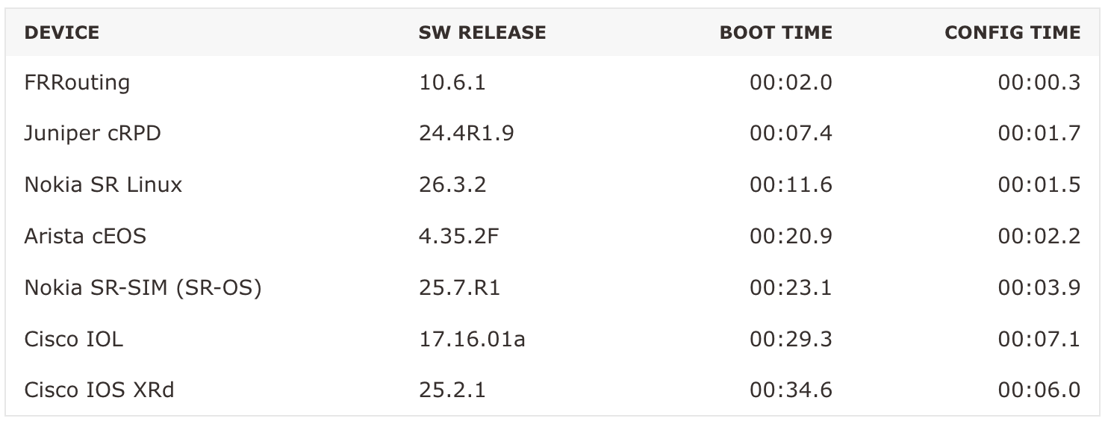
It Takes Forever to Start a Lab (without Native Containers)

Slide 17
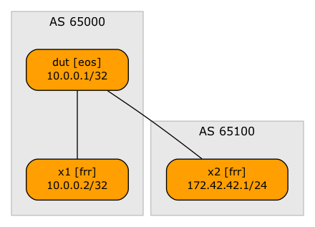
Multi-Platform Testing Is Really Hard
Challenges
  Cannot write tests that would parse show printouts for ~20 platforms
  IETF YANG models are still a pipe dream
  SNMP sucks
Solution
  Execute show commands (with JSON outputs) on devices attached to the tested device
  Indirectly validate configurations through observed protocol behavior
Lessons Learned
  Make sure you’re checking the relevant behavior (example: OSPF network type)
  Test small chunks of functionality (ideally a single feature)
  Build a sequence of tests, each one relying on previous tests checking prerequisite features
The Never-Ending Pain
  We have to reboot devices (start new labs) across tests and that takes forever
  Some devices take their sweet time to wake up
  Routing protocol adjacencies sometimes take longer than expected
  Beware of devices having fixed post-boot timers (example: Cisco IOS originating IPv6 BGP prefixes)

Slide 18
You Wouldn’t Believe The Network OS Bugs We Found
The Interfaces Aren’t Ready Yet
  Junos VMs start, but the interfaces are not there yet (but can be configured)
  Nexus OS VM starts and rejects interface configuration (for up to a minute)
We Love Stupid Bridges
  Cisco IOS L2 and Extreme EXOS boot as stupid bridges (all ports in VLAN 1)
  Arista cEOS is configured that way by containerlab
Has Anyone Ever Tested This?
  DHCP client does not work on Junos mgmt interface
  Cannot reach SSH server on Dell OS10 mgmt interface
  Linux bridge ports can get stuck in Learning state
Can We Count?
  VXLAN VNI is 16 bit long on Aruba CX VM
  Invalid IP checksum in VXLAN packets on Aruba CX VM
  Junos accepts wide IS-IS metrics and advertises large values as 63
This Can’t Possibly Be True
  Most OSPF NSSA implementations are somewhat broken
  We can’t decide how to calculate VRRPv3 checksum
  Every vendor uses slightly different EVPN/ARP defaults
  We also can’t agree on MPLS entropy label with EVPN
  Cisco IOS has two MAC addresses per port (one for L3 interface, one for switchport)
  Cisco IOS XR sends a single OSPF hello on passive interface
More @ https://blog.ipspace.net/tag/netlab/#quirks

Slide 19

Questions?
Documentation: netlab.tools
Blog posts: blog.ipspace.net/tag/netlab.html
Source code: github.com/ipspace/netlab
Examples: github.com/ipspace/netlab-examples
Sample project: bgplabs.net (BGP labs)
isis.bgplabs.net (IS-IS labs)
evpn.bgplabs.net (EVPN/VXLAN labs)
To reach me
Web: ipSpace.net
Email: ip@ipSpace.net
Use GitHub issues / discussions to ask netlab questions and report challenges

