Slide 1

Practical Network Reliability Engineering
John Howard - Head of Network Infrastructure @ Proton AG
Applying NRE principles in a real network for fun and profit!
Notes:
Hello to you all, its my great pleasure to open this leadership track with a topic that is close to my heart. So thank you NAF Daddies for giving me the opportunity to kick off the thort leadership with a discussion about Network Reliability Engineering in a Practical sense.

Slide 2

whoami
John Howard (@fatred)
Head of Network Infra @ Proton (home to ProtonMail, VPN, Pass, Drive and Docs)
20y+ “experience” automating networks (with varying success)
Professional ranter
#OfficeHours-EMEA co-host (with Bart Dorlandt)
Notes:
I am John Howard, Head of Network Disruption @ Proton.
Home of Mail, VPN, Pass and many more in our ecosystem,
Our Mission is to Make privacy the default on internet. If you want to know more, feel free to acost me in the hallways.
Proton is therefore a webscaler, and i have been there for the last 5 of my 20ish years in this industry.
“webscaler” is just a fancy way of saying “cloudscaler without the headcount or the budget”. The demands are the same, but the resources are not.
Lets open this discussion with a spicy take:

Slide 3
🌶️ HOT TAKE 🌶️
✨SNMP✨
10 min alert lag
Syslog parsing
Networks are some of the most under-invested critical systems on the planet.
Hardware that can legally drink
Superhero syndrome
2am maint slots
Notes:
Networks are the most under-invested critical systems on the planet.
SNMP polling every 5 mins.
Meaning a 10-min alert lag.
Regex-ing syslogs (assuming theyre centralized at all!).
Its not all technical either
Superhero syndrome (I can fix anything!)
2am maintenance slots (hello burnout my old friend
Hardware is so old it "can legally drink"
Begs the question: If networks are critical, why do so many of them suck?

Slide 4
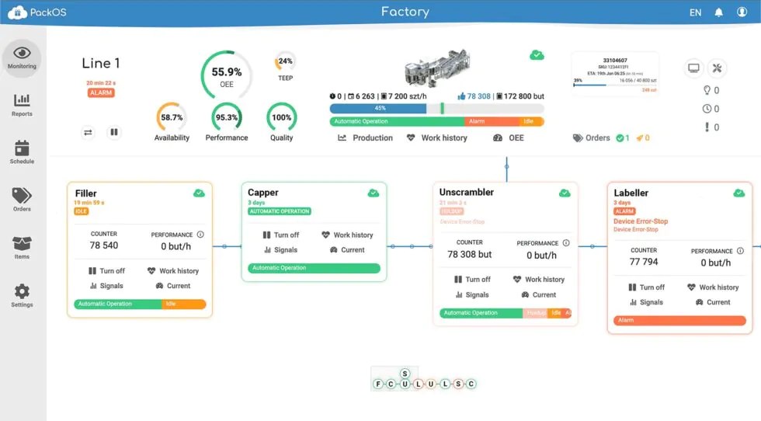
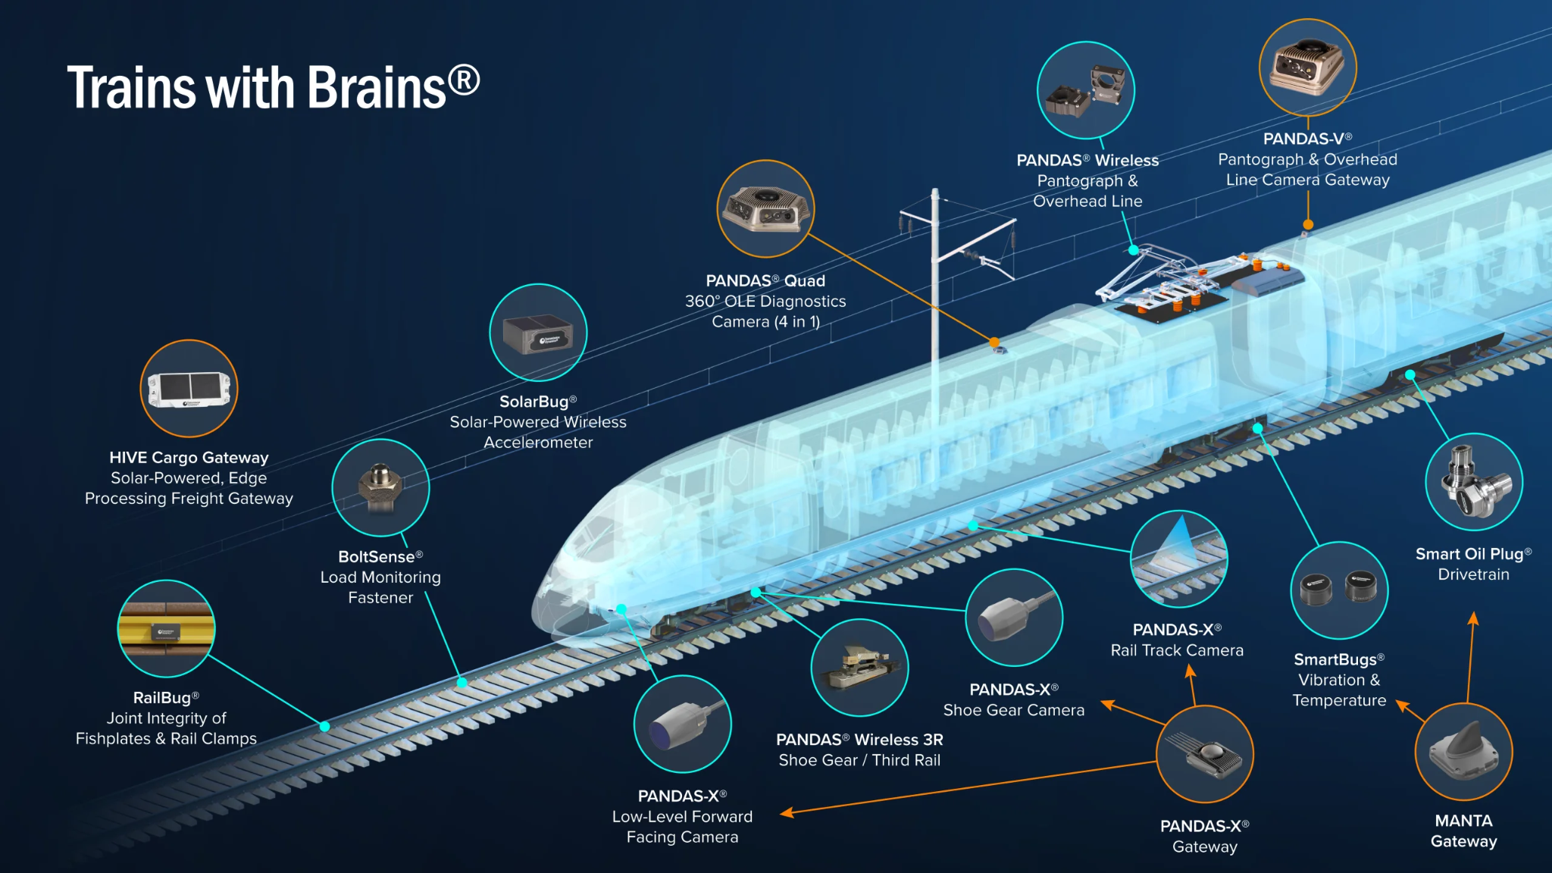
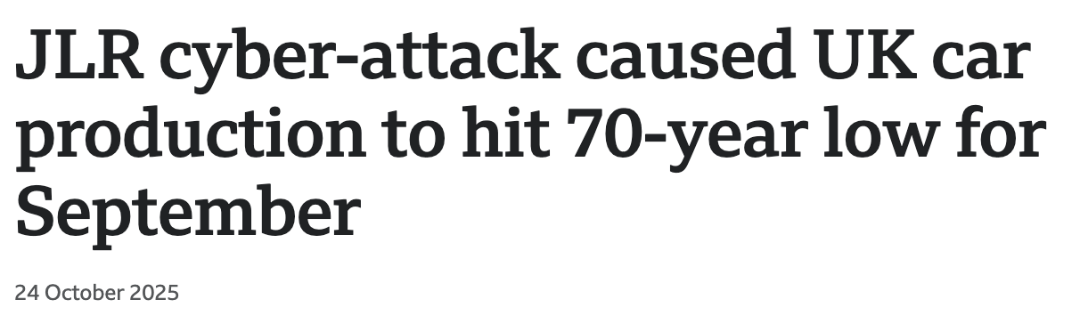
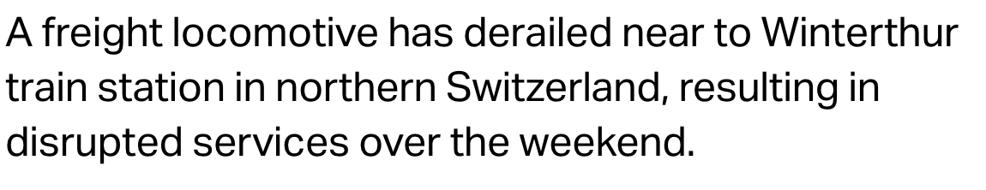
🌶️ HOT TAKE 🌶️
WHY DO WE TREAT OUR NETWORKS DIFFERENTLY?
Real time data
Customised tooling
Persistent high utilisation
Reliable forecasting
Notes:
Compare this now to similar critical networked systems like Manufacturing or Public Transport.
Manufacturing: Production lines depend on telemetry and feedback to run a max capacity non stop. One component error is a literal log jam to the system. Downtime is money,
But also rare enough that when it happens its front page news.
Transport (ok, I live in CH so im probably biased): lines are constantly Observed, route changes planned and updates propagated instantly, capacity managed, users proactively informed. Mistakes can be catastrophic.
But again they rare enough that theyre front page news too.
So. Why do we treat OUR networks differently?
I believe that NRE pushes us in the right direction

Slide 5

What is this NRE buzzword?
First(?) defined by Matt Oswalt and James Kelly (then of Juniper) at ONS 2018
Merge of ideas from DevOps and Google’s SRE
Pivots the mindset from
monitoring and operating on
individual network components
to services and availability
Notes:
So what even is NRE?
Originated at Open Networking Summit in 2018: presented by Matt Oswalt & James Kelly (Juniper).
The original presentation is pretty good, so scan the code and read the slides.
Concept: Merge of DevOps + Google SRE.
Mindset Shift: Network is not a service to operate; it is a provider of services.
Net Result: Changes the relationship with our consumers, and thus how we operate our network.
But if you want a TLDR? Ask the internet:

Slide 6
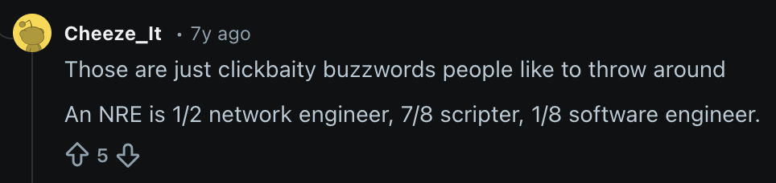

The internet speaks…
…ish
Notes:
I dunno about you, but when i want high quality analysis, i turn to reddit. So Lets check in with the internet’s brain trust for the thoughts of Leading industry expert,
Cheese_It.
Those are just clickbaity buzzwords, an NRE is ½ network engineer, ⅞ scripter and ⅛ software engineer. Well this is Europe buddy so ill ask you to convert that to metric if you please. But anyways.
Not really a perfect description, but i will come back to this later perhaps.
The main thing is all this is years old now. If its so good, why am I here shilling for it? Well, in truth, it went as quickly as it came.

Slide 7
Why did it disappear?
Accusations of Marketecture:
  Juniper centric (cynical?)
  Automation heavy (in 2018…)
  NetEng are CLI addicts (see Andy @ ac4)
“move fast and break things” is antithetical to network operations
SLI/SLO concepts were poorly defined and hard to implement in SNMP era
Notes:
Why did it disappear?
Initial Reaction: from the Community - skepticism.
"Just Juniper marketing" (which i think is cynical even by Greg Ferro standards)
"Too much automation" (understandable by 2018 standards).
"NetEng are CLI addicts." (Just ask Andy Lapteff)
Why it faded out:
"Move fast and break things" is not how we roll in network engineering right?
What _gave_ devops the right to be disruptive, was the ability to show that the impact was so constrained or hidden, that its ok.
Ways to observe your Service Level Indicators and Objectives were obscure or missing and far too laggy to be effective for this purpose.

Slide 8

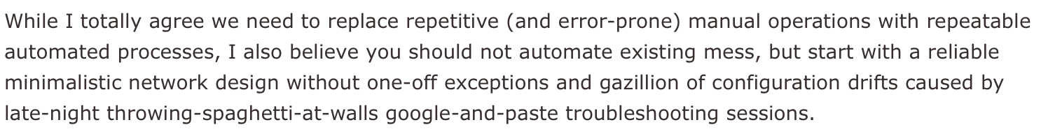

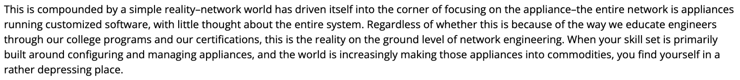
Why did it disappear?
Fix it before you automate it
AUTOMATING CHAOS IS BUSY WORK
https://blog.ipspace.net/2020/06/network-reliability-engineering-more-than-automation/
Think system not boxes
https://rule11.tech/is-it-planning-or-just-plain-engineering/
Notes:
No only cheese_it: Ivan and Russ (sat right here) had thoughts, and neither were projecting confidence with their analysis.
For Ivan: he literally interviewed Matt Oswalt about the NRE concept, and surmised that the materials were good, but focus on automation and don’t acknowledge the reality of messy networks.
His core statement is: Fix design before automating.
For Russ: indirectly linked by Ivan in his blog above, he said in one section he laments that networking is being commoditized so far that its just speeds and feeds into generic boxes.
He then goes on to say “the entire network is appliances running customized software, with little thought about the entire system”.
His core statement is: “The whole system matters, its not just a collection of boxes”.
Or simply put: Automating Chaos is busy work. You look like you’re innovating, but really you're just spinning your wheels.
Having followed the NRE idea for quite some time, I had similar concerns, and it was Jeremy Schulmans presentation at AC0 that started the engines again, with AC1 being the first time I felt I had some clarity on where I wanted to go with this.

Slide 9
My definition of NRE
Focus on capabilities & services, not devices & protocols
Engineer resilience in, to make failure normal
Leverage telemetry to observe the network, not react
Iterate complexity & snowflakes OUT of the platform
Accelerate data driven decision making
Observability & Assurance don’t require SWEs
Notes:
Which leads me to my definition of NRE today.
Systems thinking means we should be looking at the whole of the system, understanding our surroundings, and applying our expertise to our corner of that system.
Our focus is on Capabilities & Services, not devices/protocols.
Resilience is the foundation: Engineer it in; make failure normal.
Telemetry is the tool: High-res data to observe, not just react.
Complexity is the enemy: Iterate it out of the platform.
Decision Making can then be Data-driven, not gut-feel.
As Ivan and Russ both implied, the and the history of talks from this stage have echoed, automating a network that is “overly diverse” is a fools errand
We must design to simplify first and only then, automate that. Observability and Assurance testing use scripting, but dont have to leverage Software engineering skillsets. Coding is just fine.
When your design is well codified, and your devices conform to it, building workflows for automated change processes which leverage live state - semi or fully autonomously - are much more likely to succeed.

Slide 10

I thought you said this was practical?
Notes:
But enough about the theory. Lets get down to business.
Ive said we need a systems approach, and the network is full of low level primitives
How do i zoom out from them - to the system - to build service level indicators and objectives, and make them visible?
Once i reach this nirvana, how can i then use these new insights to direct my work?
Lets start with composition

Slide 11
Service Composition
Service:
I have a 100G wavelength from DC1 to DC2 spanning 1000km
I have a 100G wavelength from DC1 to DC2 spanning 800km
Capability:
I can deliver packets from DC1 to DC2
I have 100G max redundant capacity from DC1 to DC2
I have 8-10ms latency expectation from DC1 to DC2
Takeaway:
Capabilities translate well to Service Level Indicators
Services are “thing” that provide & constrain the capability
I can build SLOs for capabilities easier than “the service”
Notes:
Here is a little example: Data Centre Interconnection.
Service: Two wavelengths for diversity. Different distances mean they offer different latency envelopes.
Capability provided: Packet deliverability (bool), Max Capacity (100G), Latency (8-10ms).
The point is that Capabilities translate easily to SLIs. I can write some prometheus alert rules for this - certainly more successfully than I can write SLIs for “a wavelength”.
Ultimately: We measure what the thing provides, not the hardware state.
This is a formula we can use across the datacentre. Where before we would think about BGP and interface up/down/rates, now we are looking at what that thing provides, and measuring that instead.
But we are getting a little ahead of ourselves. Platforms will only expose these low level primitives, and to produce a service metric we need to assemble these together. So lets look at what these components might be.

Slide 12
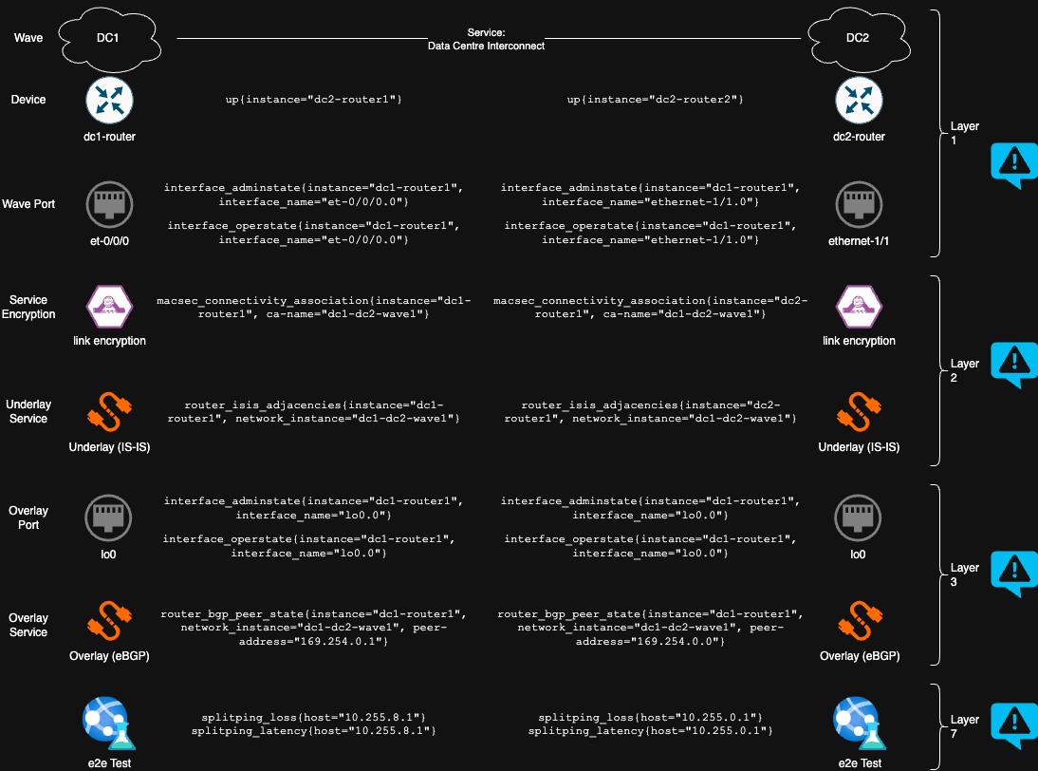
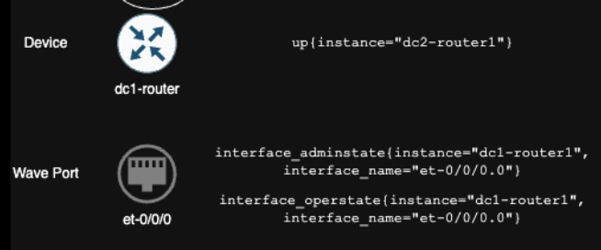
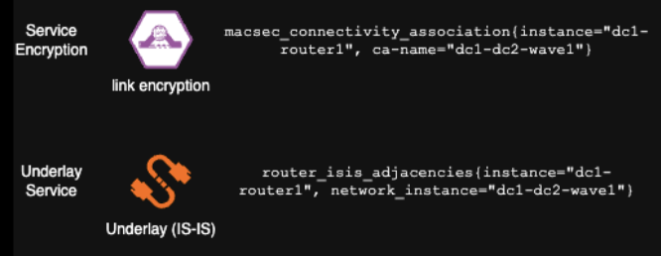
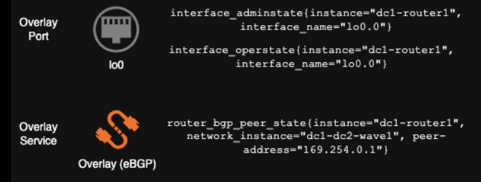
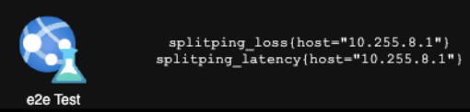
name: DCI DC1 DC2 MyISP
rules:
- record: dci_dc1_dc2_myisp_port_state
expr: min(interface_operstate{instance="dc1-router1", interface_name="et-0/0/0.0"}) or vector(0)
- record: dci_dc1_dc2_myisp_crypto_state
expr: min(macsec_connectivity_association{instance="dc1-router1", ca-name="dc1-dc2-wave"}) or vector(0)
- record: dci_dc1_dc2_myisp_underlay
expr: min(router_isis_adjacencies{instance="dc1-router1", interface_name="et-0/0/0.0"} == bool 1) or vector(0)
- record: dci_dc1_dc2_myisp_overlay
expr: min(router_bgp_peer_state{instance="dc1-router1", network_instance="dc1-dc2-wave", peer_addres="169.254.0.1"} == bool 1) or vector(0)
- record: dci_dc1_dc2_myisp
expr: dci_dc1_dc2_myisp_port_state + dci_dc1_dc2_myisp_crypto_state + dci_dc1_dc2_myisp_underlay + dci_dc1_dc2_myisp_overlay == bool 3 or vector(0)
1 2
3 4
5 6
7 8
9 10
11 12
13 14
15 16
17 18
19 20
Notes:
Here is a deep dive on the telemetry implementation of that same Composition. This is quite small, so zoom in as we go.
These layers reflect what telemetry provide from the device:
L1: Device Up/Down + Port Up/Down.
L2: Crypto service and ISIS Adjacency over that crypto
L3: Loopback state and the BGP overlay state
L7: ICMP/Application level Testing.. BUT
thats 10 metrics per site, 20 metrics per service.
All these are key for troubleshooting. But we need so elevate to the service - To do this, we use prometheus recording rules.
Tada: Recording rules to coalesce these into Service Level Entities. Not everything in that list of 10 objects matters when we consider the service chain and dependencies . We end up with rules reflecting OSI Layers 1, 2, 3 and 4.
Down the bottom here: One overall alert for me and the SLI - up/down? Same, these summaries are good for triage, but for SLO tracking, its this last recording rule, and the ping one behind.
So thats a hint for how we can decompose and reconstruct a service to a capability. Lets look now at the other key element to success not only with NRE, but with automation in general - design simplification.

Slide 13
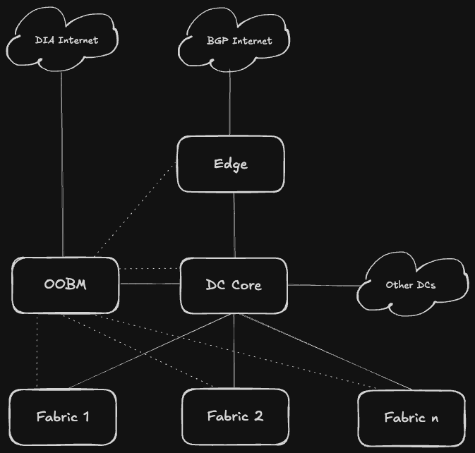
Design Composition
You can't automate complexity. Simplicity is the prerequisite.
EDGE
Internet boundary - does all the work of getting traffic in and out of the site
DC CORE
L3 transit between fabrics - Defines your scale limits too
FABRIC
L3 segmentation with VRFs, L2 segmentation with EVPN. Defines the blast radius for a user facing change
OOBM
Control plane access. Diverse hardware and connectivity from that which it manages.
Notes:
After a bit of work with a chisel and some sandpaper, we refined our network implementation to fit this pretty standardised model. If you think it looks like something out of Cisco in the 1990s, well, yeah, the hierarchical model got a lick of paint for the 2020s ;)
Thee blocks made sense for us, but you may have bery different ones, especially if you are in a different vertical.
Look at your infra, and block the assets you have together because they all do _a thing_ the same way.
This is the start of the cycle that breaks the mental model of device and instead thinks of role. So what are these roles?
Our 4 Blocks:
Edge: Internet boundary (Ingress/Egress).
DC Core: L3 block to block interconnection point, defines a location’s scale limits (port density/oversubscription)
Fabric: L2 Segmented with EVPN, L3 segmented with VRFs. Defines blast radius for most impacts.
OOBM: Proper segmented management with dedicated hardware to ensure access when its needed the most.
Design Philosophy: The block is a boundary - no blurred lines. Independent governance. Change one block at a time. Validate before moving to the next block.

Slide 14
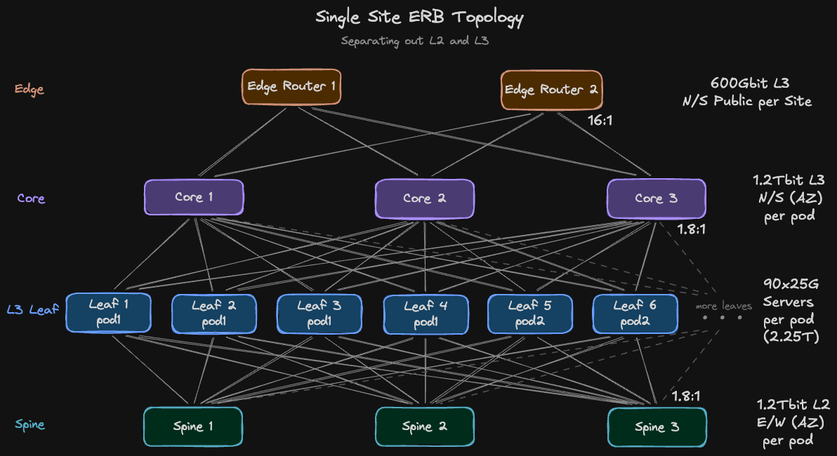
Design Implementation
L2/L3 Split
Data workloads are heavy L2 users - sharding/ replication
Tenants (VRFs) have man cross tenant flows
N/S and E/W have same capacity, no sharing
Predictable latency between AZs for tenants
Border leaves suck
Notes:
So here is how that looks in a little bit more detail. Since we require N+1 by design, you see Two Edges, but three cores and spines.
The quick answer to that is I can borrow transit off other sites via DCI, but inside the DC it is vastly more sensitive to the loss of a device.
Another key point is the split of the core and spine. This is a mixture of an L2 EVPN and an L3 only fabric for the best of both worlds. L2 loads have dedicated capacity, and those which are crossing VRF boundaries are all routed over the core. We then benefit also from loss of devices only impacting 33% capacity, not 50%, and we can still add one more to increase both metrics the other way.
The final key design point is the Pod Concept: we group 3 adjacent racks into a pod, with 2 ToR switches at either end in Rack 1 & 3, such that servers in Rack 2 borrow left over switchports from neighbours. Now we can Balance power, cooling, and rack unit density to maximise utilization on a 48 port device. Also creates a maintenance zone concept for users to consider in their HA planning.
As long as you are in more than one site you are fault tolerant (can failover). As long as you are in more than one pod per AZ you are also Highly available (scale out).
So, lets see redundancy in action during an upgrade cycle.

Slide 15
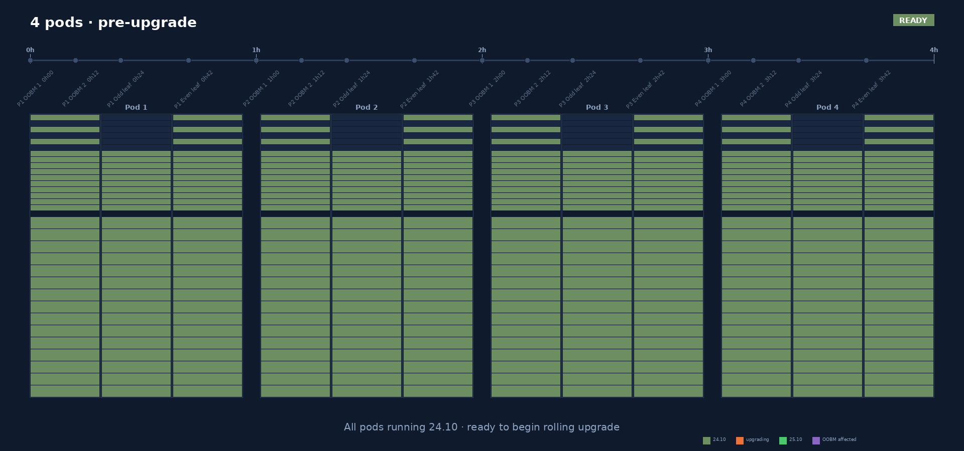
Notes:
What we see here is one row, which is half an AZ. Each activity operates on one pod of 3 racks at a time.
We start with the Purple stage: where we upgrade our OOBM devices, which impacts the BMCs and Mgmt ports on half a pods systems at once, but doesnt impact the applications on the servers.
We then proceed with the first Orange stage where we Upgrade Odd Leaves (Drop 50% capacity, invisible to apps).
Once the odd devices are back we reconverge the network and validate all systems recover and tests pass.
We can then proceed to Upgrade Even Leaves in the same manner.
Result: roughly 45 mins/pod and a 4h hour target for the row with zero customer impacting downtime. Any unexpected failure has a Blast radius just 3 racks, or 12.5% of that AZ.
So now we have a resilient design, we need to ensure the blocks we build make use of the capabilities we engineered in. We do this with contracts.

Slide 16
What’s a contract?
Think a software interface for infra.
// define the interface
type Shape interface {
Area() float64
}
// generalise the capability once
func PrintArea(s Shape) {
fmt.Printf("Area: %.2f\n", s.Area())
}
// define a new component
type Rectangle struct {
Width, Height float64
}
// expose the capability
func (r Rectangle) Area() float64 {
return r.Width * r.Height
}
// create the object
rect := Rectangle{Width: 10, Height: 5}
PrintArea(rect) // use the general implementation
Same, Same
...but different
// define a new component
type Circle struct {
Radius float64
}
// expose the capability
func (c Circle) Area() float64 {
return 3.14 * c.Radius * c.Radius
}
// create the object
circ := Circle{Radius: 7}
PrintArea(circ) // use the general implementation
Notes:
You could look at a contract in the legal sense, and that wouldnt be far off, but lawyers are expensive and tend to avoid “wiggle room”, which we actually quite like.
Instead we look at a contract closer to the interfaces in software engineering.
When someone builds a unit of software they will typically create an interface that allows for extension or change later without having to start from scratch. Some people call it DRY for dont repeat yourself.
In this golang example, the first two blocks create a shape type that provides an area function. We then write a single function to print that area. We can now create a new rectangle type that holds the uniqueness it requires, and then “meets” the interface by offering an Area function, which we can use in a very generic way thanks to our generalised capability.
If i want to have a new shape, i only need to create that type with whatever uniqueness it requires, and then “meet” that interface with very different calculation, to the same Area function request.
Its doing the exact same thing, but under the covers, its very very different. The end user doesnt care, because all they do is “printarea”

Slide 17
Contracts enable controlled disruption
Provider and Consumer model is well established design
Edge < * > Core
Core < * > Fabric
Agreements
Edge provides Core defaults
Core provides Edge /32 anycast, /21 tenant aggregates, /19 Site summaries
Both sides always provide N+1 paths
Edge is sole arbiter of internet path selection.
Edge provides no L2 bridge domain for internet routed prefixes
Implementation
Full mesh, eBGP + BFD
v4 unnumbered over v6lla
Drain via graceful restart (or just deactivate)
Anycast or full routed subnet redistributed from fabric to edge
Agreements
Core provides Fabric Defaults + summaries for other AZs + DCs
Fabric provides Core /32 anycast, /21 tenant summaries
Both sides always provide N+1 paths
VRF egress traffic is deny by default
1ms Cross AZ latency, 30ms Cross site latency
Implementation
eBGP + BFD + dot1q (per-VRF subifs)
Loopback via v4 unnumbered over v6lla
Drain via graceful restart (or just deactivate)
ACLs function like route leaking
External SLA 99.9% · Internal target 99.98%
Notes:
Contract: agreement between two blocks where each block has an interface of what it “provides”. Provider/consumer model.
Between the Edge & Core:
Edge provides default routes .. Core provides: fabric local anycast /32 & Site local aggregates + DCI accessible summaries.
Rules: N+1 paths always with ECMP, only edge does internet path selection, no L2 internet segments
Between the Core & Fabric:
Core Provides: Defaults + Remote summaries. .. Fabric provides: Tenant summaries + local anycast /32s.
Rules: Deny by default, we documented the latency.
In all cases: We use eBGP+BFD (1s) with v4unnumbered over v6lla.
Maint: With BGP+BFD+ECMP, the “right way” to drain a path is graceful restart community.
in practice: just deactivate the peer: fast, effective, no noticeable impact.
So this covers a lot of the network internal agreements, but as I said at the start, we are a part of a larger system. How does this apply outside?

Slide 18
The Network/App contract
The contract that really matters.
App < * > Network
Network < * > App
Agreements
Never utilise more than 50% of assigned network capacity (p99) for more than 5 mins
Anycast for HA addressing (no VRRP)
Services placed diversely (HV/Rack/AZ/Site)
All services load balanced with healthchecks
Implementation
Servers L2 Bonded and/or L3 BGP
Alerting for over-utilisation
VM/K8s placement policies
OKRs for non-diverse deployments
Design reviews prior to new deploys
Agreements
Never reduce network capacity by more than 50% at any given time
Reliably provide internal services
Predictable port to port latency
Reliable VRF to VRF connectivity
Resilient connectivity to other sites
All connectivity is default deny
Implementation
ESI for multi chassis bonding/L3 ports
Anycast gateways on the leaf
Provide critical services such as DNS/NTP
Provide latency expectations for DCI and Transit
ACL Automation to self service policy
External SLA 99.9% · Internal target 99.98%
Notes:
Apps are our consumers: internal to infra or customer facing apps.
Apps Promise the network:
Will not exceed 50% capacity utilization persistently (bursting is ok) .. Will be Diversely placed (different HyperVisors / Racks & AZs).
Will always be Load balanced with healthchecks .. Will use negotiated primary functions, so that clusters move leader roles to healthy nodes autonomously wherever possible.
Some people still prefer to isolate or migrate a primary role off a workload before we act, so as to not needlessly reduce their own error budgets, but it should be possible that any issues self heal within 90s.
The Network promises the app:
Will never drop capacity below 50% for planned work .. Will offer Predictable latency within the DC and across the DCI - which is both resilient and encrypted.
No traffic will flow between their application and anything else without an audited change.
Maint is now notify only. Application teams can build their app as suits them, within the boundaries we set, which includes the same 99.9% SLA to the App and 99.98% internal target for ourselves.

Slide 19
Make failure predictable
Redundancy can’t solve everything
Risks left after redundancy
Mitigations
VLAN / EVPN misconfigs
Human error in changes
Unclean hardware failure
Fabric wide blast radius!
Multiple fabrics per location
4eyes review and runbooks for everything
Canary rollouts with rapid rollback
Auto isolation on failure
External SLA 99.9% · Internal target 99.98%
Notes:
So our chief weapon is redundancy .. redundancy and contracts - TWO chief weapons... Its not enough.
Top remaining Risks after redundancy applies are:
L2 dramas and misconfigs (Flooding domains!!) .. Human Error - havent automated everything, runbooks can still have oopsies.
Unclean Hardware Failure. Absolute killer - dataplane misbehavior due to SW/HW bugs.
Mitigations:
Limiting the L2 domains - 32 port spine is a design choice - use up to 3 fabrics with a 128 port core across the site.
4-eyes review is sacrosanct - no runbook? Make one, update them .. Big win from canary - Rapid rollback with telemetry.
Auto-isolation is scary, but it has its place: bond disable script.
large amount of residual risk comes from network events - failures or changes .. telemetry stack is Cruicial. Its the beating heart of our processes. So lets look at how we do that.

Slide 20


Tools: GNP-Stack
Building blocks:
gNMIc - capture
NATS - buffer
Prometheus - store
Grafana - visualise
Alertmanager - act
Fancy bits:
BMP - routing
IPFIX - traffic
Clickhouse - analysis
View the OST talk here:
Notes:
The GNP stack is a generalisation of the work we did in Proton for streaming telemetry. its on github, but sadly not ready yet, Prague > Munich. Not enough time in a year :(
The Core of the Stack consists of: ...
We leverage two pipelines where we sample counters every 15 seconds, and we use the gnmi “on_change” method for states to be pushed in real time. Think SNMP Poll and Traps but on steroids.
Lots of this is familiar, but what is NATS? At 50 ish devices per instance, with the rate and quantity of metrics we pull in, we hit limits inside gnmic and prometheus. NATS lets us scale ingestion, avoid single point of failure, and later will allow us to fork data streams for extra processing.
We have recently expanded to some more data sources (with thanks to the students at OST Rapperswil!): Adding BMP for Routing data and IPFIX for flow data - shipping this to ClickHouse which is a very powerful analytics database, and again visualising the data in Grafana. More on that can be seen in this youtube video in this QR.
We expect to make a full beta release in docker compose format shortly after AC5, and will finish work on the kubernetes helm chart as well. Initial support is unsurprisingly Nokia and Juniper, and other vendors will land as users submit the gnmi path mappings.

Slide 21
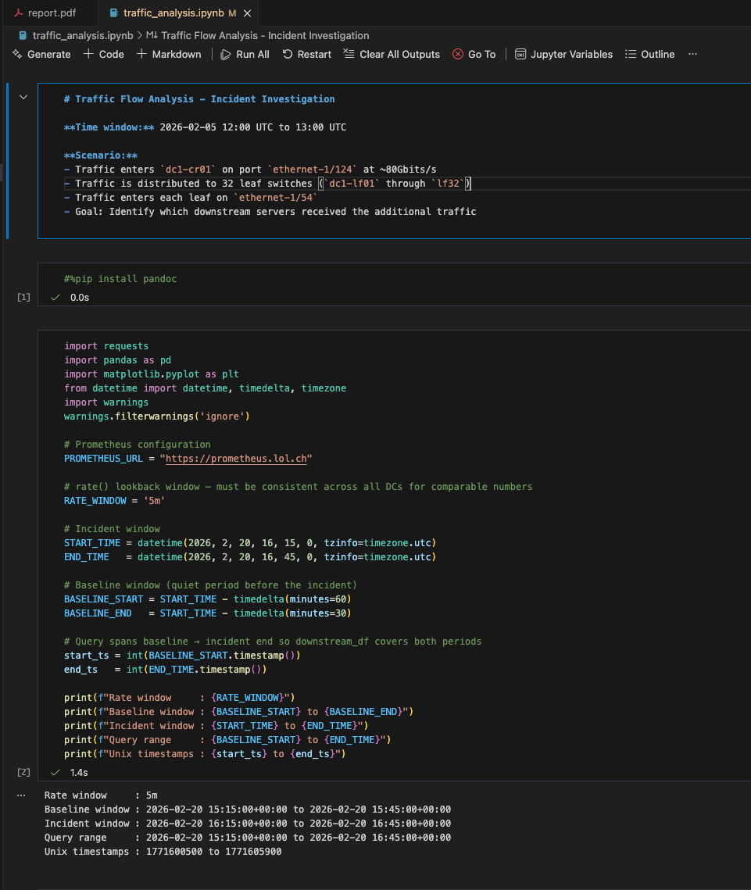
Tools: Jupyter
Just another UI for Python!
Playground that brings data together with code to produce ✨insights✨
Notes:
Next up we have an Analysis Tool called Jupyter (a webUI for Python)
Grafana is very powerful, but it has a general expectation that you can simple fetch, or trivially adapt a metric using promql syntax at runtime. One of the added values we get from having searchable data, is that we can also perform advanced analytics and even inference on it.
My favourite use of Jupyter recently was to gather 12 months of internet traffic data into a pandas dataframe, and then use the Facebook Prophet library to forecast the next 3 months of traffic growth, using seasonality and timely variation factors.
At time goes on we would like to push further into the ML use cases, but for now, jupyter is a way to push your data further than grafana allows.

Slide 22
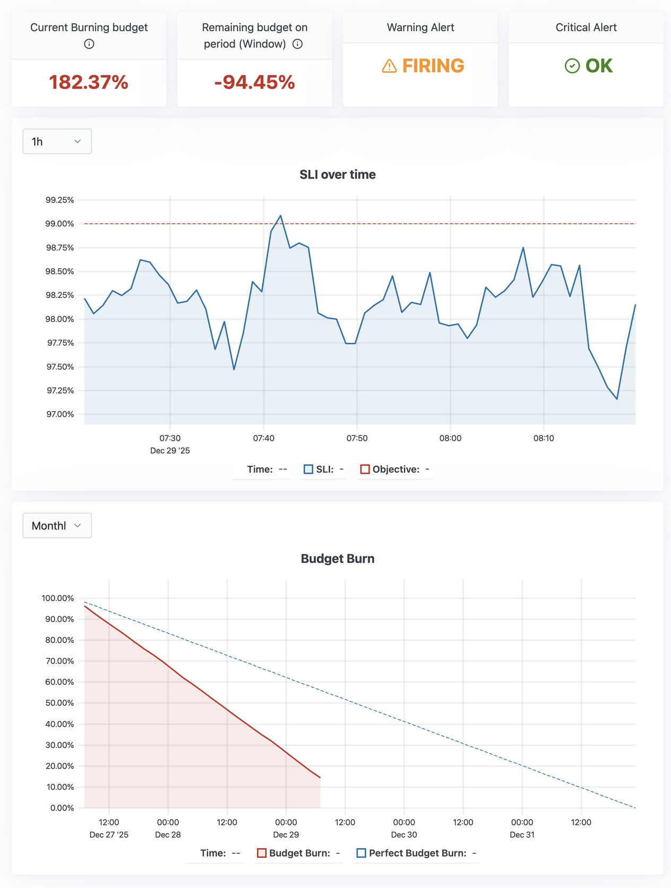

Tools: Sloth
Turns PromQL into an SLI
Produces a burn down chart of SLO decay
Provides at-a-glance view of how much failure you can absorb “free”
Generate some rules at live.sloth.dev:
Notes:
Sloth is a nice cherry on top. We only just started working with it truth be told - not a hard requirement. More a value add for the SLO process.
Sloth converts PromQL SLIs status into SLO viz and alerts. To monitor your SLO burn down rate and status, to know how much failure you can absorb “for free”. Install for this view, or use generator and grafana.
Strategically, we acknowledge almost all changes are disruptive—every change will diminish an SLI. Tracking this fosters a culture where "spending pocket money" is okay if within budget.
On Dash: Red are highlighting runway issues Burn at 182% means over a 30-day window you'd run out of SLO in about 15 days (double perfect burn) .. -94 same. 2x the remaining runway currently required to stay in SLO
SLI over time chart - 99% target line in red, and the service SLI is constantly below by about 1% - we are missing our target.
Burn rate chart shows the blue line as "perfect" burn, red line shows you're down to 15% budget with 2 days before reset.
TLDR: You're spending money faster than you make it. While you're still in credit, no problem (warning). When you go below zero (critical), the CEO turns up with a lead pipe.

Slide 23
Not all networking SLIs are “networking”
Pod - pod (local, cross-AZ, cross-site)
Number of HTTPS 5xx vs total req
Auth DNS correct response
Leaf overlay loopback reachability
BGP session uptime (per session)
DNS p99 < 10 ms
Link packet loss < 0.01% / 24h
Cross-pod loss < 0.1% / 7d
Zero uncorrectable FEC errors / day
≤ 1 link flap / week
99% of 5-min intervals < 45% utilisation
We missed targets early on. That was a feature not a bug – it surfaced which layer needed attention.
Notes:
As i said at the start, finding SLIs for networking is harder than you might think. But not all of them actually come from networking. Many are in fact canaries, because, controvertial, sometimes _it is_ the network that broke the app.
In the Connectivity bucket: we have ICMP reachability, HTTPS error rates and Auth DNS validity
In the Performance bucket: ICMP latency, DNS response speed and HTTPS response times.
In the Stability bucket: we target less than one link flap per week, but as big users of 25G uncorrectable FEC errors are a key metric also.
In the Utilization bucket: we already spoke about the two server ports not exceeding one link full persistently as well.
Full disclosure: we dont have all of these today, biggest problem for me is Nokia SRL doesnt offer TWAMP/STAMP yet, which means deploying a lot of ICMP tests into servers which invalidates the atomicity of it. A server or HV problem could report network reachability issues that dont exist. One case where Juniper with its RPM is sorely missed.
Either way: Missing targets early on was a feature not a bug. These repeated failures surfaced weak layers across the stack to be remediated.

Slide 24
Where did that get us?
Notes:
So is the juice worth the squeeze? Lets have a look shall we?

Slide 25
The proof
10x
network capacity since 2021
-40%
per port cost
0
extra headcount
0
out of hours change windows
Notes:
The proof is in the pudding:
10x increase in CAPACITY (going from 16 cabinets in 2021 - to 120 today - and 160 by end of 2026).
40% reduction in per port cost. Not just hardware pricing (thanks Mike) - but also Design efficiency with the pods.
Controvertially: 0 extra headcount
same 5 engineers since 2021. Initially Grinding hard on BAU with a flaky juniper network
Invested in Training during 22/23 - google friday - directed efforts into high impact tools to buy more engineering time
ROI
Freed enough time to take on Juniper Redesign in 2023 with ERB - stop the CRB rot - Enough to take on vendor in 2024 - Greenfield site. Idea to prod inside 9 months.
Went futher - brownfield migration to an updated Nokia design in 2025 - underlay and D5 core
This year:
5 new Nokia AZs - orchestrating with Nokia EDA a big efficiency gain.
DC build lifecycle went down from 6 months in 2024 to 3 months in 2025 to 1 month each on each of these 2026 installations.
Keep People in Bed: 0 out-of-hours change windows. Changes happen 8am–12pm.
Culture shift: Complete reversal on our process. Runbooks and automation only going forward, Reward skill/engineering, not "pants on the outside"

Slide 26
Call to action
Identify your building blocks. Draw them up. Be intentional.
Get telemetry into Prometheus. Streaming where you can, SNMP where you must.
Build runbooks for every maintenance task. Bias to telemetry over CLI.
Capture block requirements. Map protocols to contracts. Write them down.
Track SLIs. Set SLOs with reasonable targets. Maintenance moves to working hours.
Add alerts for the conditions that caused your last outage.
Build and then Expose your SLI/SLO tooling to consumers.
Let them check network state without opening a ticket.
Failure and maintenance are inevitable. Apps must retry with exponential backoff, and provision to allow services to run elsewhere.
Notes:
So here is our call to action.
Identify Blocks: Draw them up. Be intentional.
Contracts: Map protocols to agreements. Write them down.
Telemetry: Get data into Prometheus (Streaming > SNMP).
SLIs/SLOs: Track them. Use SLO as the approval gate.
Runbooks: Document everything. Bias telemetry over CLI.
Alerting: Add alerts for the cause of your last outage.
Expose: Let consumers check network state without tickets.
Final Thought: Apps must retry with backoff. Failure is inevitable; design for it.
Now, we started with a hot take, lets end with one:

Slide 27
Or. Hire One.
🌶️ HOT TAKE 2 🌶️
You cannot be a Network Engineer and a Software engineer concurrently.
Pick one.
Automation =/= Building a Product
Coding =/= Engineering
Notes:
You can’t be a competent Network Engineer, and a Competent Software engineer at the same time.
They are very different jobs. Unicorns exist, sure, but theyre unicorns for a reason. If it were common, they would be everywhere, and they simply are not. Building a business case that depends on you having unicorns on staff is objectively stupid.
Important distinction: Software Coding, is not Software engineering, just as CCNA is not a CCIE. There is lineage here. You can transition from one to the other, but when you make that move, you have to focus, or ultimately FAIL.
Building automation tools is not the same as building a whole product. I have long said there is a maturity curve to network automation, and starting out with a toy like Ansible, quickly turns into python and workflows and DAGs. When you start to think that its time to build something bespoke,
GO GET SOME EXPERTS

Slide 28
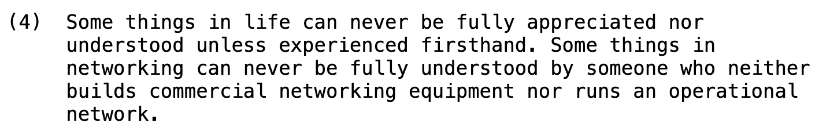
Questions?
Notes:
As microphones make their way around: A pre-emptive strike.
NRE is not actually something “you should rebrand your team as”. A lot of you are potentially queueing up to say “this is just good design”. YES thats right!
I don’t say that youre doing it wrong, and i dont say NRE is the new hotness either. Its a methodology which highlights the benefits of a design driven approach, and to go back to titan of technology “Cheese_It”:
Its 50% a network engineer, 37.5% coder and only 12.5% software engineer.
What Cheeze_it didnt say is this doesnt really need to be every human in the team, its more a recipe for skills that we need across it
In our team theyre not balanced - one is broadly low code, a few are close to only code. NONE are SWEs, we cover each others shortcomings in the review processes.
To quote the evergreen RFC1925 Rule 4 -
Some things in networking can never be fully understood by someone who does not run an operational network.
Questions?

