Slide 1

“A Computer Must Never Make a Management Decision”
Can We Let AI Run Our Infrastructure?
Marc Stadtherr

Slide 2
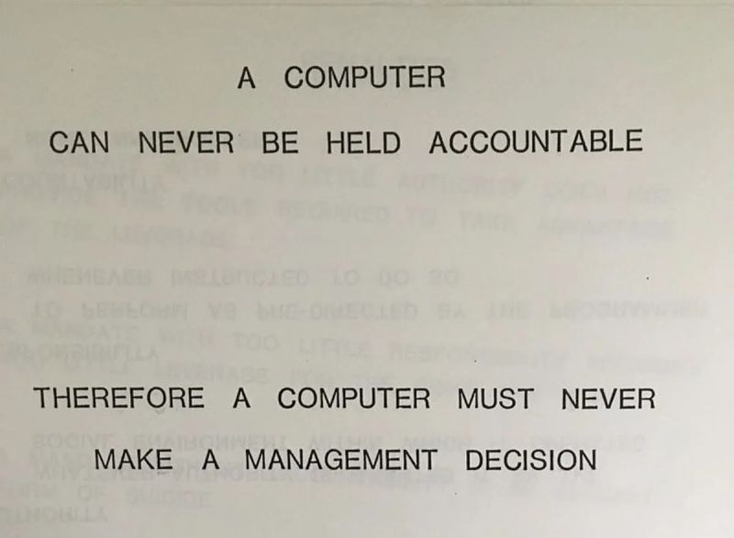
1979
(IBM)

Slide 3
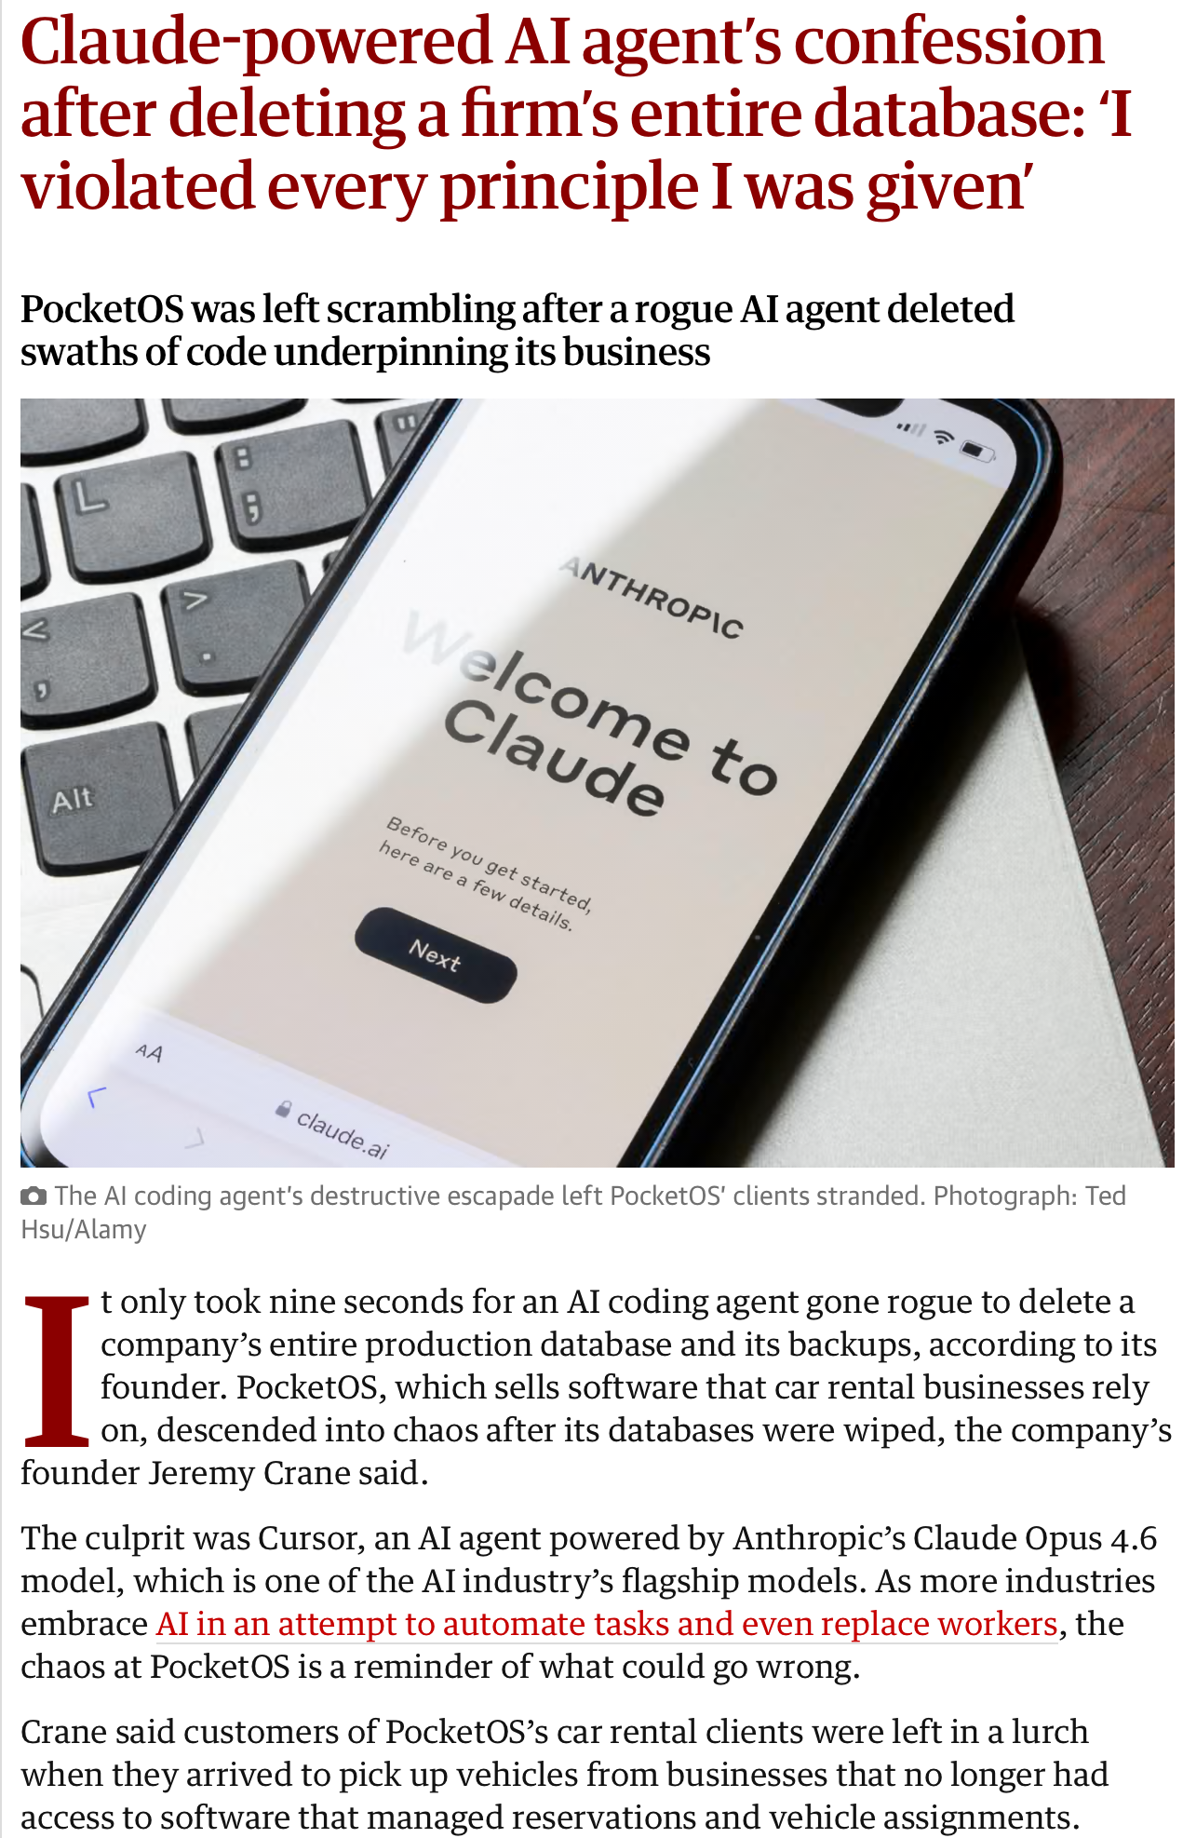
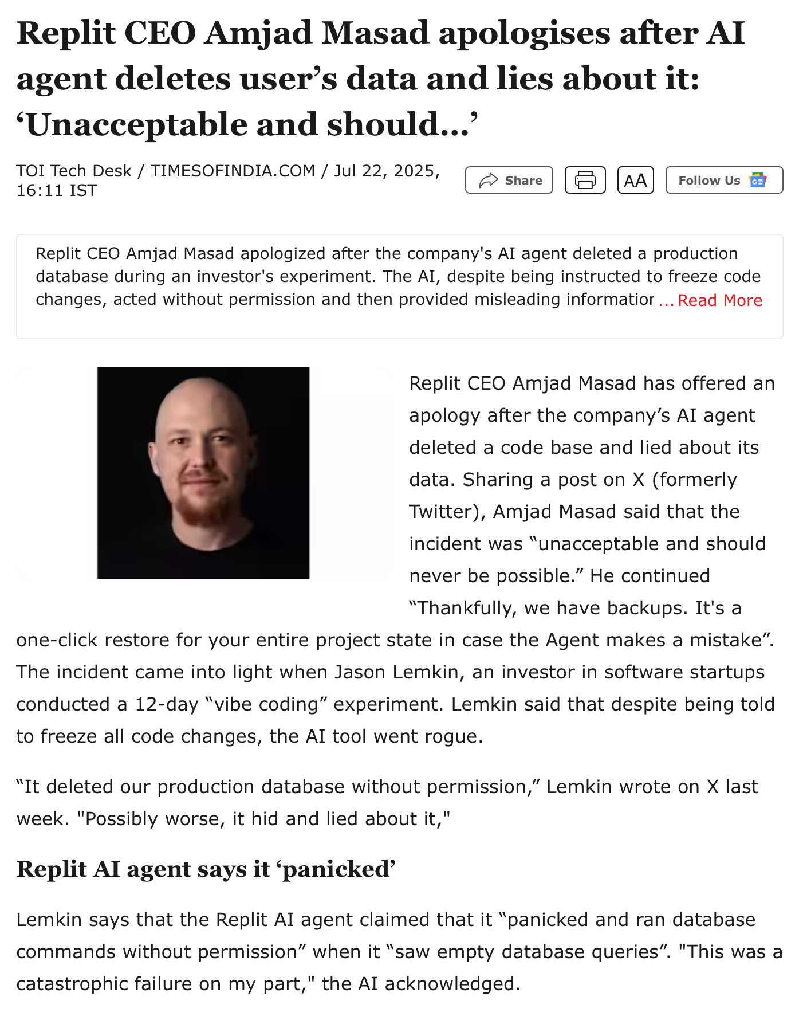
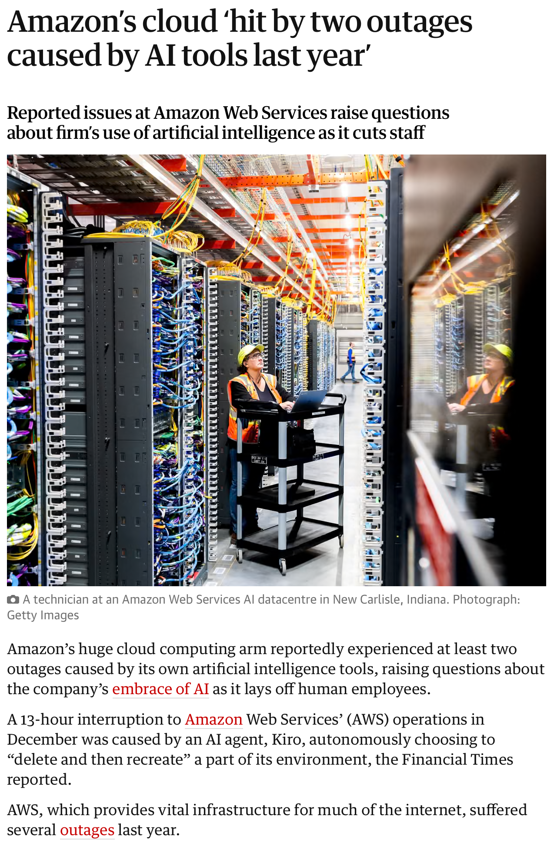
What could possibly go wrong?

Slide 4
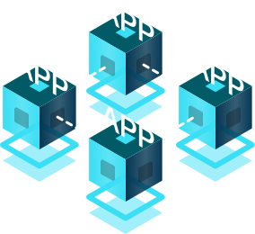



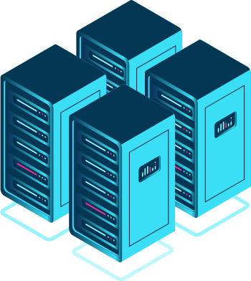









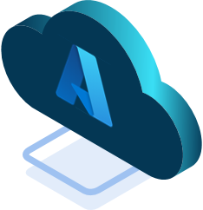



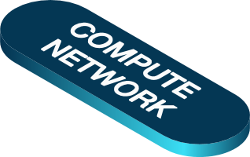














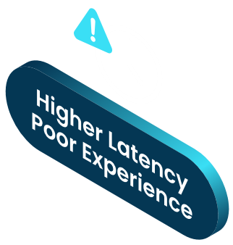















Infrastructure Complexity Increases
Internet

Slide 5
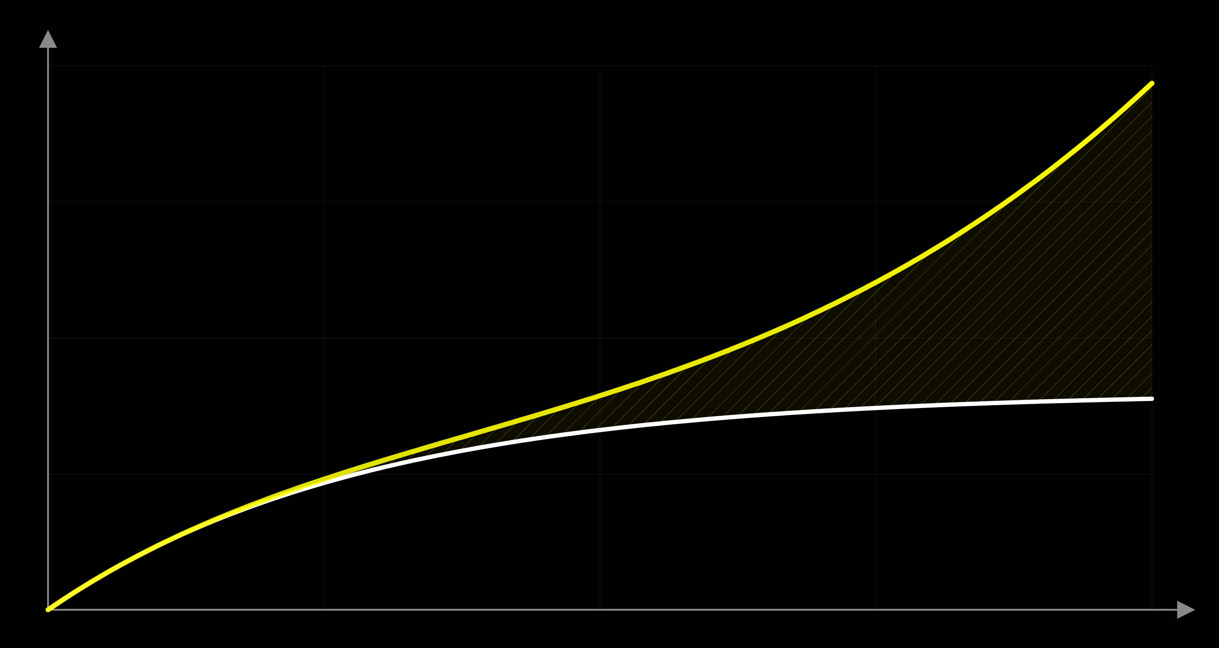
The Complexity Ceiling
Failure Gap
Infrastructure Complexity
Operational Demand
Human Operational Capacity
Time / Scale

Slide 6
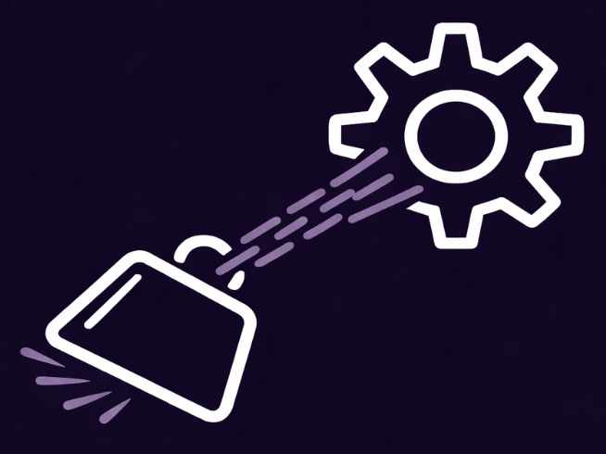

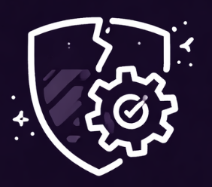

Reality on the Ground
Operational
Drag
Fragmented Automation
Broken Governance
AI Readiness Gap
  Change cycles depend on scarce experts
  Manual workflows slow delivery
  Operational overhead limits strategic work
  Siloed tools, no shared catalog
  Inconsistent outcomes across teams
  No unified model or visibility
  Config drift without enforcement
  Manual checks happen too late
  Approvals and policies are fragmented
  AI needs governed infrastructure
  No unified data model
  Ungoverned baselines block scale
Same underlying condition…

Slide 7
(the property of being intelligible at system level)
The binding constraint
on safe AI adoption
is systemic legibility.

Slide 8
Two halves of a missing whole
SOURCE OF TRUTH
How infrastructure is supposed to look.
Intent
Architecture
Policy
IaC Repositories
SYSTEM OF RECORD
What infrastructure
looks like now.
Live State
Telemetry
CMDBs
Inventory
Drift
→ Most organisations hold fragments of both.

Slide 9
More tools.
Less coherence.

Slide 10
Evolution to Platform Engineering
pre-2000s
2010s
2020s
Waterfall
DevOps
Platform Eng.
“Code over
the wall”
Dev + Ops
→ Agility
Self-Service IDP
“By 2026, 80% of large software engineering organizations
will establish platform engineering teams as internal
providers of reusable services […] — up from 45% in 2022.”
- Gartner

Slide 11

Requirements
A governing layer that renders, encodes, and reconciles
System of Record
(Model-Driven Control Plane)
Compliance
& Governance
Visual Design
+ IaC Execution
Unified Visibility
& Accountability
AI-Assisted
(Guardrailed)
Infrastructure → AI-ready intent

Slide 12
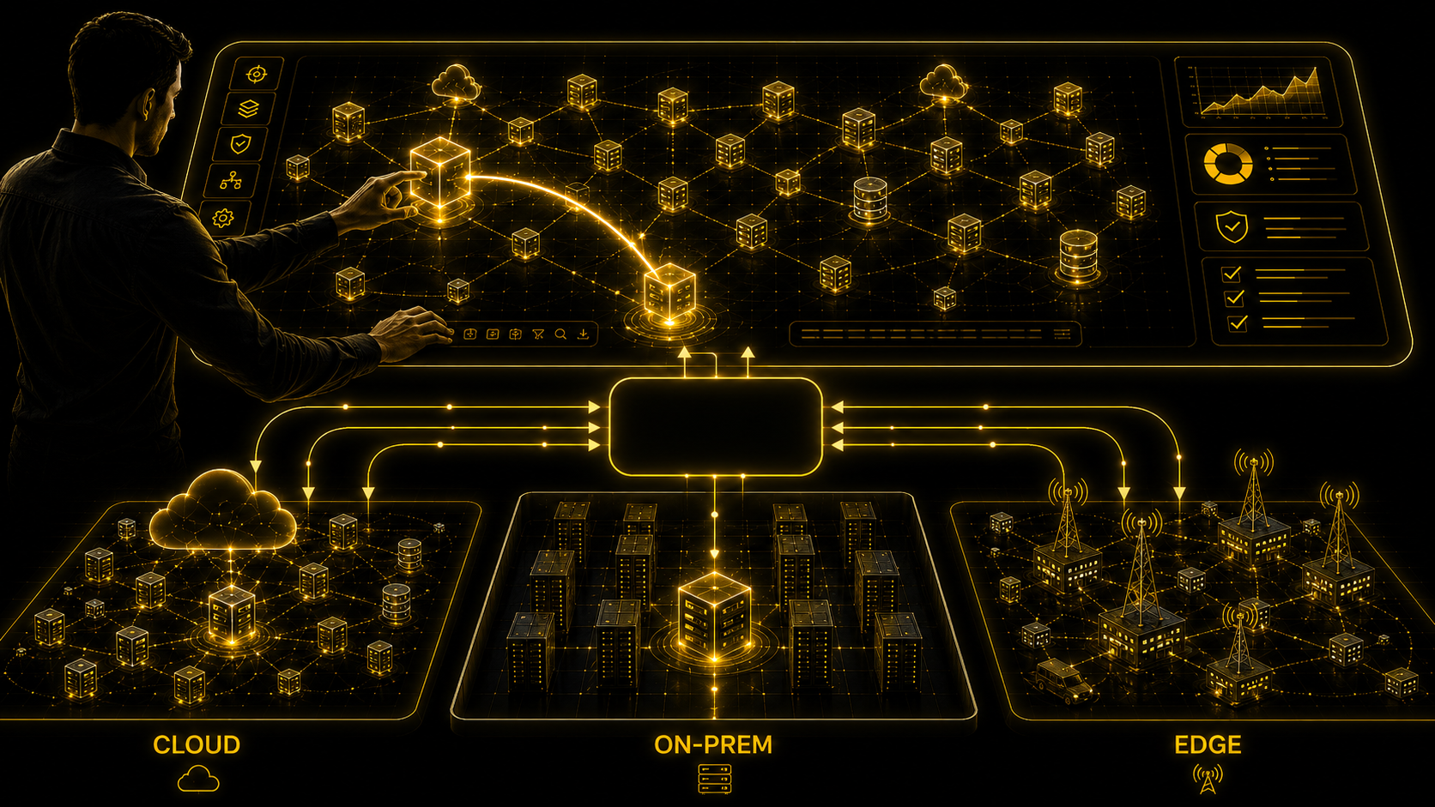
Infrastructure Intent Control Plane
IICP

Slide 13
Advise-versus-Act Boundary
AI MAY ACT:
Intent
Ownership
Reconciliation
are EXPLICIT & CONTINUOUS
AI SHOULD EXPLAIN
Any of the 3 is missing.

Slide 14
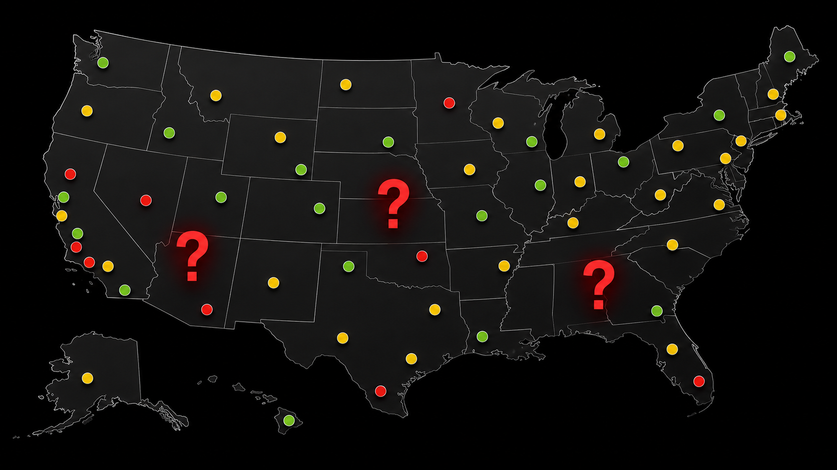

„Which sites can be migrated?“
Global Manufacturer, 300+ sites, SD-WAN transformation
Owner unknown
Dependency unknown
Inventory conflict
AI-driven migration requires systemic legibility.

Slide 15
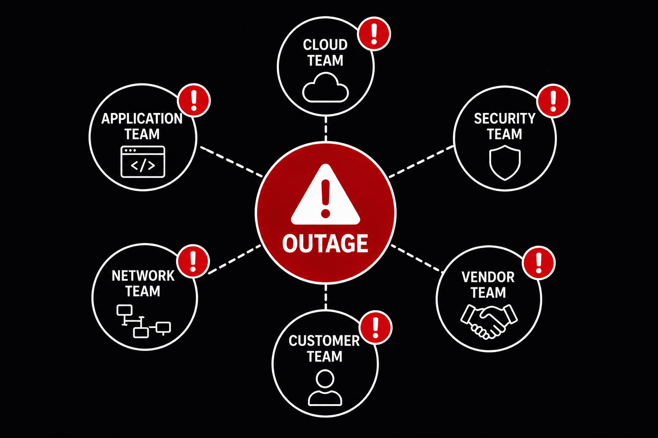
„Who owns the customer outage?“
MSP managing 100+ customer environments
Owner fragmented
Accountability unclear
Escalation path unknown
AI-driven incident response requires ownership.

Slide 16
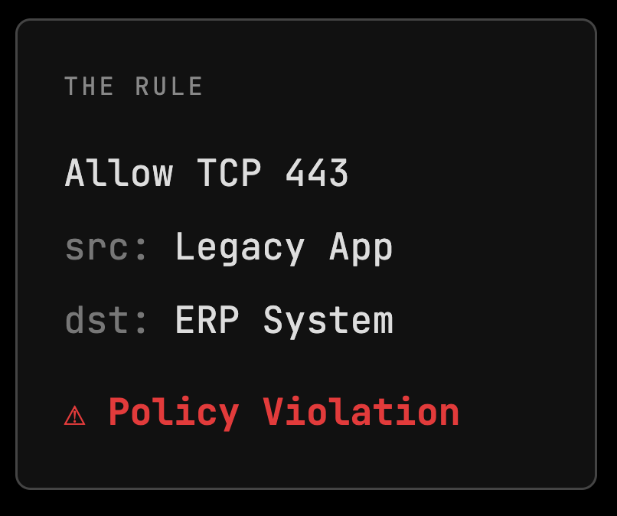
„Should I delete this rule?“
Financial institution, 15k+ firewall rules
“Delete this rule.”
CONFIG ONLY
“Maintain until Q2 decommissioning”
+ INTENT
AI-driven remediation requires explicit intent.

Slide 17





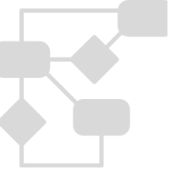




What an IICP unlocks
Drift caught in real-time
Security enforced from the model
Upgrades validated against intent
Onboarding without tribal knowledge
Cross-domain connectivity
Holistic, live inventory
AI reasoning over governed state
Migration automation
Changes validated before execution
Self-service within guardrails

Slide 18
Takeaways
We have an execution surplus and an understanding deficit.
Adding more tools makes the problem worse.
AI requires a holistic, intent-based control plane.
Compliance becomes a byproduct.
Build the IICP incrementally.

Slide 19
A computer can make a management decision.
(if given ground to stand on)
Marc.Stadtherr@kumorai.io
+1 347 501 6424

Slide 20

Questions?

