Slide 1
Automating firewall rules deployment in a highly regulated environment

Slide 2
About me
32 years old
Portuguese, moved to Sweden, working in Denmark. Met wife while studying Japanese
Speaks none of those languages. Barely even Portuguese and English
Studied software engineering. Didn’t feel it. Moved to network and security. Missed programming. Here we are

Slide 3

Now a bit more professionally
Largest offshore wind developer in the world
Biggest energy company in Denmark
Over 30 offshore windfarms in operation
Currently developing 8+ with a combined 8 GW

Slide 4
A tale as old as time

Slide 5
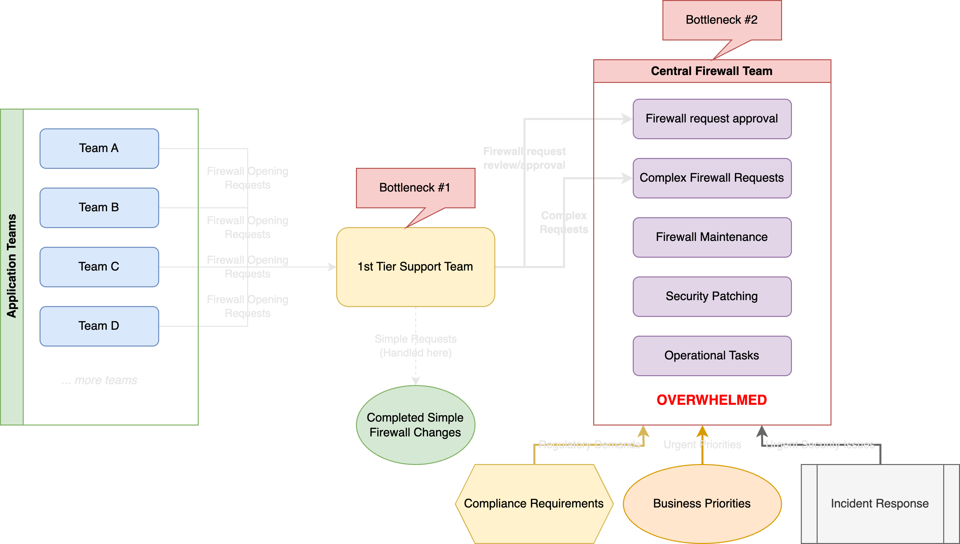
The beauty of firewall requests
Notes:
Common setup in a mid-sized company. 1st tier handles easy requests, 2nd tier handling complex requests and possibly doing everything else related to firewall maintenance, updates, operations, etc
Application teams grow faster than network teams
Technical debt: Clean-up of firewall rules is rare. Human mistakes, duplicated/shadowed rules, duplicated objects, messy naming standards. Potential compliance risk!

Slide 6
Automation?!
What options do we have?

Slide 7
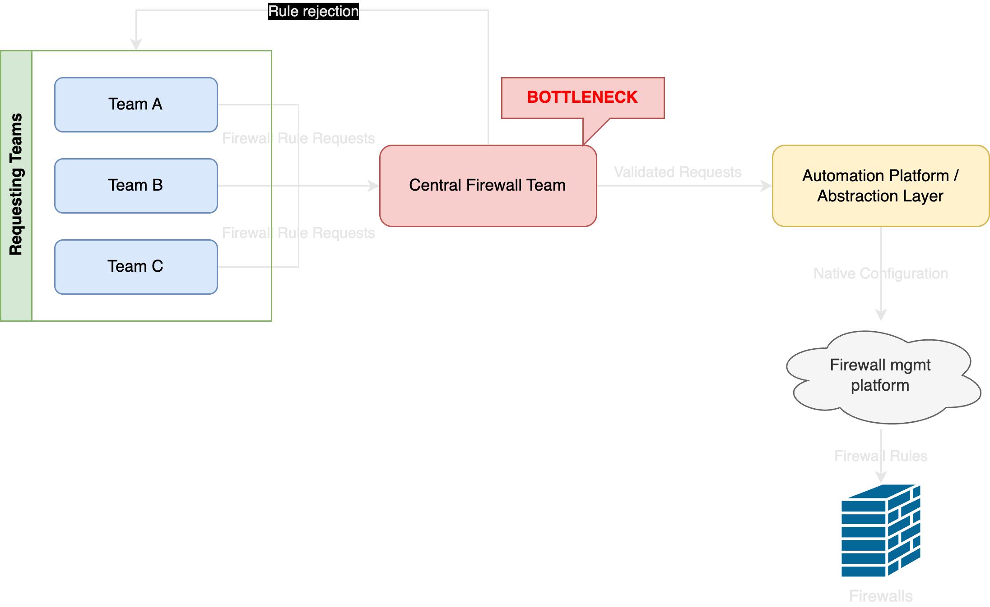
Option 1 – Automate the deployment?

Slide 8
Option 1 – Automate the deployment?
Not good enough. Doesn’t scale
Central team still exists, just slightly less overwhelmed
Configuration was never the biggest bottleneck
Notes:
- This is usually how things start. Firewall team decides to get creative themselves and not involve anyone else
- Central team still receives the requests. Still has to review them and approve them and then insert it into an “easier” version of the firewall management platform– maybe a python script, maybe a powershell script
- Still inefficient – aren’t you better off just placing it in the firewall management platform itself if all you’re doing is creating an abstraction layer for yourself?

Slide 9
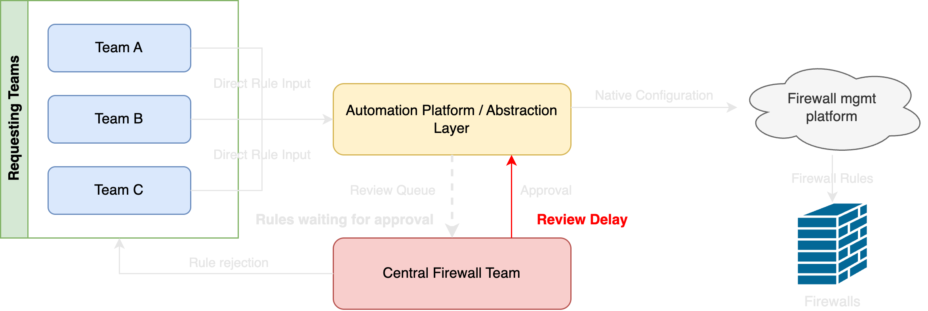
Option 2 – Automate requests and deployment?

Slide 10
Option 2 – Automate requests and deployment?
Almost there, but still not scalable
Central team still exists, spends several hours reviewing requests
Requests go back and forth until approved. Customers still angry
Notes:
- A bit better now – we actually involve the requestors and the whole process changes.
- Approving every single rule and chatting with the requestor and verifying that this is “fine and expected” will still take a considerable amount of time
- Rejecting a request will make the entire process restart

Slide 11
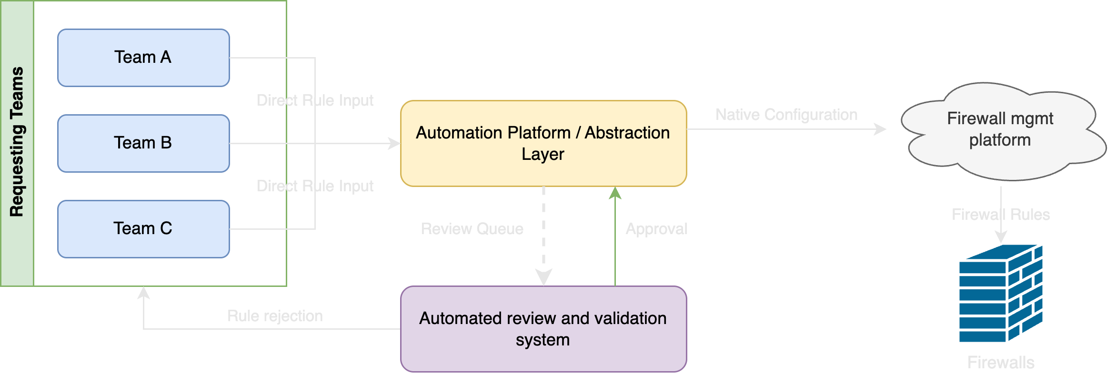
Option 3 – Automate requests, validation and deployment!

Slide 12
Option 3 – Automate requests, validation and deployment!
We have a dream!
Notes:
Central team is gone. No, they are not out of a job, now they can focus on actually maintaining the platform, innovating, backlog, security fixes and they can also focus on training and developing this platform
Responsibility of adding/removing/updating rules is totally on the requesting teams. They would be the ones answering to auditor’s questions, not the central firewall team. They are the ones that understand why a rule is necessary, and why application X needs to reach database Y
Faster feedback loop between requesting teams and our system. No need to wait for days/weeks for an approval or a rejection. Fail fast!

Slide 13
Our journey

Slide 14
The requirements. Non-negotiables
Version control and ability to audit every single firewall rule and revert if necessary
An automated rule validation system
A platform to host and run the product. Ability to modify, extend, customize our solution
Reduce dependencies on 3rd party vendors and closed source products
Strong community behind whatever platforms we choose
Abstract complexity from our customers. As user-friendly as possible
Notes:
We want to own 100% of the solution. We want to be able to apply whatever business logic we have to our solution freely, as-code
Reduce dependencies on 3rd parties - This also eliminates the risk of sudden price hikes. Looking at you, Broadcom. We don’t want to become hostages of our own solution
Abstract! Abstract! Abstract! Take complexity away from users. They don’t know firewalls, even though they tell you they do. Only expose what they absolutely need to see.
Make it easy to read and audit both by humans (e.g. auditors, change management) and programmatically

Slide 15
The requirements → Tools
Version control and ability to audit every single firewall rule and revert if necessary
An automated rule validation system
A platform to host and run the product. Ability to modify, extend, customize our solution
Reduce dependencies on 3rd party vendors and closed source products
Strong community behind whatever platforms we choose
Abstract complexity from our customers. As user-friendly as possible
Git
Notes:
Git, no surprises. GitHub more specifically

Slide 16
The requirements → Tools
Version control and ability to audit every single firewall rule and revert if necessary
An automated rule validation system
A platform to host and run the product. Ability to modify, extend, customize our solution
Reduce dependencies on 3rd party vendors and closed source products
Strong community behind whatever platforms we choose
Abstract complexity from our customers. As user-friendly as possible
Git
N/A – Developed from scratch. Python-based
Notes:
This is the single most important component of our solution

Slide 17
The requirements → Tools
Version control and ability to audit every single firewall rule and revert if necessary
An automated rule validation system
A platform to host and run the product. Ability to modify, extend, customize our solution
Reduce dependencies on 3rd party vendors and closed source products
Strong community behind whatever platforms we choose
Abstract complexity from our customers. As user-friendly as possible
Git
N/A – Developed from scratch. Python-based
Nautobot
Terraform
Ansible
Notes:
The core of the solution.
Won’t get into the whole Nautobot vs Netbox discussion, but in our case choosing Nautobot was a no-brainer due to its automation features and job models
Can you do it without it? Sure, you can even do it with Service Now if you’re into pain

Slide 18
The requirements → Tools
Version control and ability to audit every single firewall rule and revert if necessary
An automated rule validation system
A platform to host and run the product. Ability to modify, extend, customize our solution
Reduce dependencies on 3rd party vendors and closed source products
Strong community behind whatever platforms we choose
Abstract complexity from our customers. As user-friendly as possible
Git
N/A – Developed from scratch. Python-based
Nautobot
Terraform
Ansible
YAML-based structure
Notes:
You could also pick XML if you want your customers to suffer

Slide 19
Validation and compliance!
Notes:
Easy - we have guidelines from IT Security!

Slide 20
Cool, what guidelines do we have to follow?

Slide 21

Guidelines?
Do you mean SharePoint?
Security principles provided in SharePoint documents
Regulations across 100+ pages of Word documents
Gut-feelings via Teams chats and meetings from IT security teams on what rules can be allowed
Notes:
Concepts totally disconnected from the network

Slide 22
The power of a source of truth
A source of truth which can you interact with both manually and programmatically is a requirement for an effective validation strategy
Translate as much data as possible into code and custom models. No more docs and sheets. Only policy-as-code.
Your validation will only ever be as good as the quality of your data. Enforce data constraints and sanitization!

Slide 23
Example security principle: Before
IT Security:
“We approve firewall rules between Onprem IT and Azure using well-known and encrypted protocols”
Notes:
What does this mean?
Onprem IT? What is that? That’s a ton of networks…How do we group them all?
How do we translate “Azure” into actual prefixes/networks? Perhaps you have dedicated VRFs for this, or subnets?
“well-known and encrypted protocols” too fluffy…

Slide 24
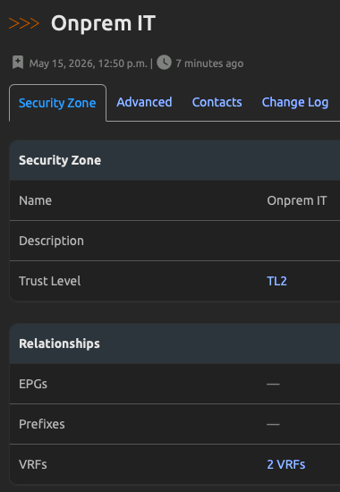
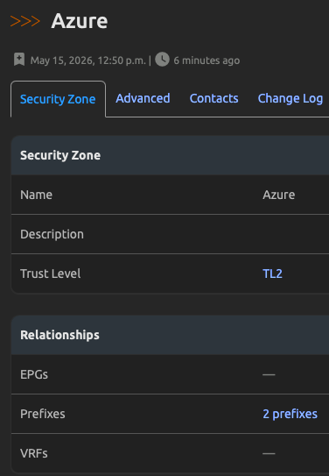
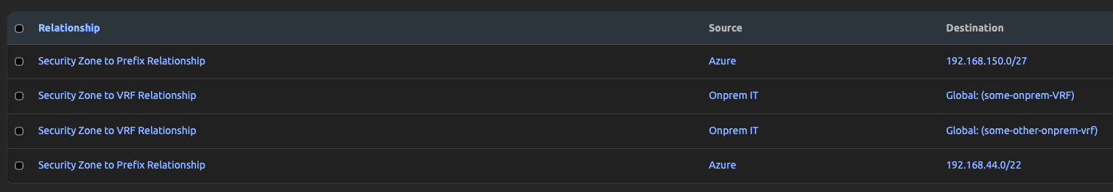
Example security principle: After
1. Build custom models for business logic and abstract security concepts
2. Relate these models to real network constructs

Slide 25
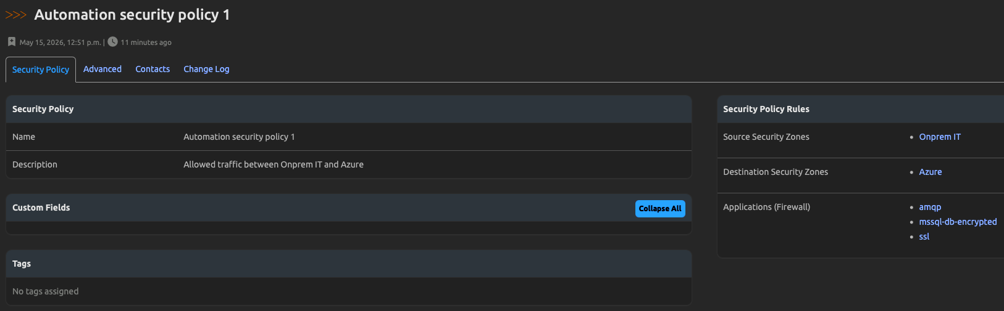
Example security principle: After
3. Build the policy connecting all the models!

Slide 26
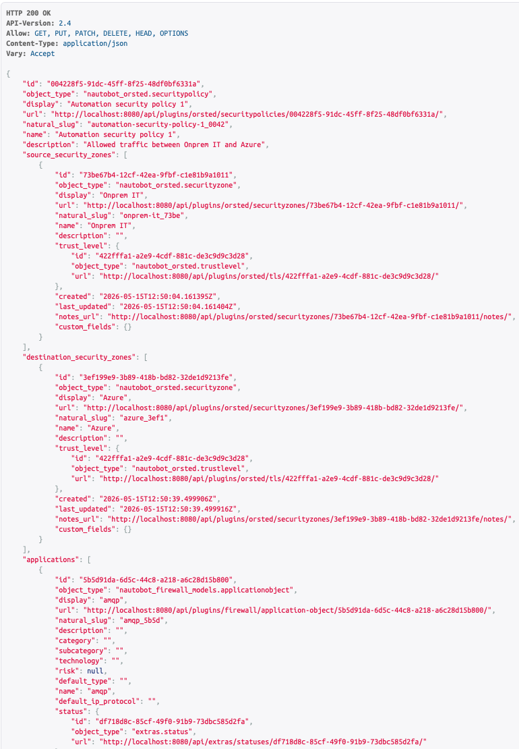
Example security principle: After
4. Expose it to humans via a GUI and machines via an API!

Slide 27
Now glue everything together

Slide 28
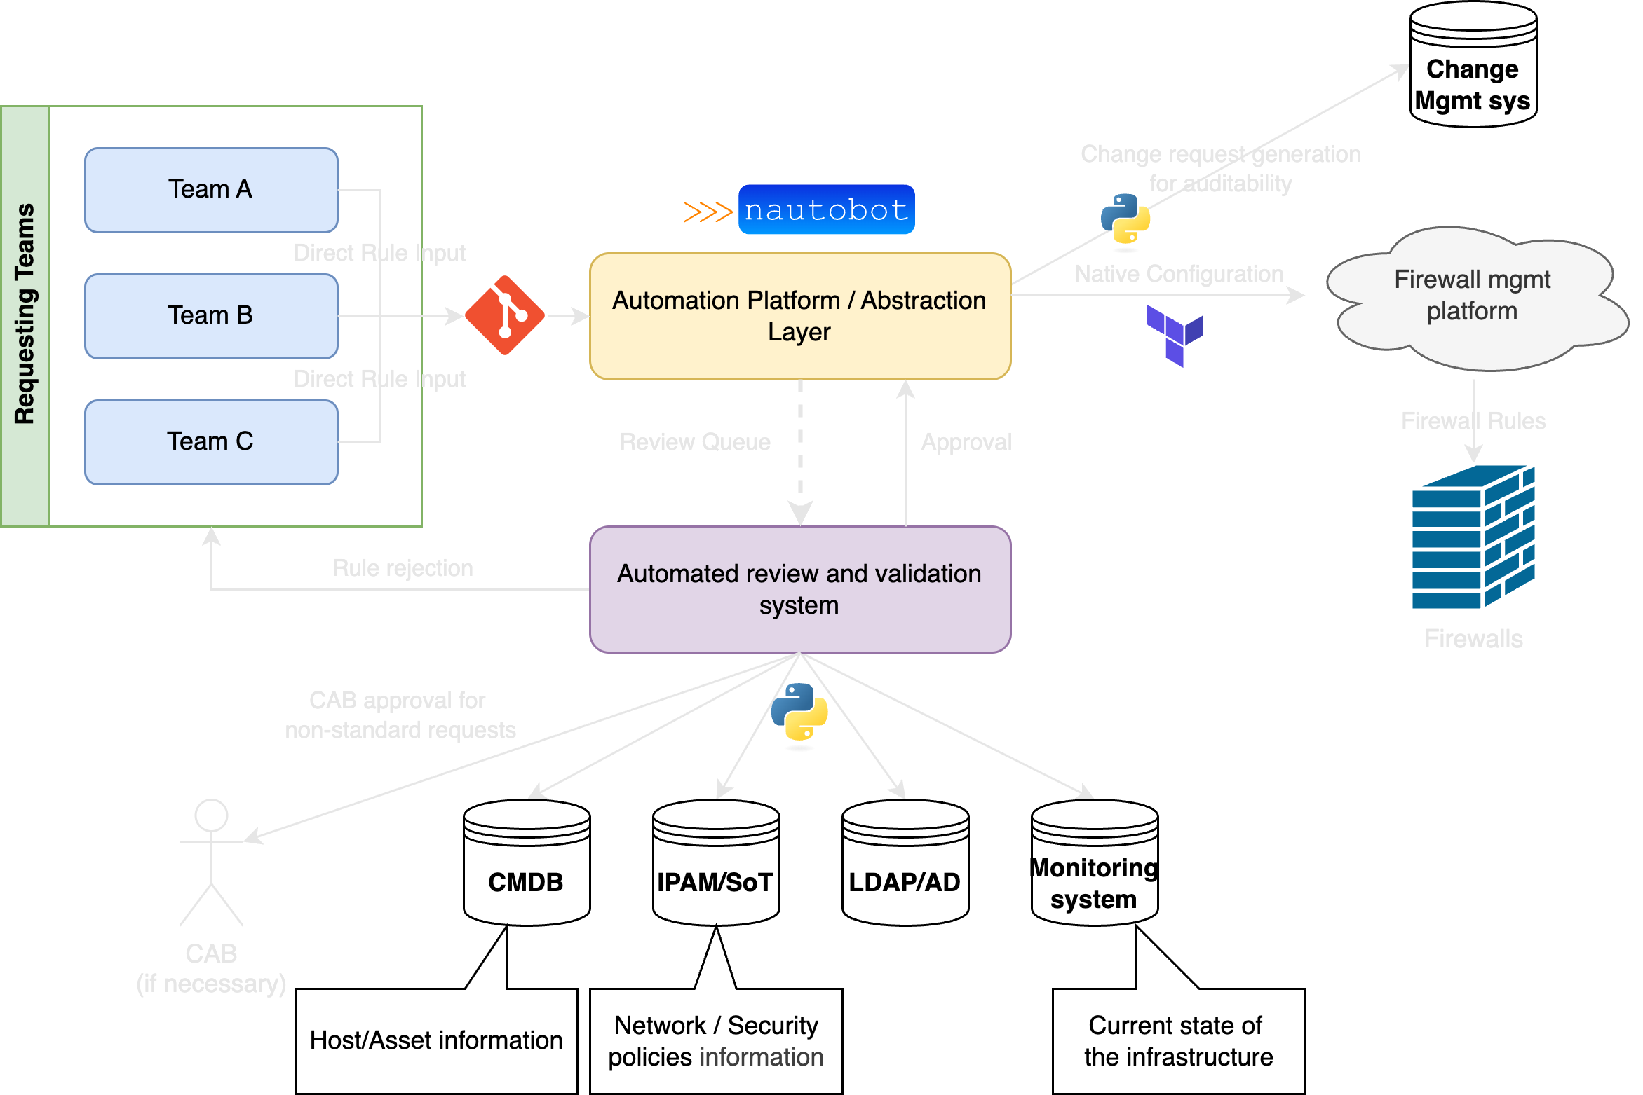
The final solution
Notes:
Compliant-by-design.
Security principles and guidelines are enforced automatically since we just turned them into code
For the non-standard requests, we can automatically involve CAB and wait for their approval – making them compliant. Humans are out of the loop (aside from the requestors)
Customers can't just use a prefix that doesn't exist, or an FQDN that doesn't resolve. Validation will catch it.

Slide 29
Takeaways and statistics

Slide 30
Some numbers as of 2026
40+ teams onboarded
150+ active users
3000+ failed validation attempts
3500+ successful deployments (rule additions, deletions, changes)
Number of yearly firewall requests increased by ~250%
Automated requests up from 0% to 80% (to be 100% soon)
Lead time for firewall requests handled by humans down by 88%

Slide 31
Key takeaways and advice
Data is everything. A solid data foundation goes a long way
Involve your customers and security from the start
Treat your automation as a real product. Proper name, versioning, releases, changelogs and support channels
Customers start caring about firewall rules if they own them. They even start to optimize and clean-up after themselves!
Number of requests increases dramatically. The hidden cost of an inefficient process becomes obvious after automating it
Notes:
More rules get deployed because customers have no obstacles now, but also they want to take full ownership over the manual rules deployed before this product
We found out that our customers/developers were planning conservatively to compensate for our inefficient process. They were forced to be less ambitious

Slide 32
Questions?
Catch me out there!

