Slide 1
AD-FRQCVT1
Low Frequency Adapter for FMCOMM3
Initial Evaluation Results
Benjamin Sam, Charly El-Khoury
3/18/2015

Slide 2
AD-FRQCVT1 Standalone Rx Conversion Gain

Slide 3
Standalone Rx P1dB

Slide 4
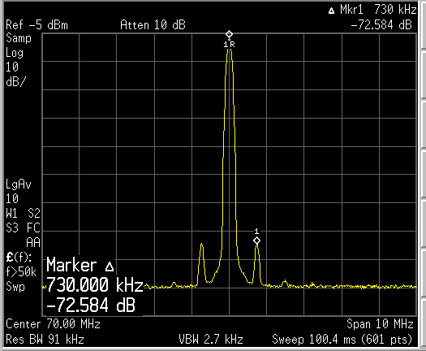
Standalone Tx Output Spectrum
Tx frequency set to 70 MHz
Fin=370 MHz, Pin=-15 dBm
Found Reference Spurs at +/-730 kHz

Slide 5
System Evaluation: Tx Output
Output Level: adjustable with TX Ch2 Attenuation
  FTX = 25 MHz
  0 dB Attn => Po = +8.1 dBm
  80 dB Attn => Po = -73 dBm
Pout is flat to 1 dB from 20-100 MHz, but peaks up by 6 dB at 2 MHz, due to FRQCVT1 gain flatness
Rx setting changed from 1-100 MHz, no additional spur observed (<-85 dBm)
Rx input varied from 1-100 MHz, no additional spur observed

Slide 6
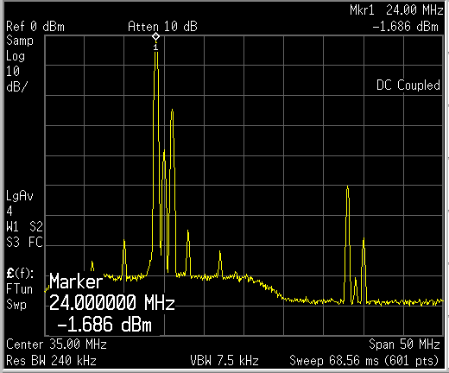
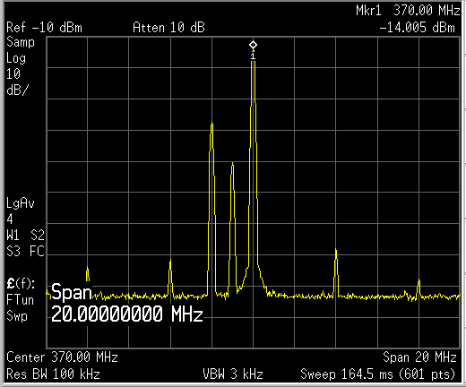
System Evaluation: Tx Output
Output frequency is low by 1 MHz, with two spurs
  Set to 25 MHz, got 24, 25 & 26 MHz
2nd harmonics is 50 dB down
Came from AD9361 Tx Output, with Fo modulated by DDS
If DDS is turned off, only LO feedthrough remains (-50 dBm) at output of AD9361
FRQCVT1 output
25 MHz
AD9361 TX2 output
370 MHz

